Slide 1

The Development of Securities Crowdfunding Industry in Indonesia
Presented at
26th Meeting of the COMCEC Financial Cooperation Working Group
"Potential of Crowdfunding for Economic Development in the OIC Member Countries"
September 21-22, 2026
Ankara, Turkiye
Noviyanto Utomo
Deputy Director of Securities Crowdfunding Supervision
Indonesia Financial Services Authorithy

Slide 2
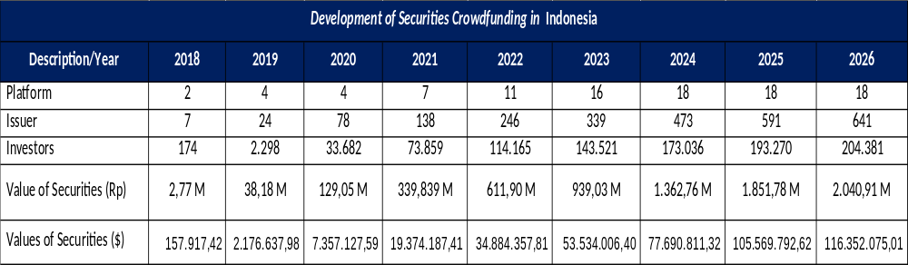
Securities Crowdfunding Landscape
*Data August, 31, 2026
**Kurs USD to IDR, September 9, 2026, 1 USD = 17.541 IDR
Notes:
IFSA regulate and supervise Peer To Peer Lending dan Securities Crowdfunding, in this session we will explain securities crowdfunding

Slide 3
Securities Crowdfunding Landscape
Notes:
Overall, the crowdfunding industry in Indonesia shows a continued positive growth trend from 2018 to August 2026.

Slide 4
Evolution of SCF Regulation
2018
2020
2025
Equity Crowdfunding (ECF)
Securities Crowdfunding (SCF)
Issuance of POJK 17/2025
Clause:
POJK 37/2018 concerning Information Technology-Based Crowdfunding Services through Share Offerings (Equity Crowdfunding).
Facilitates start-ups and MSMEs in obtaining funds through the issuance of shares in the capital market.
Clause:
POJK 57/2020 concerning Information Technology-Based Securities Offerings through Crowdfunding Services.
POJK 16/2021 concerning Amendments to POJK 57/2020.
Facilitates start-ups and MSMEs in obtaining funds through the issuance of shares/bonds/sukuk in the capital market because not all MSMEs are established as Limited Liability Companies (PT).
POJK 57/2020 concerning Information Technology-Based Securities Offerings through Crowdfunding Services
POJK 16/2021 concerning Amendments to POJK 57/2020
are revoked and replaced by POJK 17/2025
Notes:
This slide shows technical workflow between the Investor, SCF Platform, Issuer, and third-party institutions such as KSEI (Depository), Custodian Banks, and credit information agencies

Slide 5
Background of Regulatory Changes
The quality of the Securities Crowdfunding (SCF) industry requires enhancement due to insufficient levels of compliance and corporate governance among Platforms.
Key Requirements for Improvement:
Industry Quality: Enhancing capital requirements, corporate governance, and transparency.
Protection: Increasing legal protection for both business operators (Issuers) and investors.
Legal Framework: Establishing a more comprehensive legal basis and reference for the licensing and supervision of SCF activities.
Regulatory Alignment: Adjusting existing provisions to align with the mandates of the Financial Sector Omnibus Law (UU P2SK).
Mandate of the Financial Sector Omnibus Law (UU P2SK)
Based on Chapter V, Articles 69A and 69B Paragraph (4) of the UU P2SK:
OJK Authority: OJK regulates the maximum funding limits and investor requirements for SCF.
Licensing: SCF Platforms are mandatory required to obtain a business license from OJK.
LJK Approvals: Platforms that are already Financial Service Institutions (LJK) licensed by OJK must obtain additional OJK approval.
Secondary Market: OJK has the authority to exempt share transfers via deed for secondary market trading on SCF platforms.
Transparency: Platform must ensure the completeness, adequacy, objectivity, and clarity of Issuer documents while upholding the Principle of Transparency.
Exclusivity: Issuers are prohibited from issuing securities through more than one Platform.
These improvements are accommodated in POJK 17/2025, which replaces and repeals POJK 57/2020 and POJK 16/2021.

Slide 6
Strategies and Action to Improve Quality and Supervision
of SCF Industry
Key Revisions in POJK 17/2025:
            Minimum Capital
    Increased to IDR 25 Billion.
    Minimum Equity
    Mandatory minimum equity of IDR 5 Billion at all times (to be implemented over a 3-year transition period).
    Governance
    Strengthening Due Diligence for Issuers and oversight of affiliated parties.
    Liquidity
    Enhancing the liquidity of securities.
    Performance Metrics
    Mandatory use of an investment success rate ratio for all Platforms.
Implementation of APOLO for reporting and the development of SCFNet (integrated platform) by KSEI for data integration and public transparency.

Slide 7
Keys Take Away
The Securities Crowdfunding industry in Indonesia shows a continued positive growth trend from 2018 to August 2026;
The primary objective of changing the SCF regulations is to provide a stronger and more comprehensive legal reference for licensing and supervising SCF activities;
Through revisions to minimum capital, minimum equity, governance, liquidity, and performance metrics, the SCF industry is expected to grow continuously in support of MSMEs;

Slide 8

Thank You

Slide 9








Success Story of Issuer
Creative Industry (Film) funding various film projects
PT Dinamika Selaras Bersama
Film Project “Glenn Fredly The Movie”
Equity
Funding $ 41.902
98 Investors
Reached approximately 97,588 audience
PT Sinema Selaras Bersama
Film “Soul Reaper “ and “Blood Sacrifice”
Equity
Funding $ 71.547
106 Investors
Soul Reaper garnered around 400,000 audience
Blood Sacrifice reached 50,388 audience
PT Aster Sinema Selaras
3 Film Project Aster Adhya Pictures (Romeo's Broken Promise, Bones Upon Bones, and The Hole)
Equity
Funding $ 442.307
318 Investors
Bones Upon Bones reached 36,874 audience in the first 3 days of release
PT Dwi Danamitra Kavita
Film Harlot's Prayer
Bond
Funding $ 285.046
17 Investors
655,725 audience after 34 days

Slide 10


Success Story of Issuer
Renewable Energy Company
The company issued sukuk through SHAFIQ's SCF platform and has now been acquired by a Japanese firm

