Slide 1


27TH MEETING · COMCEC POVERTY ALLEVIATION WORKING GROUP
Preventing Skill Mismatch in
Azerbaijan’s Labour Market
The career-guidance and data-driven matching model of the State Employment Agency
State Employment Agency — Central Career Branch (CCB)
Ankara, Türkiye • 16–17 September 2026
www.dma.gov.az
Notes:
[~0:40] Distinguished Chair, dear colleagues, thank you for the opportunity to speak today. My name is Elvira Sadigova, Deputy Head of the Central Career Branch at Azerbaijan's State Employment Agency. My presentation covers how our Agency is working to prevent skill mismatch in Azerbaijan's labour market through career guidance and data-driven matching. This reflects a deliberate, multi-year reform led by our Ministry of Labour and Social Protection of the Population, and I am pleased to share it with the Working Group today.

Slide 2



NATIONAL CONTEXT
The starting point: three structural gaps
Fragmented procedures
Uneven access to guidance
Limited labour-market data
Employment services were historically split across institutions and processes, slowing job matching.
Career guidance reached citizens unevenly — concentrated in the capital, thinner in the regions.
Policy decisions lacked centralised, real-time evidence linking skills to jobs.
Closing these gaps has been a deliberate, multi-year effort led by the Ministry of Labour and Social Protection of the Population, through the State Employment Agency.
State Employment Agency • Central Career Branch (CCB)
2
Notes:
[~0:55] Let me start with the starting point. When we assessed our labour market some years ago, we identified three structural gaps. First, employment services were historically fragmented across different institutions and processes, which slowed job matching. Second, career guidance reached citizens unevenly: concentrated in the capital, but much thinner in the regions. Third, policy decisions lacked centralised, real-time evidence linking skills to jobs. Closing these three gaps has been a deliberate, multi-year effort, led by the Ministry of Labour and Social Protection of the Population, and implemented through the State Employment Agency.

Slide 3
INSTITUTIONAL ARCHITECTURE
One agency, one mandate for matching skills to jobs
Ministry of Labour and Social
Protection of the Population
State Employment Agency
(SEA)
Central Career Branch (CCB)
Staff training & methodology
CCB designs the professional-development programmes, evaluation systems, and career-guidance tools used by counsellors across Regional Employment Branches nationwide.
94%
digitalisation rate across the Agency’s core services — 15 of 18 services fully digitalised, built on the AMAS labour-relations and employment platform.
State Employment Agency • Central Career Branch (CCB)
3
Notes:
[~0:50] Structurally, we operate under a clear, single line of accountability. The Ministry of Labour and Social Protection of the Population sets policy; the State Employment Agency implements it; and within the Agency, the Central Career Branch — my own department — designs the professional-development programmes, evaluation systems, and career-guidance tools that are then used by counsellors across every Regional Employment Branch in the country. This structure is backed by strong digital infrastructure: today, ninety-four percent of the Agency's core services are digitalised — fifteen of eighteen services — all built on our AMAS labour-relations and employment platform.

Slide 4
CCB AT A GLANCE — 2026
A national toolkit, organised in eight directions
8
36
5
13
Strategic directions
Active projects, Jan–Jun 2026
Brand-new initiatives launched in 2026
Regional branches piloting the flagship Academy
The programmes on the following slides map onto five layers of prevention — from first-line outreach to employer engagement and digital innovation.
State Employment Agency • Central Career Branch (CCB)
4
Notes:
[~0:40] To give you a sense of scale: the Central Career Branch works across eight strategic directions. In the first half of 2026 alone, we ran thirty-six active projects, including five brand-new initiatives launched this year. Thirteen regional branches are currently piloting our flagship Academy programme, which I will describe shortly. The initiatives on the following slides map onto five layers of prevention — from first-line outreach all the way through to employer engagement and digital innovation.

Slide 5


LAYER 1 — OUTREACH & FIRST-LINE GUIDANCE
Prevention starts with information
Career Counsellor
Specialty guide
930 consultations, Jan–May 2026
9,430 participants in March 2026
Free call-centre career counselling reaching jobseekers directly. Annual target: 2,360 consultations.
A career & qualification guide delivered as a concentrated district campaign, scaling from 13 districts in 2026 to all 78 districts by October.
State Employment Agency • Central Career Branch (CCB)
5
Notes:
[~0:50] Prevention begins with information. Our first layer is outreach and first-line guidance, delivered in two ways. Our career-counsellor call centre offers free consultations directly to jobseekers — nine hundred thirty consultations between January and May 2026, against an annual target of two thousand three hundred sixty. And our specialty guide — a career and qualification guide — is delivered through a concentrated district campaign, reaching nine thousand four hundred thirty participants in March 2026 alone. That campaign is scaling fast: from thirteen districts this year to all seventy-eight districts by October.

Slide 6



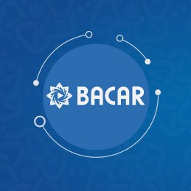
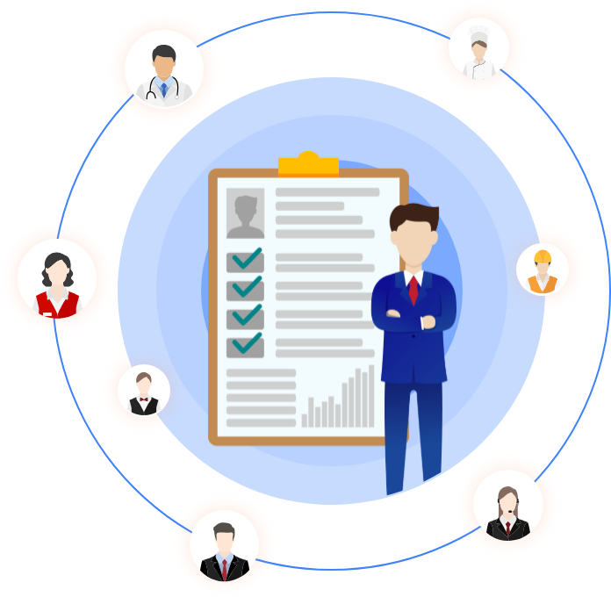
Digital Services and Projects
Career councelor
A support call center service for the target groups of career-oriented counseling assistance to personal and professional development of individuals.
Profession Map
Create your CV
A virtual platform created for people to easily prepare their CV, to apply for a suitable job by recording the information about their education, experience and other professional characteristics.
“Work Values” tool
The platform consists of formal and informal tests, surveys, and other self-service tools specialized for the specific needs of citizens.
A platform that integrates key facts and development opportunities on professions and helps individuals make more complete and correct decisions about their career choices and development directions.
Notes:
[~0:55] We support this outreach with a growing suite of digital tools available to every citizen. 'Create Your CV' lets jobseekers build a professional CV online and apply directly for suitable vacancies. Our Career Counsellor call-centre service, which I just mentioned, is complemented online. The 'Work Values' tool offers formal and informal self-assessment tests and surveys tailored to individual needs. And the Profession Map integrates key facts and development pathways for different professions, helping citizens make more informed decisions about their careers. Together, these tools extend guidance beyond office hours and beyond the reach of any single call centre or counsellor.

Slide 7

Workforce Index
The Workforce Index is a development initiative that measures students’ readiness for the labor market and assesses their competencies.
In cooperation with the Agency and career centers of the HEIs , it evaluates students and provides development recommendations based on the results.
Notes:
[~0:40] One of our newer, and more data-driven, initiatives is the Workforce Index. This is a development tool that measures students' readiness for the labour market and assesses their competencies. We run it in cooperation with the Agency and career centres at higher-education institutions: it evaluates students and returns individual development recommendations based on their results — connecting the world of higher education directly to labour-market expectations, well before graduation.

Slide 8
Project Objectives
1
Measuring non-academic activities
Measuring students’ non-academic activities and establishing an alternative criterion that aligns with modern labor market requirements for employer decision-making
2
Promoting balanced development
Measuring the factors that affect students' labor market value and identifying gaps that may arise in achieving balance
3
Addressing the skills gap
Supporting policy development to address potential skills gaps through the analysis of labor market value factors and the measurement of outcomes
Notes:
[~0:55] The Index pursues three specific objectives. First, it measures students' non-academic activities, establishing an alternative criterion aligned with what modern employers actually look for in a candidate. Second, it promotes balanced development, by measuring the factors that shape a student's labour-market value and identifying gaps that stand in the way of that balance. And third, it directly addresses the skills gap: the results feed into policy development, supporting evidence-based decisions on where skills training is most needed. In short, this is prevention at its earliest possible point — before a young person even enters the labour market.

Slide 9
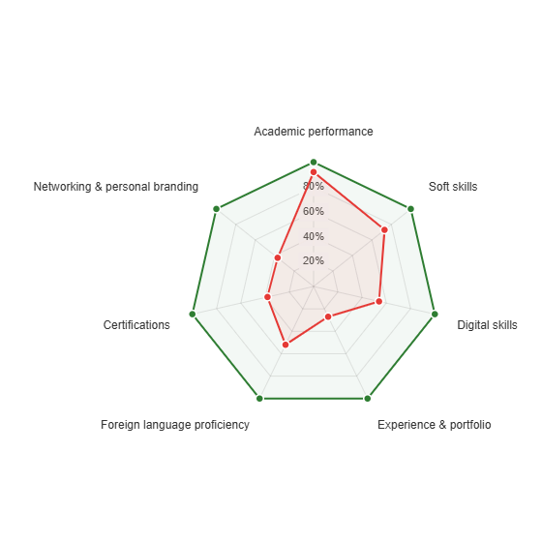

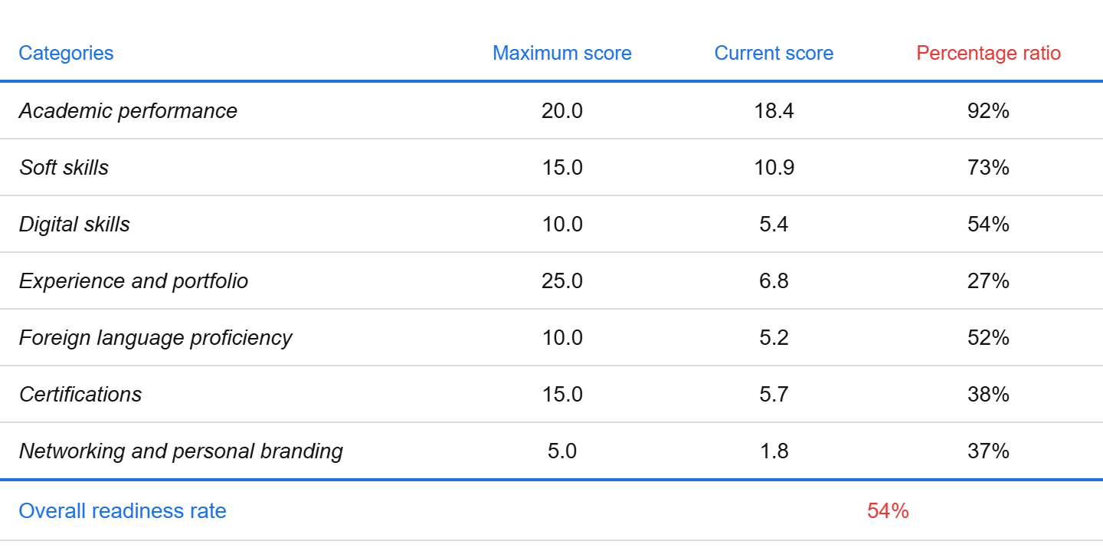
Workforce Index – Average scoring
Benchmark rate Percentage ratio
Notes:
[~0:40] This slide shows our average scoring results against the benchmark rate we set for the Index. As you can see, the data allows us to compare student performance systematically, and to track how well our results are converging with the benchmark over time. This evidence base is exactly the kind of centralised, real-time information that was missing under the old, fragmented system I described earlier.

Slide 10

LAYER 4 — FLAGSHIP INITIATIVE
Career Counsellors’ Academy
5
7
38
13
H2 2026
stages
modules
counsellors piloted
branches
national launch
A unified, certified methodology for career guidance across every participating Regional Employment Branch — grounded in established career-development theory (Holland RIASEC, Super, Krumboltz, Egan, NCDA) and built on 30 evaluated role-play case studies.
Having completed design and piloting, the Academy launches its full national roll-out in the second half of 2026 — the months surrounding this very meeting.
Azerbaijan’s most transferable contribution to this Working Group — open to share with interested Member States.
State Employment Agency • Central Career Branch (CCB)
7
Notes:
[~1:15] I want to spend a little more time on what I consider Azerbaijan's most transferable contribution to this Working Group: our Career Counsellors' Academy. This is a unified, certified methodology for career guidance, built on established international career-development theory — Holland's RIASEC model, Super, Krumboltz, Egan, and NCDA — and grounded in thirty evaluated role-play case studies drawn from real counselling situations. The Academy is structured in five stages and seven modules. Thirty-eight counsellors have already completed the pilot, across thirteen Regional Employment Branches. Having finished design and piloting, we are now launching the Academy nationally in the second half of this year — the very months surrounding this meeting. Because the methodology is standardised and fully documented, we see real potential to share it with other Member States facing similar challenges in professionalising career guidance, and we would welcome that conversation with interested colleagues.

Slide 11




LAYER 5 — BRIDGING JOBSEEKERS AND EMPLOYERS
Guidance that ends in a job
HR Community
Job Fairs
TİPx Conference
GPS Summit
Direct dialogue between employers and counsellors
Labor connect graduates with recruiters
Annual careers & employability conference
Held twice yearly to keep engagement continuous
START Project — a structured pipeline from registration to placement
100
Registered
30
Selected
5
Employed
State Employment Agency • Central Career Branch (CCB)
8
Notes:
[~1:00] Guidance is only meaningful if it ends in a job. Our fifth layer focuses on bridging jobseekers and employers directly. We maintain an ongoing HR Community for direct dialogue between employers and counsellors; we organise job fairs connecting graduates with recruiters; we host the TİPx conference, our annual careers and employability event; and twice a year, the GPS Summit keeps that engagement continuous rather than a one-off. The clearest illustration of results is our START Project — a structured pipeline from registration through to placement. In the current cycle, one hundred jobseekers registered, thirty were selected for intensive support, and five have already been placed in employment, with more moving through the pipeline.

Slide 12


DIGITAL INNOVATION
Extending the match through technology
CV–Vacancy Matching Engine
AI Career-Planning Voice Assistant
Technical specification completed, 2026
Technical specification completed, 2026
An automated matching layer between jobseeker CVs and open vacancies. Enters piloting in the months ahead.
A voice-based assistant guiding citizens through career planning. Enters piloting alongside the matching engine.
Part of a wider digital ecosystem:
Central Career Portal · CV Builder (CV Yarat) · Occupations Atlas · Work Values Tool · Alo Career
State Employment Agency • Central Career Branch (CCB)
9
Notes:
[~0:55] Looking ahead, we are extending this matching function through technology. Two new tools completed their technical specification in 2026 and are entering piloting in the months ahead: a CV–vacancy matching engine that automates the link between jobseeker profiles and open positions, and an AI-based career-planning voice assistant that guides citizens conversationally through their career decisions. Both sit within a wider digital ecosystem that already includes our Central Career Portal, the CV Builder — 'CV Yarat' — the Occupations Atlas, the Work Values tool, and our Alo Career helpline. Taken together, these tools mean that data-driven guidance is available to a citizen wherever and whenever they need it.

Slide 13


QUALITY ASSURANCE
Standards behind the numbers
ISO 10015:2019
ISO 10667-1:2020
ISO 29993:2017
ISO 9001:2015
New in 2026
Competence management
Assessment services
Learning services
Quality management
University Career-Centre Certification — 3 universities
Four Agency-wide ISO certifications, now joined by a dedicated compliance standard for university career centres.
State Employment Agency • Central Career Branch (CCB)
10
Notes:
[~0:40] None of this would be credible without quality assurance behind it. The Agency holds four ISO certifications, covering competence management, assessment services, learning services, and quality management overall. And new in 2026, we have extended certification to the university level: three universities have now achieved our dedicated Career-Centre Certification standard. This means the standards behind these numbers are independently verified, not self-declared.

Slide 14
Thank you for
your attention!
Elvira Sadigova
Deputy Head Central Career Branch of State Employment Agency
Elvira.f.sadigova@sosial.gov.az
dma.sosial.gov.az
dma.sosial.gov.az
dmasosialgovaz
State Employment Agency
www.dma.gov.az
Notes:
[~0:25] To conclude: Azerbaijan's approach shows that preventing skill mismatch requires closing structural gaps deliberately, building one coherent institutional architecture, and backing it with data at every layer, from first-line outreach to the Academy I described. We remain fully open to sharing this experience with fellow Member States. Thank you very much for your attention, and I welcome your questions.

