Slide 1

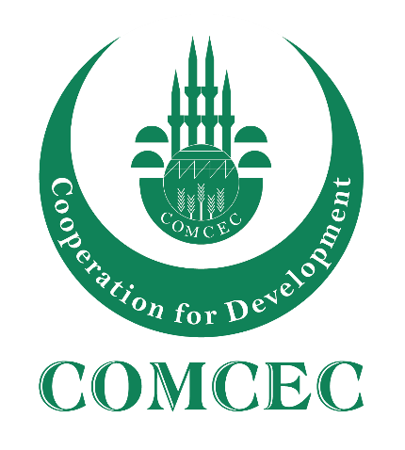
COMCEC STRATEGY
Making Cooperation Work
For Building an Interdependent Islamic World
COMCEC
TOURISM OUTLOOK
2026
Gurel CETIN, PhD
COMCEC Coordination Office
September, 2026
Notes:
[Sources]
- COMCEC Tourism Outlook 2026, September 2026.
[/Sources]

Slide 2
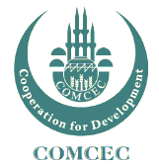
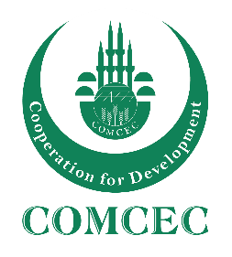
OUTLINE
The Importance of Tourism for Development
Tourism Trends
Overview of International Tourism in the World
International Tourism in the OIC Member Countries
Making Cooperation Work
Making Cooperation Work
COMCEC STRATEGY
COMCEC STRATEGY
1
For Building an Interdependent Islamic World
For Building an Interdependent Islamic World
1

Slide 3

The Importance of Tourism for Development
A remarkable socio-economic phenomena
A critical sector for both advanced and developing economies
Related to more than 185 supply-side economic activities, with direct and indirect effects
Making Cooperation Work
Making Cooperation Work
COMCEC STRATEGY
COMCEC STRATEGY
2
For Building an Interdependent Islamic World
For Building an Interdependent Islamic World

Slide 4
The Importance of Tourism for Development
10 % GDP
(Direct, Indirect and Induced)
1/9
JOBS
US $ 2.2 TRILLION IN EXPORTS
7%
OF WORLD’S TRADE
30 %
OF
SERVICES EXPORTS
Source: WTTC (2026); UN Tourism (2026).
Making Cooperation Work
Making Cooperation Work
COMCEC STRATEGY
COMCEC STRATEGY
3
For Building an Interdependent Islamic World
For Building an Interdependent Islamic World

Slide 5
Key Tourism Trends
  Demographic changes
  Behavioral changes
  Advancements in technology
  Crises and risk management
  Sustainability
Making Cooperation Work
COMCEC STRATEGY
4
For Building an Interdependent Islamic World

Slide 6

Demographic Changes
Share of global population over the age of 60
8 %
12 %
21 %
1950
2013
2050
Active travelers
Security is important
Personalized services
Soft adventure for «feeling young»
Health, sport and wellness products
Making Cooperation Work
COMCEC STRATEGY
4
For Building an Interdependent Islamic World

Slide 7
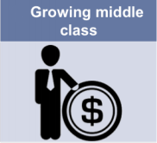
Demographic Changes
Middle Class Population
(in billion)
1.8
3.2
4.9
2009
2020
2030
The increase in average income results in a growing middle class
Emerging source markets
Making Cooperation Work
COMCEC STRATEGY
6
For Building an Interdependent Islamic World

Slide 8

Demographic Changes
Generation Y (Millennials)
50 % of all travelers by 2025
Technology is essential!!!
Generation Z (iGen – 6-25 ages)
Spend parents’ money faster
High level of involvement in digital trends
A more dynamic lifestyle
Source: Horwart HTL Tourism Megatrends, 2016
Making Cooperation Work
COMCEC STRATEGY
5
For Building an Interdependent Islamic World

Slide 9

Behavioral Changes
Increase in the share of emerging economies
14 cities are from the Middle East and Asia in the top 20 global destinations by international overnight visitors.
Emerging Destinations
58 % of Total Arrivals
2030
Source: Travelness, 2024
Making Cooperation Work
COMCEC STRATEGY
7
For Building an Interdependent Islamic World

Slide 10

  Technology / Artificial Intelligence
Personalization
Speed
Translation
Routing
Marketing - Nudging
Human Resources
Operations
GPDR issues
Making Cooperation Work
COMCEC STRATEGY
10
For Building an Interdependent Islamic World

Slide 11
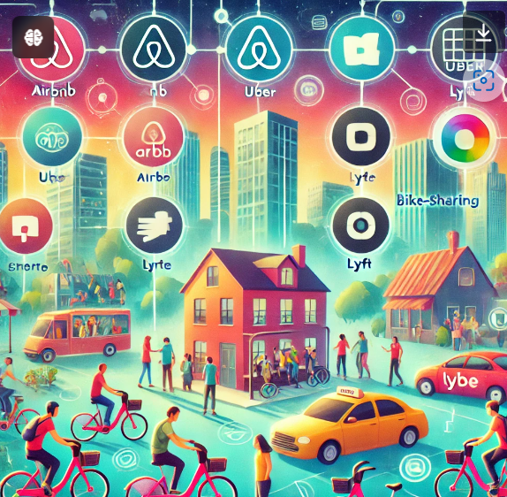
  Technology / Sharing Economy
Security
Taxing
Unfair Competition
Inflation
Gentrification
Making Cooperation Work
COMCEC STRATEGY
10
For Building an Interdependent Islamic World

Slide 12

  Technology / Digital Nomads
Remote Work (30%)
Extended Stays
Slow Tourism
Visa Issues
Infra-structure
Health services
Education Services
Accessibility
Making Cooperation Work
COMCEC STRATEGY
10
For Building an Interdependent Islamic World

Slide 13
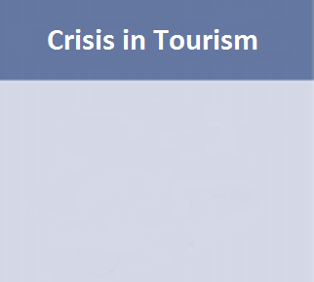
  Crises and Risk Management
Source: WTTC, 2016
Making Cooperation Work
COMCEC STRATEGY
10
For Building an Interdependent Islamic World

Slide 14
  Crises and Risk Management
−13.9%
−37.2%
Middle East arrivals
Q1 2026
Middle East arrivals
March 2026
−61%
75% → 48%
Middle Eastern carrier traffic
March 2026
Regional hotel occupancy
Jan → Mar 2026
PREPARE
RESPOND
RECOVER
Risk scanning • scenarios • continuity plans
Real-time information • coordinated support
Market & route diversification • recovery campaigns
Source: UN Tourism (2026b; 2026c); COMCEC (2017).
Making Cooperation Work
COMCEC STRATEGY
10
For Building an Interdependent Islamic World

Slide 15

Sustainability
Tourism
Tourist Numbers
Sustainable Tourism
Environmental Concerns
Social Concerns
Economic Concerns
Economic Concerns
Sustainable Tourism is defined as:
« tourism that respects both local people and the traveler, cultural heritage and the environment»
Making Cooperation Work
COMCEC STRATEGY
11
For Building an Interdependent Islamic World

Slide 16
Sustainability
Climate risks
2026 COMCEC policy priorities
Heat & drought
Wildfire
Flooding & sea-level rise
Water scarcity
Ecosystem loss
Snow reliability
1. Integrate climate risk, mitigation and adaptation into tourism planning
2. Strengthen tourism–climate institutional coordination
3. Protect climate-sensitive natural and cultural assets
4. Expand tourism-specific climate finance, especially for SMEs
5. Improve climate-tourism data, monitoring and capacity building
Source: COMCEC (2026), Impacts of Climate Change and Mitigation Strategies for Sustainable OIC Tourism.
Making Cooperation Work
COMCEC STRATEGY
11
For Building an Interdependent Islamic World

Slide 17
International Tourist Arrivals
2025: 1.534 billion (+5%) • Q1 2026: 307 million (+2%)
Source: UN Tourism (2026b); updated through 2025.
Making Cooperation Work
Making Cooperation Work
COMCEC STRATEGY
COMCEC STRATEGY
12
For Building an Interdependent Islamic World
For Building an Interdependent Islamic World
8

Slide 18
2026 UPDATE
  International Tourism- Market Share
Tourist Arrivals
2019
2025
Source: UN Tourism (2026b).
Making Cooperation Work
Making Cooperation Work
COMCEC STRATEGY
COMCEC STRATEGY
13
For Building an Interdependent Islamic World
For Building an Interdependent Islamic World
10

Slide 19
International Tourism Receipts
2025: USD 1.884 trillion
Source: UN Tourism (2026); updated through 2025.
Making Cooperation Work
Making Cooperation Work
COMCEC STRATEGY
COMCEC STRATEGY
14
For Building an Interdependent Islamic World
For Building an Interdependent Islamic World
8

Slide 20
International Tourism Market Share
Tourism Receipts
2019
2025
Source: UN Tourism (2026), updated dataset.
Making Cooperation Work
Making Cooperation Work
COMCEC STRATEGY
COMCEC STRATEGY
15
For Building an Interdependent Islamic World
For Building an Interdependent Islamic World
11

Slide 21
International Arrivals in the OIC Member Countries
(Millions)
2025: 301 million arrivals • 19.5% of global arrivals
Source: OIC Master Table Appendix (2026); UN Tourism (2026b).
Making Cooperation Work
Making Cooperation Work
COMCEC STRATEGY
COMCEC STRATEGY
17
For Building an Interdependent Islamic World
For Building an Interdependent Islamic World
22

Slide 22
International Receipts in the OIC Member Countries
2025: USD 309 billion • 16.4% of global receipts
(Billion $)
Source: OIC Master Table Appendix (2026); COMCEC Tourism Outlook 2026.
Making Cooperation Work
Making Cooperation Work
COMCEC STRATEGY
COMCEC STRATEGY
17
For Building an Interdependent Islamic World
For Building an Interdependent Islamic World
22

Slide 23
Tourist Arrivals in OIC Regions
(OIC-MENA, OIC-Asia, and OIC-Sub-Saharan Africa)
(Millions)
Source: OIC Master Table Appendix (2026).
Making Cooperation Work
Making Cooperation Work
COMCEC STRATEGY
COMCEC STRATEGY
18
For Building an Interdependent Islamic World
For Building an Interdependent Islamic World
22

Slide 24
Tourism Receipts in OIC Regions
(OIC-MENA, OIC-Asia, OIC-Sub-Saharan Africa)
(Billion $)
Source: OIC Master Table Appendix (2026).
Making Cooperation Work
Making Cooperation Work
COMCEC STRATEGY
COMCEC STRATEGY
19
For Building an Interdependent Islamic World
For Building an Interdependent Islamic World
23

Slide 25
Top 10 OIC Tourism Destinations in International Tourist Arrivals (2025)
(Thousands)
Source: OIC Master Table Appendix (2026).
Top-10 countries hosted 236 million international tourist in 2024.
Making Cooperation Work
Making Cooperation Work
COMCEC STRATEGY
COMCEC STRATEGY
20
For Building an Interdependent Islamic World
For Building an Interdependent Islamic World
16

Slide 26
Top 10 OIC Tourism Earners in International Tourism (2025)
(Billion $)
Source: OIC Master Table Appendix (2026).
Top-10 countries earned US$ 261 billion as international tourism receipts in 2024.
Making Cooperation Work
Making Cooperation Work
COMCEC STRATEGY
COMCEC STRATEGY
21
For Building an Interdependent Islamic World
For Building an Interdependent Islamic World
18

Slide 27
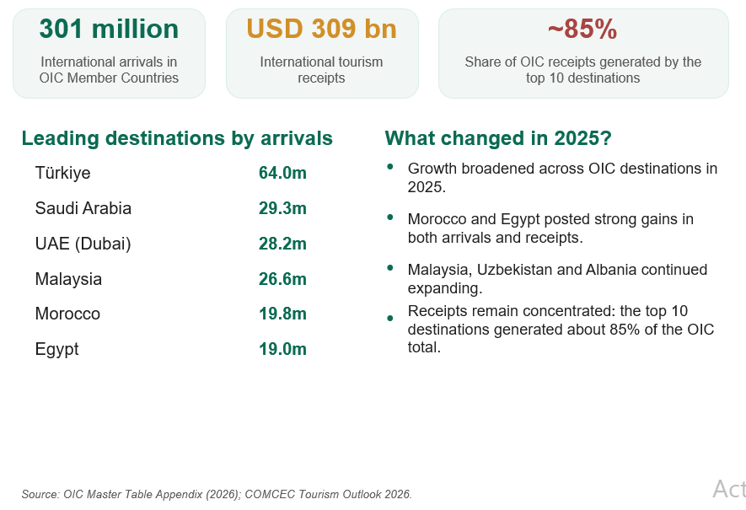
Recent Developments in the OIC Member Countries
Making Cooperation Work
Making Cooperation Work
COMCEC STRATEGY
COMCEC STRATEGY
23
For Building an Interdependent Islamic World
For Building an Interdependent Islamic World
24

Slide 28
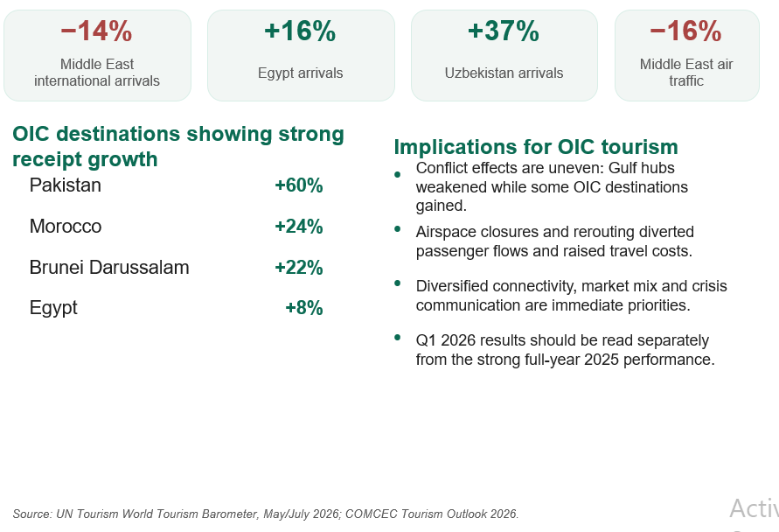
Recent Developments in the OIC Member Countries
Making Cooperation Work
Making Cooperation Work
COMCEC STRATEGY
COMCEC STRATEGY
24
For Building an Interdependent Islamic World
For Building an Interdependent Islamic World
24

Slide 29
Tourism Opportunities and Challenges
for the OIC Member Countries
Opportunities
Natural Resources
Human Resources
Authenticity and novelty
Price competitiveness
Dynamism
Cultural Resources
Challenges
Insufficient Tourism Investment & Infrastructure
Low Tourism Service Quality
INSUFFICIENT MARKETING AND PROMOTION
Insufficient Image Building and Branding
POOR DESTINATION PLANNING & PRODUCT DEVELOPMENT
Travel Facilitation Problems
Safety and Security Related Problems
LACK OF TOURISM DIVERSIFICATION
Making Cooperation Work
Making Cooperation Work
COMCEC STRATEGY
COMCEC STRATEGY
28
For Building an Interdependent Islamic World
For Building an Interdependent Islamic World
30

Slide 30
COMCEC ANALYTICAL TOPICS (2026 – 2027)
2026
Impacts of Climate Change and Mitigation Strategies for Sustainable OIC Tourism
Utilization of Big Tourist Data
2027
Making Cooperation Work
Making Cooperation Work
COMCEC STRATEGY
COMCEC STRATEGY
29
For Building an Interdependent Islamic World
For Building an Interdependent Islamic World
24

Slide 31
COMCEC STRATEGY
Making Cooperation Work
For Building an Interdependent Islamic World
THANK YOU
comcec@comcec.org
www.comcec.org
Gurel CETIN, PhD
COMCEC Coordination Office
September, 2026

