Slide 1


Impacts of Climate Change and Mitigation Strategies for Sustainable OIC Tourism
Prof. Gurel Cetin Istanbul University, Türkiye gurelc@Istanbul.edu.tr

Slide 2

Type | Countries
Field Cases – OIC | Egypt, Maldives
Desk Cases – OIC | Indonesia, Türkiye
Benchmark Desk Case – Non-OIC | New Zealand
Prof. Gurel Cetin
Istanbul University, Türkiye
gurelc@Istanbul.edu.tr

Slide 3

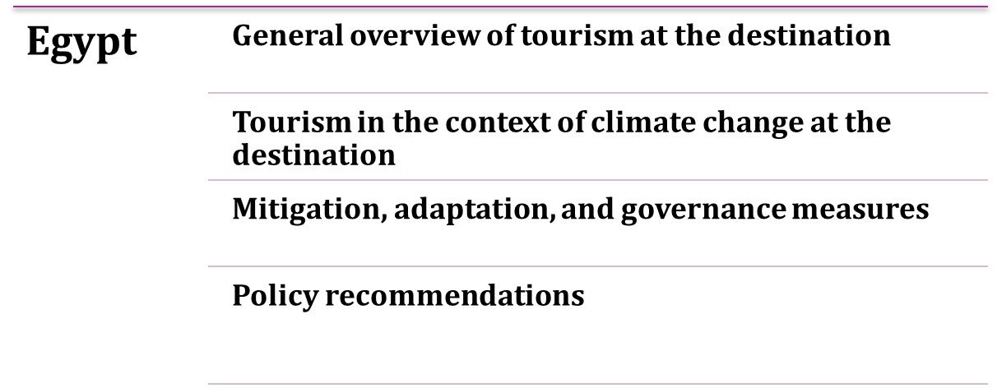
Field Cases Country

Slide 4
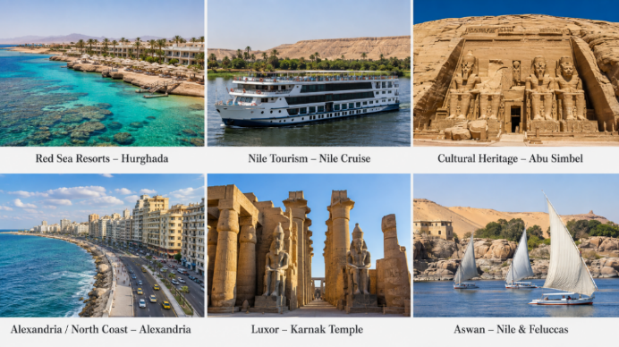
General overview of tourism at the destination
Egypt is a major and diversified OIC tourism economy, with strong post-pandemic growth and but high exposure to climate-related disruption.
19 million international tourists in 2025, historical high.
US$18 billion international tourism receipts in 2025
Tourism’s direct GDP contribution reached 3.7%

Slide 5
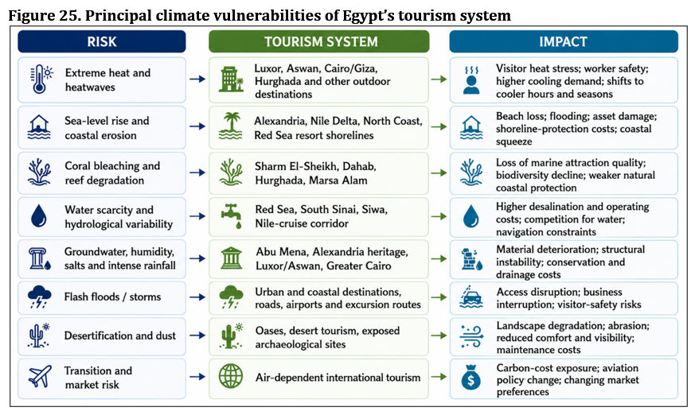



Tourism in the context of climate change at the destination

Slide 6
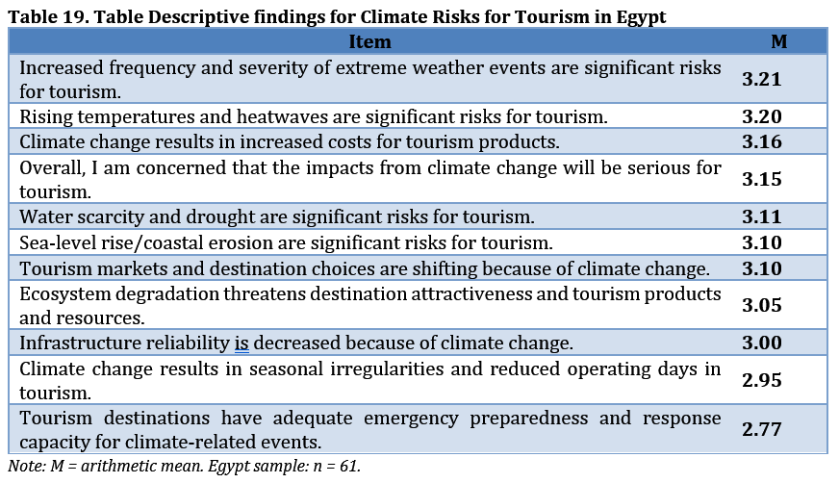
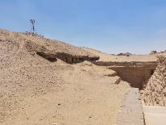

Slide 7

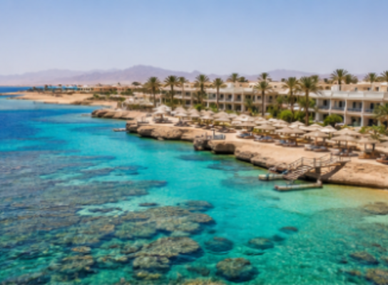

Tourism in the context of climate change at the destination
Mitigation strategies:
Tourism-related mitigation strategies
Sustainability certification and environmental standards
Solar energy and energy-efficient tourism facilities
Low-carbon visitor mobility and cleaner transport
Waste reduction, recycling and circular practices
Protecting coral reefs and coastal carbon sinks

Slide 8
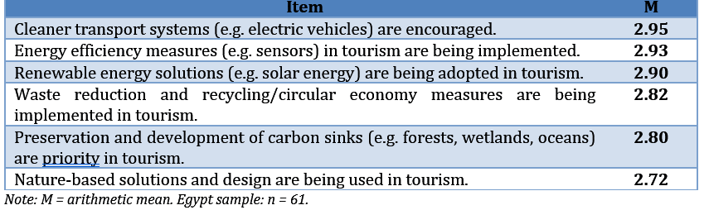
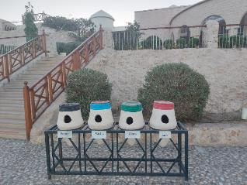
Mitigation, adaptation, and governance measures
Table 21. Descriptive findings for Mitigation Measures in Egypt

Slide 9
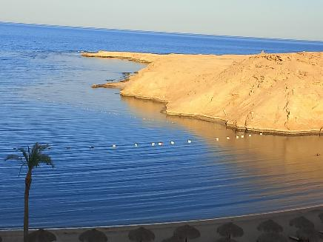
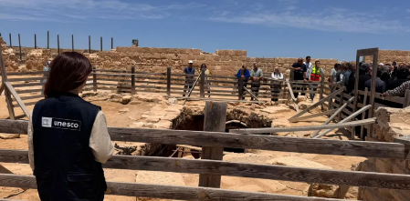
Tourism in the context of climate change at the destination
Adaptation strategies:
Tourism-related adaptation strategies
Integrated coastal planning and resilient infrastructure
Reef protection and marine ecosystem management
Water security and efficient utility systems
Heat management and climate-sensitive visitor operations
Heritage conservation and site-protection measures
Product diversification

Slide 10
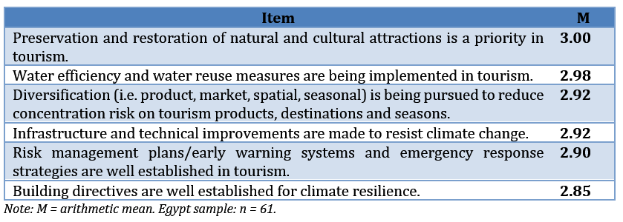
Mitigation, adaptation, and governance measures
Table 23. Descriptive findings for Adaptation Measures in Egypt

Slide 11
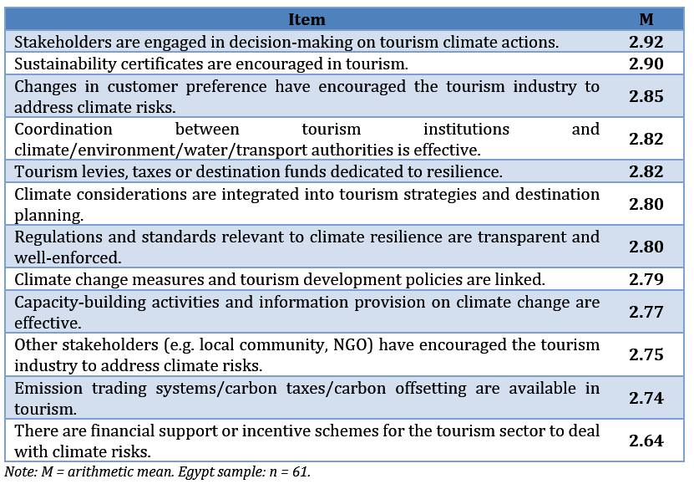
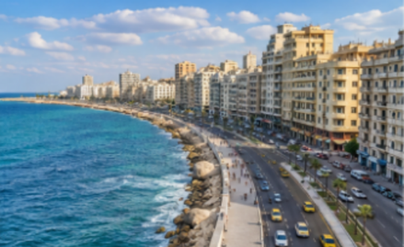
Mitigation, adaptation, and governance measures
Table 25. Descriptive findings for Governance Measures in Egypt

Slide 12
Policy and Governance Measures
Analytical SWOT: Egypt
STRENGTHS
• Diversified coastal, marine, heritage, Nile, desert and wellness portfolio • Proven destination-level green programmes in Sharm El-Sheikh and the Red Sea • Globally significant reefs, protected areas and cultural heritage assets • National climate strategy and an emerging tourism climate coordination function • Strong air connectivity and access to international development partnerships
WEAKNESSES
• Fragmented responsibilities across tourism, environment, water, heritage and local bodies • Limited destination climate data and uneven monitoring and reporting • High water, desalination and cooling intensity in arid tourism areas • Finance and technical-capacity constraints for smaller tourism enterprises • Large fixed assets in exposed coastal and heritage locations with uneven preparedness
OPPORTUNITIES
• Scale Green Sharm and Red Sea delivery models across priority destinations • Apply climate-risk screening and suitability mapping to new tourism investments • Expand green retrofit finance for cooling, solar, water reuse and circular systems • Use visitor and climate finance for reef, coastal-buffer and heritage resilience • Develop shoulder-season, evening, oasis, wellness and community-based products
THREATS
• Extreme heat, drought, water scarcity and Nile variability • Sea-level rise, coastal erosion and saltwater intrusion • Coral bleaching and declining Red Sea ecosystem quality • Flash floods, storms and groundwater or humidity damage to heritage and access • Higher aviation-transition costs and geopolitical or economic demand shocks

Slide 13
Egypt: Future Policy Recommendations
Priority | Purpose | Country-specific future action
Tourism climate unit | Coordination and governance | Operationalise the unit with budgets, targets and tourism monitoring, reporting and verification.
Climate-risk screening | Minimize risks | Require future-climate tests (heat, sea levelrise, water scarcity, flooding etc) for major tourism and heritage investments.
Destination data platform | Close local evidence gaps | Build national tourism-risk and suitability maps for priority destinations.
Green retrofit finance | Scale proven measures | Offer grants and loans for cooling, solar, water efficiency and small enterprises.
Water and circular standards | Manage scarcity and waste | Use destination water budgets, reuse requirements and verified waste plans.
Ecosystem and heritage resilience | Protect core tourism assets | Finance Red Sea reefs, coastal buffers and climate-sensitive heritage preservation.
Preparedness and local value | Protect visitors and livelihoods | Standardise heat alerts and continuity plans; operating hours, strengthen local green procurement to decrease supply chain vulnerability.

Slide 14


Field Cases Country

Slide 15
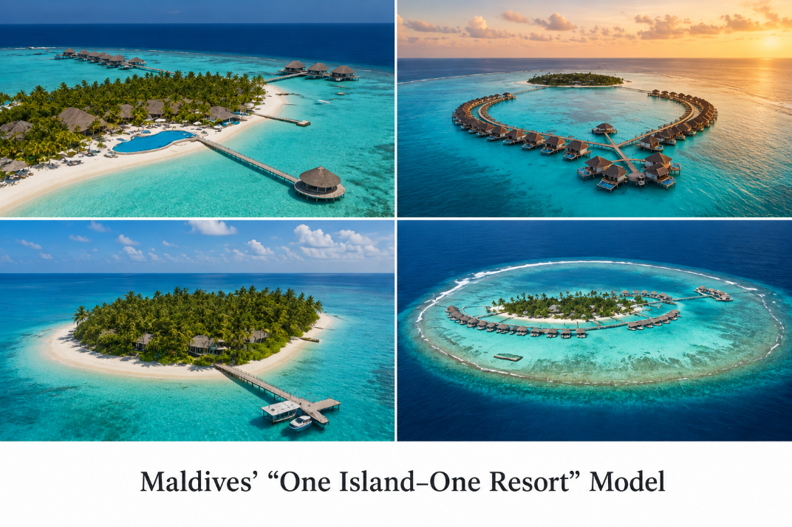
General Overview of Tourism at the Destination
Economic backbone: Tourism is a central pillar of the Maldivian economy.
Nature-dependent: The sector relies heavily on beaches, coral reefs, lagoons, and small-island ecosystems.
Distinctive tourism model: Since 1972, tourism has primarily developed around the “one island–one resort” model.
Tourist arrivals exceeded 2 million in 2024, grew further in 2025 to 2.2 million.
Growing diversification: Guesthouses, safari vessels, and locally based tourism services have expanded, spreading tourism benefits beyond resort islands.
Strong market positioning: The Maldives has established itself as a high-value marine and luxury destination.

Slide 16
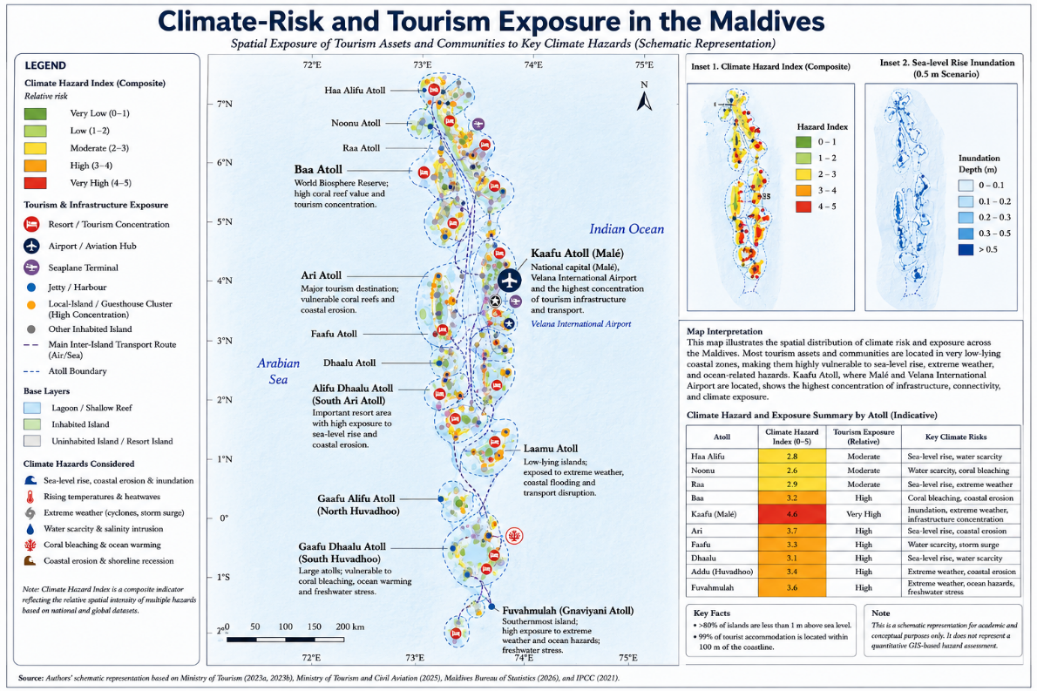
Tourism in the Context of Climate Change at the Destination
Figure 27. Climate-Risk and Tourism Exposure in the Maldives

Slide 17
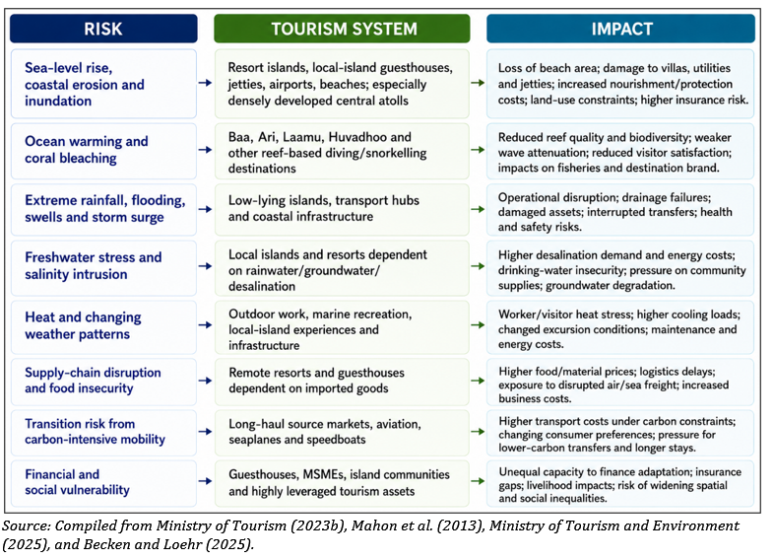
Tourism in the Context of Climate Change at the Destination

Slide 18
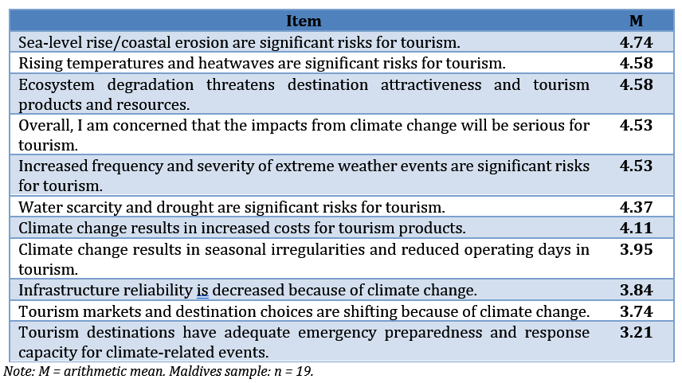
Tourism in the Context of Climate Change at the Destination
Table 34. Descriptive findings for Climate Risks for Tourism in the Maldives

Slide 19
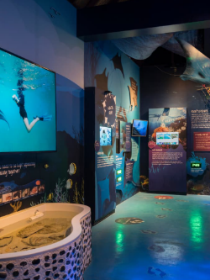
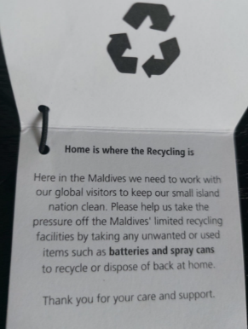
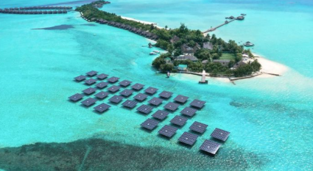
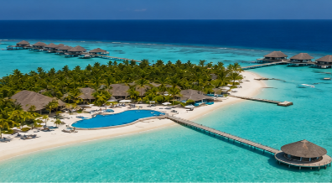
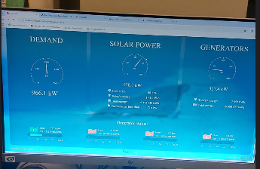
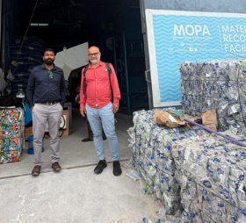
Tourism in the context of climate change at the destination
Mitigation strategies:
Tourism-related mitigation strategies
Renewable energy and battery storage on resort islands
Energy-efficient buildings and cooling systems
Water–energy efficiency and low-carbon desalination
Waste prevention and circular resort operations
Local and nature-positive procurement
Protecting reefs, seagrass and mangroves as carbon sinks

Slide 20
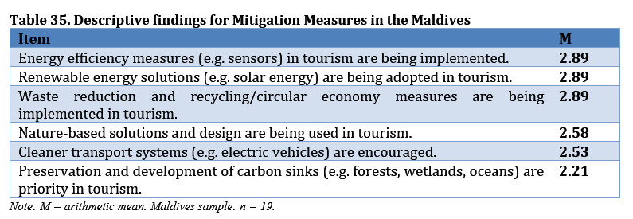
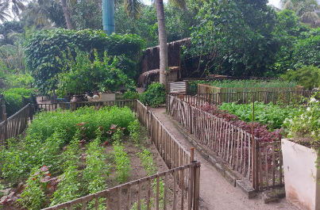
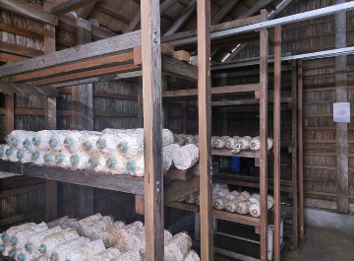
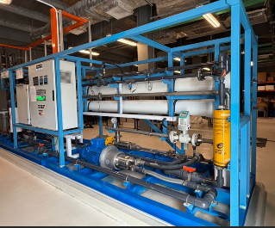
Tourism in the Context of Climate Change at the Destination

Slide 21
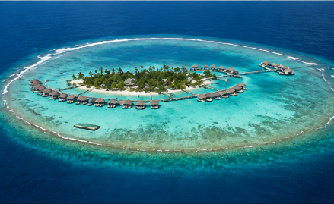
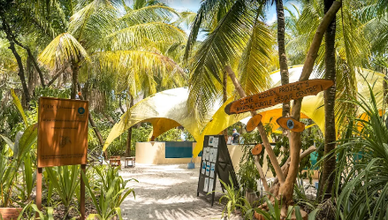
Tourism in the context of climate change at the destination
Adaptation strategies:
Tourism-related adaptation strategies
Hybrid shoreline protection and beach nourishment
Coral-reef, seagrass and mangrove restoration
Water efficiency, rainwater and resilient utility systems
Multi-hazard preparedness and business continuity
Marine research, visitor education and ecosystem monitoring
Community-based tourism and diversification

Slide 22
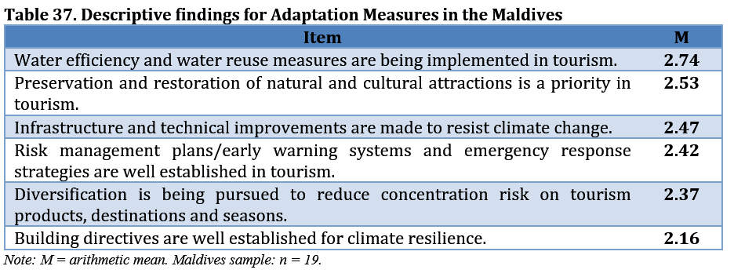

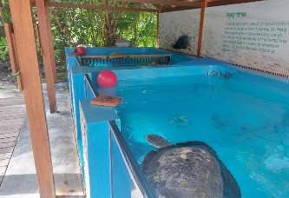
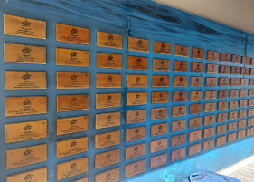
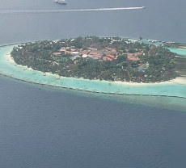
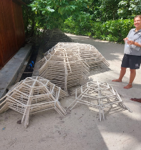
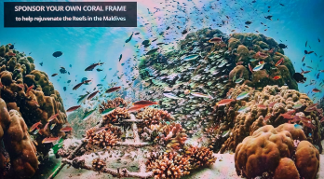
Tourism in the Context of Climate Change at the Destination

Slide 23
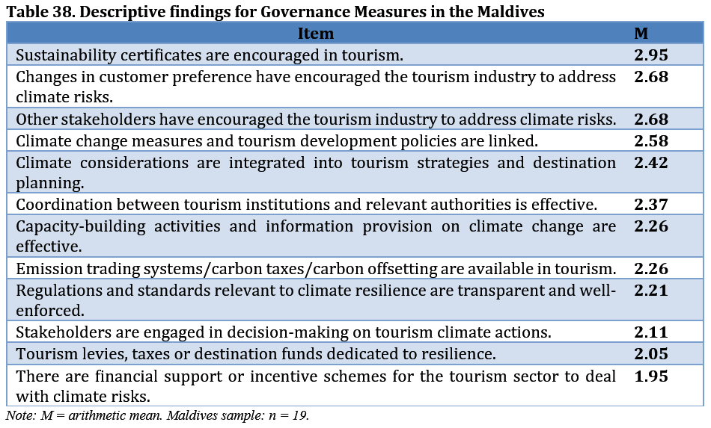
Policy and Governance Measures

Slide 24
Policy and Governance Measures
Analytical SWOT: Maldives
STRENGTHS
• Premium global brand built around high-value marine tourism • Explicit tourism climate planning and strong international visibility • Proven resort innovation in solar, storage, water and circular operations • Established reef research, restoration and ecosystem-stewardship experience • Climate-finance partnerships and growing local-island participation
WEAKNESSES
• Extreme concentration of tourism assets on low-lying coasts • Dependence on imported diesel, aviation, seaplanes and marine transfers • Fragmented island utilities and energy-intensive desalination and waste logistics • Uneven capacity across resorts, guesthouses, small businesses and island councils • Incomplete carbon and adaptation data and reliance on reactive coastal engineering
OPPORTUNITIES
• Use atoll risk screening and climate-smart licensing for tourism assets • Scale island packages for solar, storage, efficient cooling and desalination • Finance reef, seagrass and mangrove restoration as protective infrastructure • Link insurance and concessional finance to verified island resilience • Increase longer stays, local supply chains and community-led experiences
THREATS
• Sea-level rise, shoreline erosion and saltwater intrusion • Coral bleaching and loss of marine ecosystem quality • Freshwater stress and rising heat-related utility demand • Storms and disruption to aviation, seaplanes and marine transfers • Rising insurance and finance costs
Source: Authors’ synthesis based on Ministry of Tourism and Civil Aviation (2023b), Mahon et al. (2013), and Becken and Loehr (2025).

Slide 25
Maldives: Future Policy Recommendations
Priority | Purpose | Country-specific future action
Atoll risk screening | Guide investment | Maintain island and atoll risk maps and apply them in licensing decisions.
Resilient licensing and buildings | Reduce asset exposure | Update environmental assessment and building standards for future climate conditions.
Island decarbonisation | Cut diesel dependence | Scale solar-plus-storage, efficient cooling and low-energy desalination.
Low-carbon access | Address transport emissions | Create an aviation, seaplane and marine-transfer roadmap linked to longer stays.
Ecosystem finance | Strengthen natural protection | Fund measurable reef, seagrass and mangrove restoration around inhabited tourism islands.
Water, circularity and resilience finance | Improve island self-reliance | Link water budgets, reuse and waste systems with concessional finance and insurance.
Climate data and local value | Make action accountable and inclusive | Build a tourism dashboard and costed action plan with community supply chains.

Slide 26
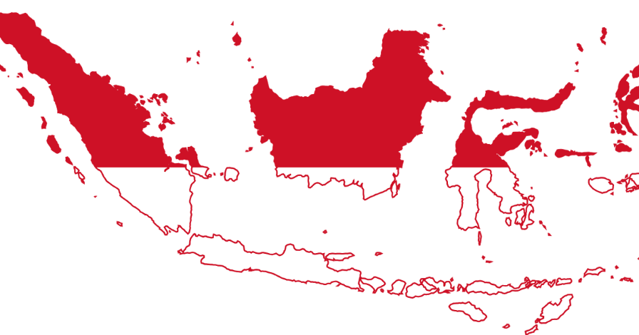

Desk Case Country

Slide 27
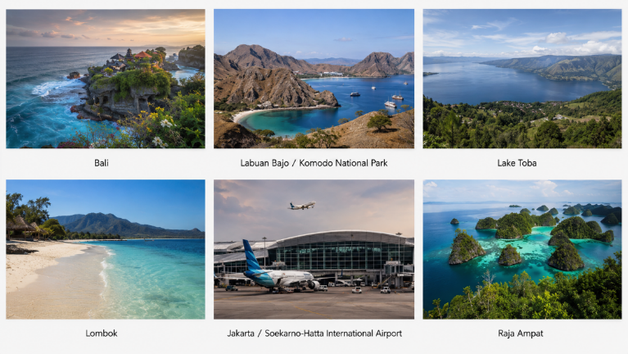
General Overview of Tourism at the Destination
Tourism arrivals exceeded prepandemic volume and reached 14 million also supported especially by a large domestic tourism market that improves resilience.
International tourism is dominated by regional markets, while Indonesia’s island geography makes aviation essential for connectivity.
Indonesia’s tourism sector is highly diverse and geographically dispersed creating both competitive advantages and significant climate-management challenges.

Slide 28
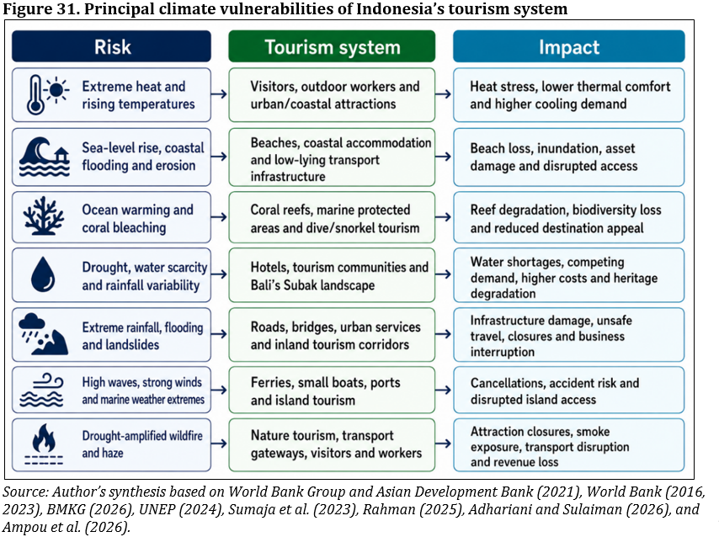
Tourism in the Context of Climate Change at the Destination
Climate Risks and Vulnerabilities

Slide 29
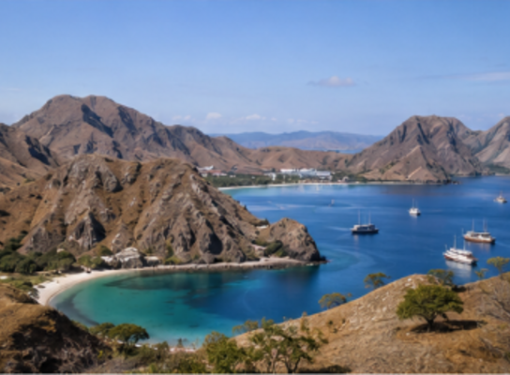
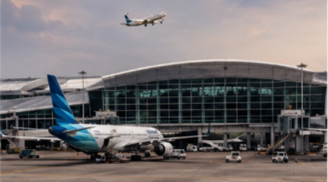
Tourism in the context of climate change at the destination
Mitigation strategies:
Tourism-related mitigation strategies
Renewable energy and efficient destination facilities
Electric mobility and walkable tourism areas
Water efficiency, wastewater reuse and circular waste systems
Marine-plastic reduction and community waste management
Protecting mangroves, seagrass, forests and watersheds
Applying sustainable-tourism standards and certification

Slide 30
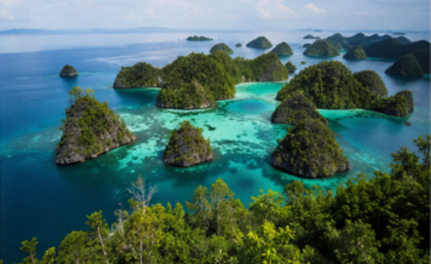
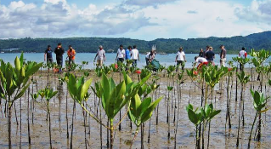
Tourism in the context of climate change at the destination
Adaptation strategies:
Tourism-related adaptation strategies
Climate-resilient destination and infrastructure planning
Flood control, drainage and resilient transport access
Coastal ecosystem restoration and biodiversity monitoring
Climate information, early warning and emergency planning
Community-based adaptation and tourism-village capacity
Spatial and product diversification across destinations

Slide 31
Analytical SWOT for Indonesia
STRENGTHS
• Large domestic market and a geographically diverse tourism portfolio • Exceptional reefs, mangroves, seagrass, forests and cultural assets • Strong national disaster-management and climate-information institutions • Sustainable-tourism standards and major destination-planning experience • Tourism-village and climate-village networks for community involvement
WEAKNESSES
• Fragmented mandates and uneven provincial and destination capacity • Dependence on aviation, ferries and exposed coastal infrastructure • Water, sanitation and waste gaps in some fast-growing destinations • Climate and carbon metrics are not consistently embedded in investment decisions • Finance, insurance and technical constraints among smaller tourism businesses
OPPORTUNITIES
• Embed climate screening and risk registers in destination investment plans • Scale low-carbon systems demonstrated in Nusa Dua and Mandalika • Treat reefs, mangroves, seagrass, forests and watersheds as infrastructure • Translate national climate services into tourism and village-level protocols • Promote longer stays, higher local value and diversification beyond Bali
THREATS
• Sea-level rise, coastal erosion, coral bleaching and ecosystem decline • Extreme rainfall, floods and landslides affecting destinations and access • Heat, drought, wildfire and water scarcity • Inter-island transport disruption and rising infrastructure and insurance costs • Aviation-transition pressure
Source: Authors’ assessment based on sources cited throughout the Indonesia case.

Slide 32
Indonesia: Future Policy Recommendations
Priority | Purpose | Country-specific future action
National tourism climate framework | Coordinate implementation | Set responsibilities, funding and destination risk registers across ministries and provinces.
Mandatory climate screening | Avoid high-risk investment | Test major tourism projects against future heat, water, flood, fire and coastal hazards.
Destination carbon budgets | Turn targets into delivery | Require plans for energy, accommodation, waste and visitor transport; fund retrofits.
Archipelagic mobility strategy | Lower transport emissions | Coordinate aviation, ferry, electric and public-transport action on priority corridors.
Water-security standards | Protect communities and tourism | Set destination water budgets, reuse targets and drought triggers before expansion.
Ecosystems as infrastructure | Protect coasts and biodiversity | Finance mangroves, reefs, seagrass, forests and watersheds with measurable outcomes.
Climate services and local capacity | Improve readiness and inclusion | Link national warnings to tourism protocols and performance-based village finance.

Slide 33

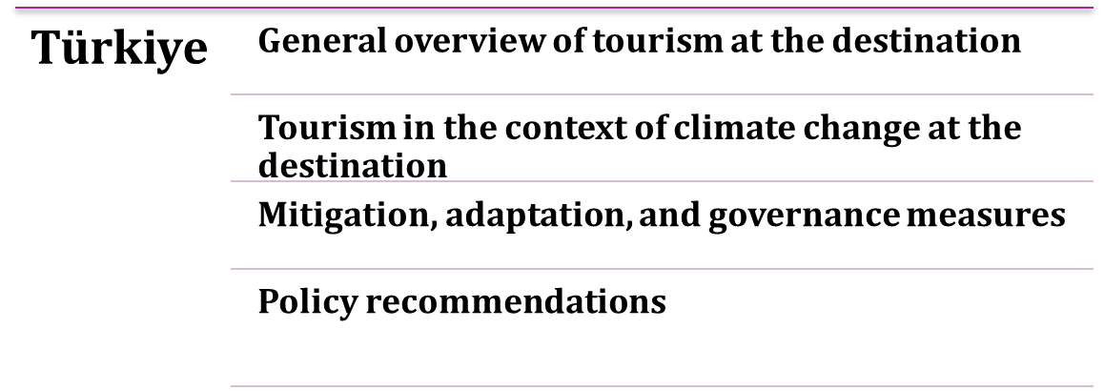
Desk Case Country

Slide 34
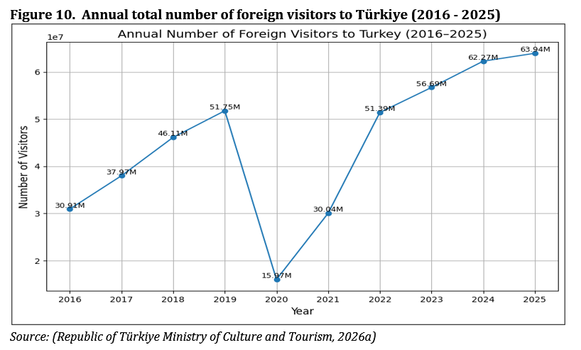
General overview of tourism at the destination
Continuous growth since the 1980s
Strong public–private sector cooperation
Welcomes 60+ million tourists annually.
Major visitors from OECD countries

Slide 35
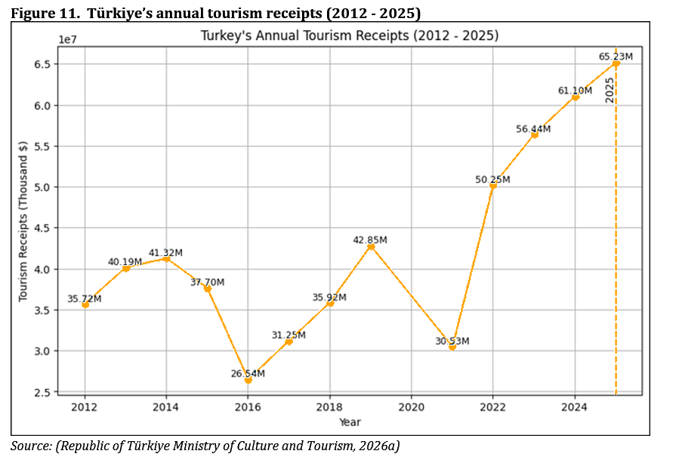
General overview of tourism at the destination
An analysis of Türkiye's tourism income from 2012 to 2025 shows that the sector has experienced fluctuations, but a general upward trend is evident over time

Slide 36
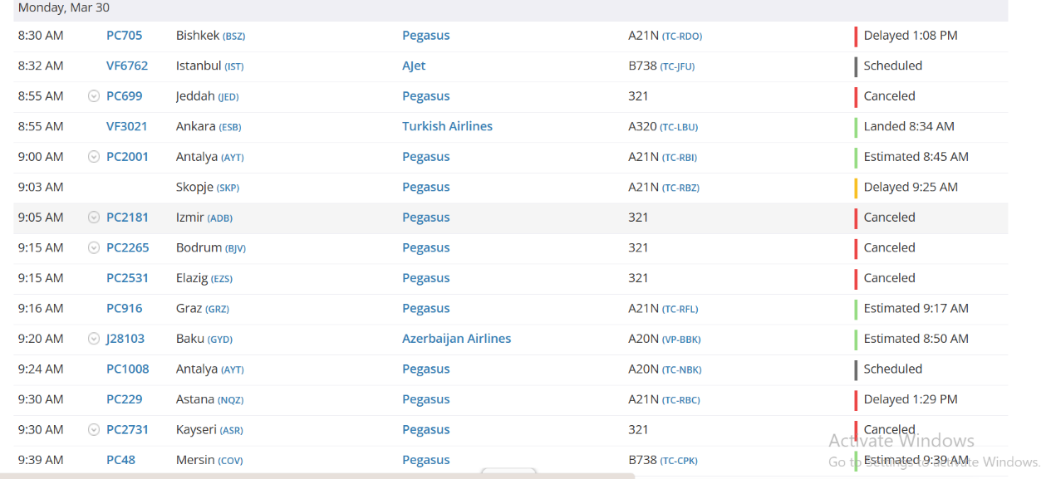
Tourism in the context of climate change at the destination
Climate risks and vulnerabilities:
Climate change poses significant risks to Türkiye,
including rising temperatures,
decreasing rainfall,
more frequent extreme events, and
sea-level rise,
all of which threaten natural ecosystems and coastal tourism areas.
As part of the Mediterranean climate risk hotspot, these impacts increasingly challenge the sustainability and attractiveness of Türkiye’s tourism sector.

Slide 37
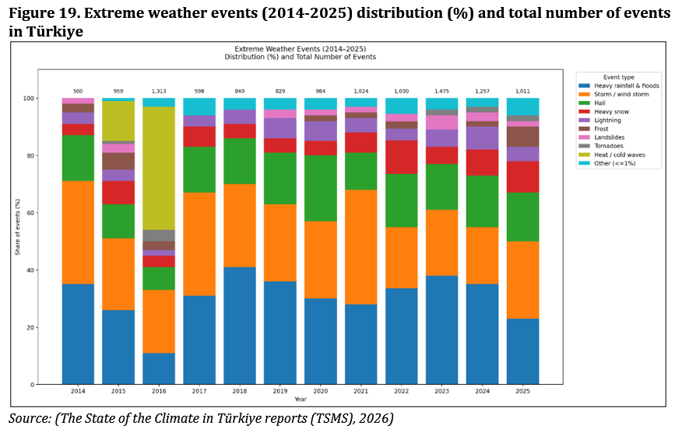
Tourism in the context of climate change at the destination
Climate risks and vulnerabilities:
Extreme weather events in Türkiye have increased significantly in both frequency and variety, with storms and heavy rainfall/flooding being the most dominant types, especially after 2020. These developments highlight growing vulnerabilities in tourism infrastructure and accessibility, posing risks to climate-sensitive tourism sectors such as coastal, winter, and nature-based tourism.

Slide 38


Tourism in the context of climate change at the destination
Mitigation strategies:
Tourism-related mitigation strategies
Sustainability certification
Encouraging low-carbon tourism models (e.g., ecotourism)
Promoting the use of renewable energy and energy efficiency
in tourism operations (e.g. solar)
Improving waste management practices
Protecting natural resources, ecosystems, and coastal areas
Developing and encouraging sustainable transportation systems
Increasing carbon sinks (e.g., forests) and their protection
Restrictions on land use change

Slide 39
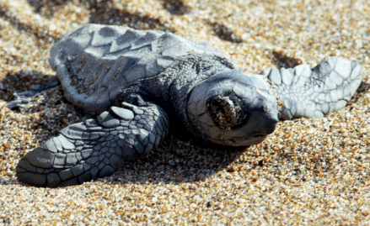
Tourism in the context of climate change at the destination
Adaptation strategies:
Tourism-related adaptation strategies
Product development, temporal and spatial diversification
Demand management (changing operation hours)
Water management (Waste water treatment, protecting water reserves)
Infra-structure investments
Risk management, early warning systems and emergency response
Climate resistant design guidelines
Finance mechanisms, incentives

Slide 40
Analytical SWOT for Türkiye
STRENGTHS
• Large, accessible tourism economy with strong demand and rapid recovery capacity • Diversified coastal, cultural, health, gastronomy, nature and winter products • National climate direction and a comprehensive sustainable-tourism programme • Public-private coordination, promotion and certification capacity • Emerging destination-level climate risk and suitability assessments
WEAKNESSES
• Coastal and summer concentration within a resource-intensive mass-tourism model • Fossil-energy dependence and rising transport and cooling emissions • Weak enforcement, inter-institutional coordination and local implementation • Uneven destination data, climate skills and investment finance • Existing infrastructure and investment exposed to multiple hazards
OPPORTUNITIES
• Shift toward higher-value, longer-stay and shoulder-season tourism • Expand inland, cultural, health, gastronomy and high-altitude destinations • Scale green retrofits, renewable energy and carbon-market modernisation • Use climate screening, water budgets and destination resilience plans • Turn European market standards into verified low-carbon competitiveness
THREATS
• Mediterranean heat, drought, water scarcity and wildfire • Sea-level rise, coastal degradation, storms and flooding • Declining snow reliability and changing winter-tourism geography • Geopolitical demand volatility and cost-competitiveness pressure • International carbon and aviation standards outpacing domestic transition

Slide 41
Recommended Practices
Recommended Practices | Description | Suggested Actions / Notes
Integrated Tourism Climate Governance & Institutional Coordination | Climate considerations embedded into tourism policy through coordinated, multi-level structures that link national strategies with destination. | Align tourism with NDCs and climate strategies; destination-level Tourism Climate Coordination Units; strengthen DMOs with climate mandates; stakeholder participation.
Regulatory Frameworks, Planning & Enforcement | Creating and enforcing binding climate regulations in tourism planning, investment, and operations. | Enforce climate-resilient zoning and land-use planning in tourism; adopt climate-resilient design standards (heat, water, fire, LUC); establish monitoring and compliance systems.
Climate Finance & Economic Instruments | Develop financing framework to support mitigation and adaptation investments while creating economic incentives for low-carbon transition. | Introduce carbon pricing and ETS into tourism; establish climate funds; provide green loans, subsidies, and blended finance; develop climate risk insurance instruments; earmark tourism revenues for resilience.
Capacity Building & Local Implementation | Strengthen technical and institutional capacity at the local level to ensure effective implementation of climate policies in tourism destinations. | Training for municipalities and SMEs; develop technical guidelines and toolkits; support knowledge-sharing platforms.
Sustainable Operations, Resource Efficiency & Local Supply Chains | Improve efficiency and strengthen local economic linkages. | Promote water and energy efficiency measures (reuse systems, renewables); encourage local sourcing of goods and services; reduce waste and food loss
Market Transformation, Diversification & Demand Management | Transition from a high-volume tourism model toward a more resilient, diversified, and value-oriented system that reduces climate vulnerability. | Strengthen domestic tourism; diversify into cultural, rural, and off-season tourism; longer stays and higher per capita spending; redistribute demand (e.g., shift school holidays).
Climate-Resilient Infrastructure, Transport & Risk Management | Enhance the resilience of tourism through infrastructure investment, sustainable mobility, and robust crisis management mechanisms. | Invest in water, energy, and cooling technology; expand rail and public transport systems; EV; develop destination-specific crisis and emergency response plans.

Slide 42


Benchmark Case
Country

Slide 43
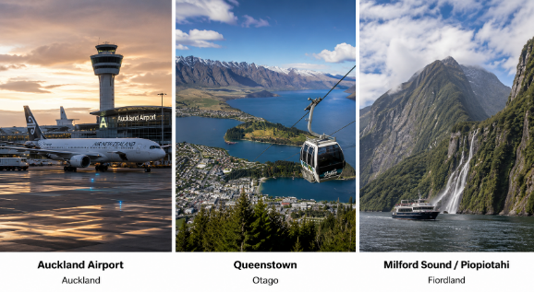
General overview of tourism at the destination
Strong international demand: About 3.6 million overseas visitors arrived in 2025, reaching 90% of pre-pandemic volume generating approximately US$8 billion in expenditure.
Climate change is a strategic challenge for New Zealand tourism because visitor demand depends heavily on coastal environments, alpine landscapes, glaciers, protected ecosystems and biodiversity.
High aviation dependence: New Zealand’s geographic isolation makes air travel essential, but also creates a major carbon-emissions challenge.

Slide 44


Tourism in the Context of Climate Change at the Destination

Slide 45


Tourism in the context of climate change at the destination
Mitigation strategies:
Tourism-related mitigation strategies
Renewable electricity and energy-efficient tourism facilities
Carbon measurement and business climate-action plans
Sustainability certification and operator capability
Electric mobility and public transport
Waste prevention, reuse and recycling
Native forest, wetland and biodiversity restoration

Slide 46


Tourism in the context of climate change at the destination
Adaptation strategies:
Tourism-related adaptation strategies
Protecting and preparing visitor infrastructure
Working with ecosystems and nature-based solutions
Seasonal, product and market diversification
Transitioning visitor access and tourism operations
Relocating or redesigning highly exposed assets
Community-led and Māori-informed adaptation

Slide 47
Analytical SWOT for New Zealand Tourism
STRENGTHS
• Advanced tourism-climate science, hazard information and research capacity • Highly renewable electricity and established business decarbonisation tools • Strong conservation institutions and climate-informed visitor-asset management • Experienced destination collaboration and emergency coordination • Māori stewardship and a strong regenerative-tourism foundation
WEAKNESSES
• Structural dependence on long-haul aviation • Fragmented tourism, climate, transport and conservation responsibilities • No single tourism carbon system covering access, mobility and operations • Uneven finance and technical capacity among smaller and remote operators
OPPORTUNITIES
• Create a measurable tourism climate implementation framework • Use destination plans to choose protect, adapt, relocate or retreat pathways • Combine low-carbon mobility with a longer-stay, higher-value aviation strategy • Direct visitor and business finance to resilience and ecosystem outcomes • Expand Māori-led regeneration, community participation and product diversification
THREATS
• Floods, landslides, wildfire, coastal change and extreme rainfall disrupting access • Glacier retreat and declining snow reliability changing iconic products • Biodiversity and ecosystem decline weakening nature-based experiences • Repeated shocks raising insurance, maintenance and interruption costs • Carbon-constrained source markets and higher long-haul aviation costs

Slide 48
New Zealand: Future Policy Recommendations
Priority | Purpose | Country-specific future action
Tourism climate framework | Make national policy operational | Align tourism policy with emissions-reduction, adaptation and conservation programmes.
Destination risk plans | Anticipate disruption | Assess priority destinations and define protect, adapt, relocate or retreat pathways.
Tourism carbon system | Track total and intensity emissions | Report aviation, domestic mobility, accommodation and attractions consistently.
Aviation and value strategy | Address long-haul dependence | Develop sustainable aviation fuel while encouraging longer stays and higher local value.
Low-carbon resilient mobility | Decarbonise access | Join electric fleets, charging and public transport with resilient roads and bridges.
Small-business finance | Close capacity gaps | Bundle efficiency, electrification and resilience support with measurable conditions.
Visitor-funded host resilience | Link tourism revenue to place | Earmark visitor levies for nature, preparedness, Māori co-design and diversification.

Slide 49



Prof. Gurel Cetin
Istanbul University, Türkiye
gurelc@Istanbul.edu.tr

