Slide 1


Climate Change Strategies for Sustainable Tourism in Türkiye
National Mitigation Frameworks,
Localized Adaptation & Governance Models
Dr. Zeynep Fikran YENİCE, Expert of Culture and Tourism,
Şeyda BÜLBÜL İŞLER, Junior Expert of Culture and Tourism
Selin Can Yön, Certificate and Operation Assistant Manager, TGA
Ministry of Culture and Tourism
September 2026
Notes:
Speech: Distinct Guests and Colleagues, welcome to today's briefing. Today, we will explore a structural roadmap detailing how Türkiye's vital tourism industry is confronting global climate change [1]. Our focus will center squarely on the strategic mitigation and adaptation frameworks, localized adaptation methods, and the historic 2025 Climate Law designed to secure a sustainable, low-carbon future for our destinations [1].

Slide 2
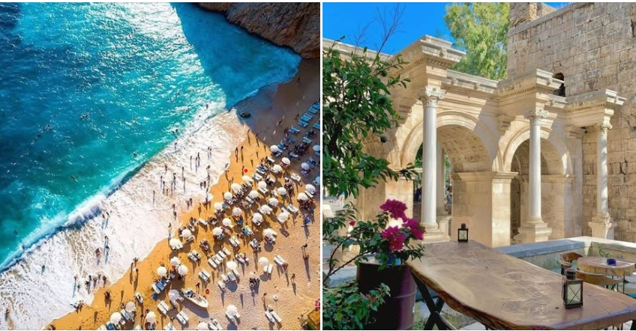
Introduction & Overview
• Tourism is heavily climate-dependent, relying on stable environmental conditions.
• Türkiye's vital sector faces escalating pressure from accelerating climate change consequences.
• The Mediterranean basin is officially classified as a critical climate risk hotspot in most reports.
• Transitioning from high-volume to high-value, climate-resilient models is essential.
CORE NEXUS
Climate Volatility
Asset Degradation
Economic Risk
Resilient Shift
Climate Change Strategies for Sustainable Tourism in Türkiye | National Report Perspective
Notes:
Tourism is fundamentally climate-dependent
.From our iconic sun-sea-sand beach resorts to our high-altitude winter ski mountains, stable weather is the primary asset base
Accelerating climate volatility means that climate resilience is no longer just an environmental ideal; it is a core economic survival strategy,
Türkiye is actively transitioning its macro-tourism model from sheer volume to climate-protected value .

Slide 3
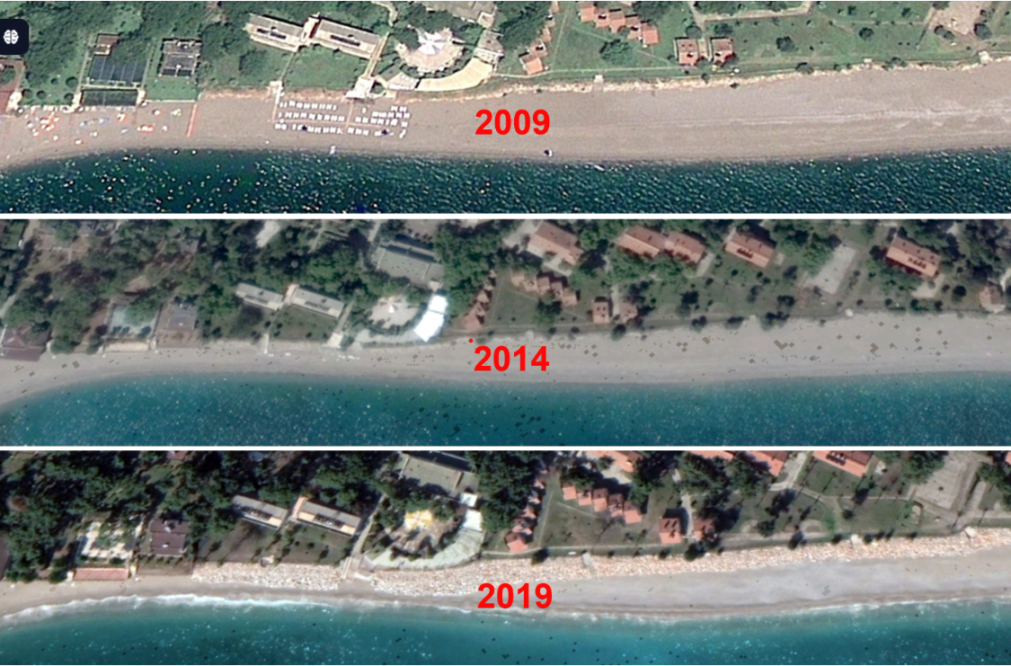
Climate Risks & Projections (IPCC 2022)
• Average temperatures are projected to increase by 1-6 °C by the year 2100.
• Summer temperatures face an intense anticipated spike of 3-8 °C.
• Annual rainfall is expected to drop by approximately 20% across the region.
• Sea levels are projected to rise by 30 cm to 1 m along the Mediterranean coasts.
Antalya Konyaaltı Beach Retreat
2100 FORECASTS
+1-6°C Temp Rise
-20% Rainfall
+30cm-1m Sea Level
Delta Flash Floods
Climate Change Strategies for Sustainable Tourism in Türkiye | National Report Perspective
Notes:
Let us look at the hard scientific baselines [1]. According to IPCC models, Türkiye's average temperatures are projected to climb up to 6 degrees Celsius by 2100, with intense summer heat stress spiking up to 8 degrees [1]. Simultaneously, annual rainfall is expected to drop by 20%, combined with up to a one-meter sea-level rise along our Mediterranean coastlines [1]. This explicitly puts our coastal deltas and low-lying resorts on the frontline of risk

Slide 4
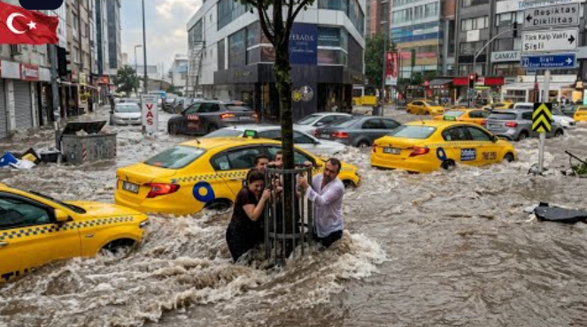
Extreme Weather Events & Infrastructure Fragility
• Total number of extreme weather events in Türkiye increased dramatically after 2020.
• Storms and significant rainfall/flooding consistently make up over half of all events.
• Recent severe storms directly disrupted critical tourism infrastructure and transport grids.
• Flight cancellations at Istanbul Sabiha Gökçen Airport (SAW) cut crucial destination flows.
EVENT DOMINANCE
Wind Storms
Flash Floods
Severe Hail
Transport Halts
Climate Change Strategies for Sustainable Tourism in Türkiye | National Report Perspective
Notes:
These projections are already materializing as observable trends [1]. Data from the Turkish State Meteorological Service shows a sharp spike in extreme events, driven primarily by severe wind storms, cloudbursts, and flash floods [1]. These events do not just degrade landscapes; they break critical infrastructure [1]. For instance, recent severe storms disrupted air transport grids like Istanbul's Sabiha Gökçen Airport, causing immediate travel delays and cutting vital destination flows

Slide 5
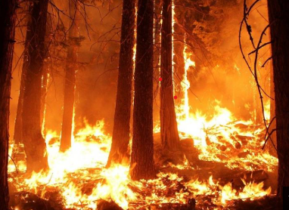
Wildfire Vulnerability & Coastal Degradation
• Aegean and Mediterranean coastal cities accounted for over half of burned forest areas.
• The 2021 fires in Antalya and Muğla directly threatened major resort infrastructure.
• A 10% increase in burned land correlates to a 0.47% decrease in foreign visitor growth.
• Southeastern coasts (Mersin, Adana, Hatay) face structural long-term coastal erosion.
IMPACT CYCLE
Forest Fires
Air Quality Drop
Poor Perception
Visitor Decline
Climate Change Strategies for Sustainable Tourism in Türkiye | National Report Perspective
Notes:
Wildfires represent a severe and direct threat to international leisure hubs [1]. Over half of Türkiye's total burned forest area between 2013 and 2021 was concentrated right along our tourism heartlands in the Aegean and Mediterranean [1]. Empirical models indicate that a 10% increase in burned land correlates with a 0.47% decrease in foreign visitor growth [1]. Furthermore, long-term sea-level rise causes slower but structural coastal squeeze and severe beach erosion in regions like Mersin and Hatay [

Slide 6
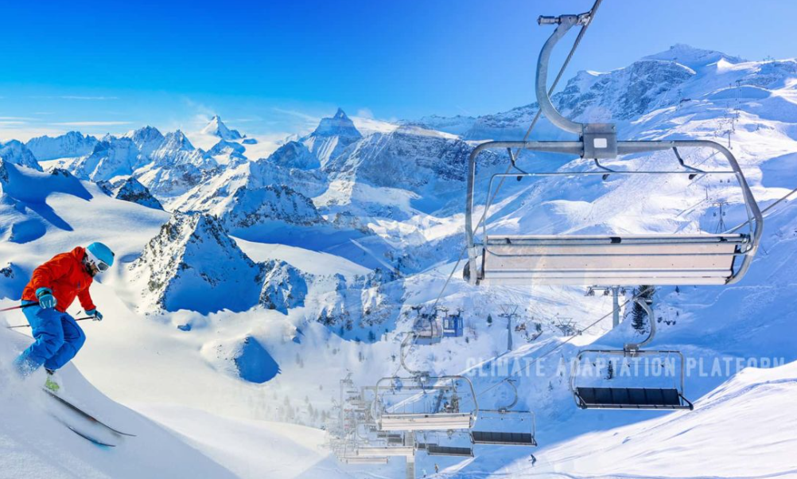
Spatial Relocation of Winter Tourism
• Winter and mountain tourism stand as the second most climate-sensitive products.
• Ski industry reliability is dropping due to shrinking snow cover and wind stress.
• Lower-altitude western mountain regions are rapidly losing spatial climate suitability.
• Investments are shifting toward higher elevation continental areas of Eastern Anatolia.
WINTER SHIFT
Western Decline
Shortened Seasons
Higher Elevation Shift
Ardahan Investments
Climate Change Strategies for Sustainable Tourism in Türkiye | National Report Perspective
Notes:
The second most climate-sensitive product is winter tourism [1]. Rising temperatures are shortening snow seasons and making artificial snow production much more energy-expensive [1]. While lower-altitude western resorts face shrinking suitability, the climate is forcing a spatial re-sorting toward higher, colder continental zones in Eastern Anatolia [1]. To proactively adapt, Türkiye is expanding investments into climate-resilient alpine spots

Slide 7
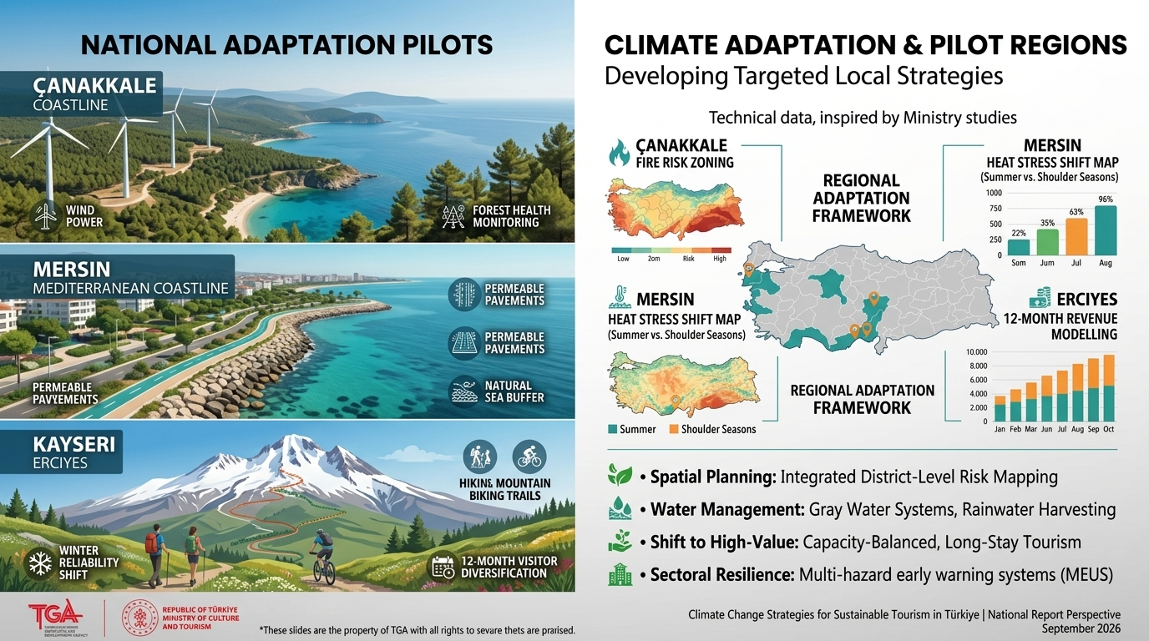
Destination-Level Climate Suitability Research
MoCT Pilot Study (TCI Methodology):
Integrated IPCC scenarios & Tourism Climate Index (TCI) to assess climate suitability (1996–2100).
Mersin (Coastal & Nature):
  Severe summer thermal stress & sea-level rise risk.
  Shift of peak comfort window (TCI) toward shoulder seasons (Spring/Autumn).
Çanakkale (Coastal & Cultural):
  High vulnerability to forest fires, heatwaves, and coastal storms.
  Comfort index declines in mid-summer > Season extension strategies required.
Kayseri / Erciyes (Winter & Alpine):
  Decreasing snow cover duration and snow reliability under high-emission projections.
  Strategic imperative for 12-month diversification (alpine, eco-tourism, congress).
Climate Change Strategies for Sustainable Tourism in Türkiye | National Report Perspective
Notes:
Besides generic national solutions, the Ministry of Culture and Tourism has launched destination-specific risk planning [1]. In Mersin, data mandates shifting peak summer mass tourism models toward spring and autumn shoulder months [1]. In Çanakkale, localized hazard mapping isolates wildfire zones at a district level [1]. Meanwhile, in Kayseri Erciyes, strategies enforce a shift from pure skiing to 12-month year-round nature and adventure tourism

Slide 8
Mitigation Strategies: Low-Carbon Transformation
• Mitigation aims to limit global temperature increase by actively reducing greenhouse gas emissions.
• Türkiye utilizes multi-sectoral roadmaps to integrate sustainable goals with low-carbon growth.
• Macro-level climate policies create direct transformation pressures on tourism operations.
• The Turkish Climate Change Action Plan drives systemic energy and efficiency upgrades.
MITIGATION SUTORS
Emissions Tracking
Energy Efficiency
Renewable Power
Low-Carbon Transport
Climate Change Strategies for Sustainable Tourism in Türkiye | National Report Perspective
Notes:
Moving into our first policy pillar: Mitigation [1]. True mitigation requires cutting greenhouse gas emissions directly at the source [1]. Even though traditional climate policies rarely target specific service sectors, the macro-level push for renewable energy and energy-efficient building regulations is fundamentally reshaping tourism operations and hospitality supply lines across Türkiye

Slide 9
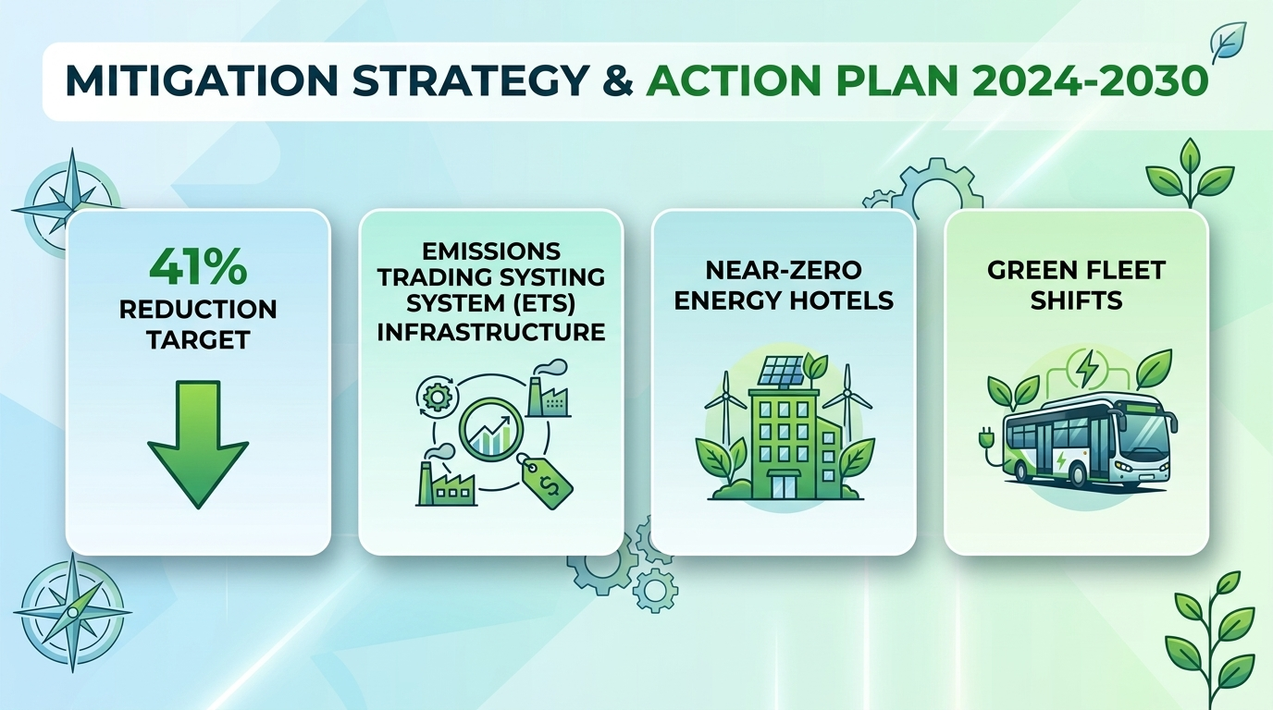
Climate Change Action Plan (2011-2023)
• The plan significantly impacted tourism through foundational macro-level sectoral regulations.
• Mandated energy performance certificates directly altered operations of hotel assets.
• Promoted tourism mobility shifts away from highways toward sustainable rail and sea transport.
• Enforced integrated waste disposal and treatment systems in high-density coastal regions.
2011-2023 PILLARS
Building Energy
Transport Shifting
Coastal Waste Grids
Basin Protections
Climate Change Strategies for Sustainable Tourism in Türkiye | National Report Perspective
Notes:
Türkiye's historical 2011–2023 Action Plan laid the groundwork by mandating Energy Performance Certificates for buildings and emphasizing eco-friendly transport shifts toward rail and maritime networks [1]. The current 2024–2030 Mitigation Strategy amplifies this by advancing near-zero energy building standards for hotels and engineering an institutional framework for a domestic Emissions Trading System or carbon tax structure

Slide 10
Mitigation Strategy & Action Plan (2024-2030)
• Presents a comprehensive multi-sectoral roadmap to accelerate low-carbon economic transition.
• Prioritizes clean production, circular economy design, and increasing natural carbon sinks.
• Prepares market-based carbon pricing tools and a domestic Emissions Trading System (ETS).
• Imposes economic cost on emissions to push sustainable building materials into tourism zones.
2030 OBJECTIVES
41% Reduction Target
ETS Infrastructure
Near-Zero Energy Hotels
Green Fleet Shifts
Climate Change Strategies for Sustainable Tourism in Türkiye | National Report Perspective
Notes:
The current 2024–2030 Mitigation Strategy amplifies this by advancing near-zero energy building standards for hotels and engineering an institutional framework for a domestic Emissions Trading System or carbon tax structure [1].

Slide 11
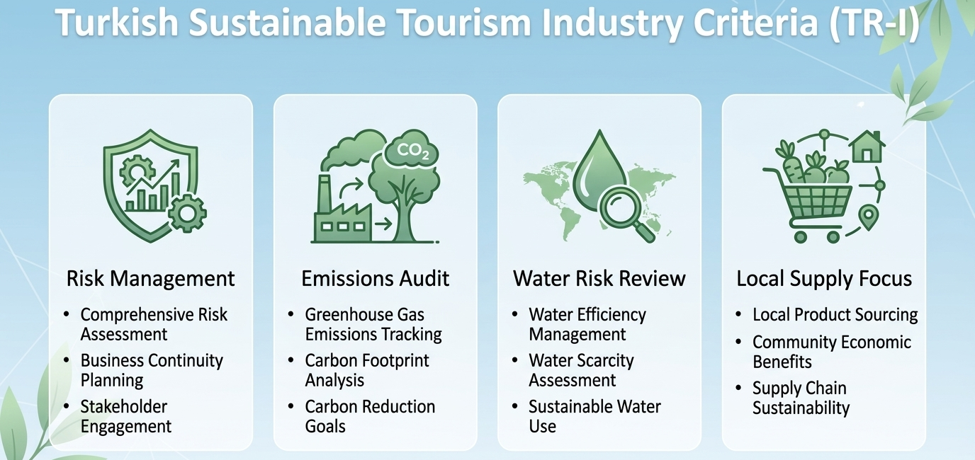
Turkish Sustainable Tourism Industry Criteria (TR-I)
• Developed under the leadership of the Ministry of Culture and Tourism alongside the TGA.
• Fully recognized by the Global Sustainable Tourism Council (GSTC) as an institutional standard.
• Stands as a legally binding, mandatory system for all accommodation facilities in Türkiye.
• Acts as a dynamic policy tool, reviewed every 3 to 5 years to adapt to changing risks.
TR-I CORE FOCUS
Risk Management
Emissions Audit
Water Risk Review
Local Supply Focus
Climate Change Strategies for Sustainable Tourism in Türkiye | National Report Perspective
Notes:
The absolute crown jewel of our mitigation policy is the TR-I—the Turkish Sustainable Tourism Industry Criteria [1]. Developed under the leadership of the Ministry and the TGA, this framework is fully recognized by the Global Sustainable Tourism Council [1]. Crucially, it is not a voluntary guideline; it is a legally binding standard for all accommodation assets and tour operators running inside Türkiye
My colleague will provide you with detailed information about the Türkiye Sustainable Tourism Program after I finish.

Slide 12
Adaptation Strategies: Building Sector Resilience
• Adaptation focuses on enhancing resilience and reducing vulnerability to inevitable impacts.
• Technological / Hard Measures: Deploying water recovery networks and artificial snowmaking.
• Ecological / Nature-Based Measures: Restoring local ecosystems and integrated coastal buffers.
• Social / Soft Measures: Accelerating staff awareness, training, and emergency preparedness.
FOURFOLD APPROACH
Hard Infrastructure
Nature Buffers
Staff Knowledge
Hybrid Systems
Climate Change Strategies for Sustainable Tourism in Türkiye | National Report Perspective
Notes:
Our second major pillar is Adaptation .
This is the operational engine that allows destinations to absorb climate shocks .
Türkiye divides its adaptation toolkit into technological hard measures—like advanced wastewater recycling; ecological nature-based measures—such as dune conservation; and social soft measures—which center heavily on staff training, climate awareness, and institutional risk preparedness

Slide 13
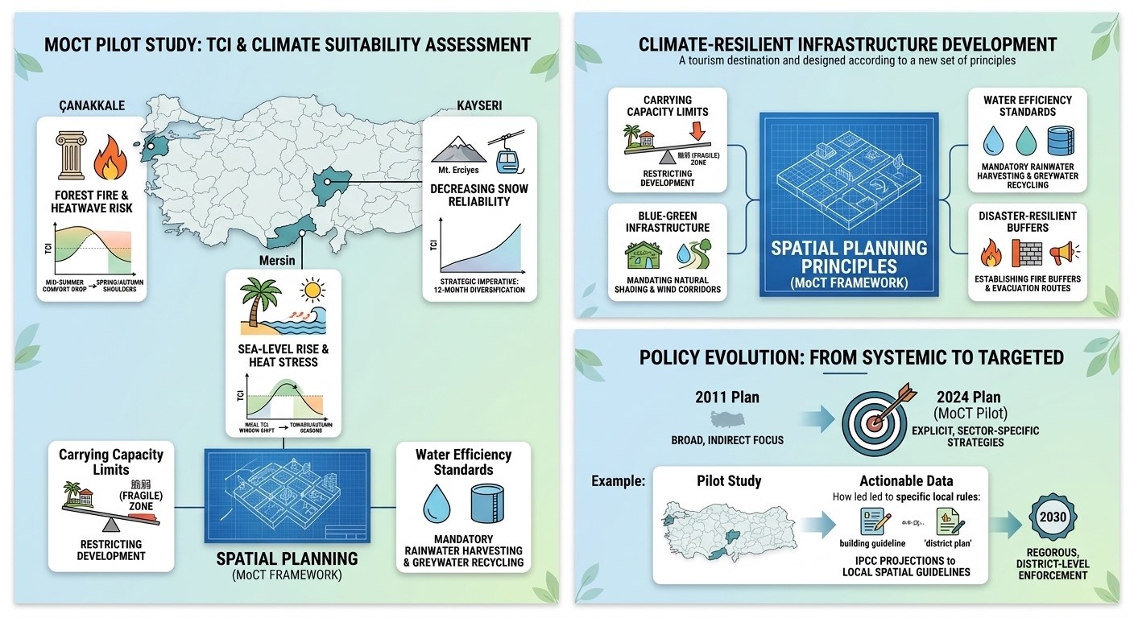
Climate-Resilient Infrastructure Development
Spatial Planning Principles (MoCT Framework):
  Carrying Capacity Limits: Restricting development intensity in climate-vulnerable zones (coastal, alpine, national parks).
  Blue-Green Infrastructure: Mandating natural shading, wind corridors, and microclimate green belts in tourism sites.
  Water Efficiency Standards: Mandatory rainwater harvesting and greywater recycling systems in hospitality assets.
  Disaster-Resilient Buffers: Establishing wildfire buffer zones and evacuation corridors aligned with MEUS early warning data.
Climate Change Strategies for Sustainable Tourism in Türkiye | National Report Perspective
Notes:
First, Carrying Capacity Limits: We must restrict development intensity in climate-vulnerable zones, such as our coastal areas and national parks.
Second, Blue-Green Infrastructure: We need to mandate natural shading, wind corridors, and green belts within tourism sites to keep them cool.
Third, Water Efficiency Standards: We are introducing mandatory rainwater harvesting and greywater recycling systems, especially for hotels and resorts
.Fourth, Disaster-Resilient Buffers: We must establish wildfire buffer zones and evacuation corridors aligned with MEUS early warning data.

Slide 14
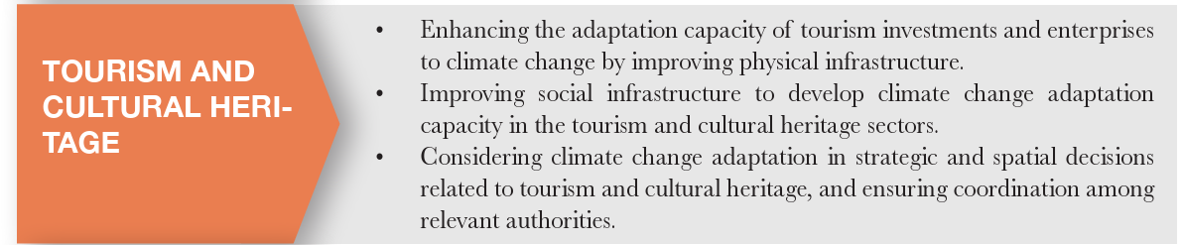
Policy Evolution: Systemic vs. Targeted Adaptation
• The historical 2011 plan utilized broad, system-level focuses where tourism was only indirect.
• The 2024-2030 Adaptation Plan explicitly establishes targeted, sector-specific strategies.
• Field survey data demonstrates high stakeholder concern regarding serious sector exposure.
• Notes significant room for improvement in establishing resilient building guidelines.
POLICY SHIFT
2011 Indirect Plan
2024 Explicit Policy
Risk-Based Focus
Enforcement Need
Climate Change Strategies for Sustainable Tourism in Türkiye | National Report Perspective
Notes:
A major shift has occurred in our policy architecture [1].
The older 2011 plan viewed adaptation through a broad, system-wide lense where tourism was only included indirectly [1].
The modern 2024–2030 Adaptation Plan treats tourism as an explicit, high-priority strategic domain [1].

Slide 15
Developing Climate-Resilient Infrastructure
• National plans prioritize structural hardening of physical assets against extreme hazards.
• Targeted funding is directed to vulnerable beach destinations like Antalya and Muğla.
• Promotes widespread deployment of water recovery, shading, and green micro-climates.
• Enforces strict carrying-capacity limits in fragile zones like Cappadocia and Pamukkale.
INFRASTRUCTURE
Coastal Barriers
Water Recycling
Green Shading
Capacity Audits
Climate Change Strategies for Sustainable Tourism in Türkiye | National Report Perspective
Notes:
Structural hardening is a priority for high-exposure zones like Antalya and Muğla [1].
National strategies focus on installing resilient coastal buffers, shading grids, and smart micro-climate infrastructure [1].
In fragile cultural heritage centers such as Cappadocia and Pamukkale, strict carrying-capacity rules are deployed to balance visitor density against accelerating environmental stress

Slide 16
Policy Evolution: Systemic to Targeted Adaptation
MoCT Pilot Project Milestone
  First comprehensive TCI & climate suitability assessment implemented at provincial/district levels (Çanakkale, Mersin, Kayseri).
  Direct translation of IPCC projections into local spatial planning guidelines and destination management plans.
Climate Change Strategies for Sustainable Tourism in Türkiye | National Report Perspective

Slide 17
Product Diversification & Seasonality Overhaul
• Portfolios are shifting away from traditional coastal models to counter main-season heat stress.
• Actively supports alternative concepts: highland, cultural, gastronomic, and health tourism.
• The Black Sea region is gaining massive traction for mountain and highland development.
• Aims to spread tourism demand evenly across 12 months and all geographical regions.
DIVERSIFICATION
Cooler Highlands
Heritage Routes
Gastronomy Tracks
12-Month Spread
Climate Change Strategies for Sustainable Tourism in Türkiye | National Report Perspective
Notes:
Mitigating climate risk requires breaking our dependence on seasonal coastal crowds [1].
Türkiye is actively diversifying its portfolio into cultural tracking, gastronomy paths, and health tourism [1].
Concurrently, cooler regions like the Black Sea highlands are gaining massive policy traction, providing a comfortable, natural alternative for summer travelers escaping intense Mediterranean heatwaves [

Slide 18
Early Warning Systems & Disaster Management
• The massive 2021 coastal fires accelerated the need for real-time disaster resilience.
• Meteorological Early Warning System (MEUS) provides advance alerts for storms and fires.
• AFAD's National Disaster Response Plan anchors institutional coordination across regions.
• Mandates localized emergency plans, crisis protocols, and regular staff drill exercises.
DISASTER GRID
Predictive MEUS
AFAD Coordination
Resort Evacuation
Micro-Level Drills
Climate Change Strategies for Sustainable Tourism in Türkiye | National Report Perspective
Notes:
Disaster risk management became an urgent priority following the intense wildfire waves of 2021 .
The Meteorological Early Warning System now pumps real-time localized hazard data directly to regional authorities and hotel operators
This is fully integrated with AFAD's National Disaster Response Plan, ensuring that micro-level evacuation maps and crisis drills are live across all major resort hubs

Slide 19
Chronological Milestones of Climate Governance
• 2001: Establishment of the central Climate Change Coordination Board (CCCB).
• 2004 & 2009: Official ratification of the global UNFCCC and the Kyoto Protocol regimes.
• 2021: Formal signing of the Paris Agreement and commitment to the 2053 Net-Zero path.
• 2025: Passing of Türkiye's first comprehensive Climate Law (No. 7552) into statutory law.
LEGAL EVOLUTION
2001 Coordination
2004-09 Treaties
2021 Paris & Net-Zero
2025 Climate Law
Climate Change Strategies for Sustainable Tourism in Türkiye | National Report Perspective
Notes:
Türkiye's climate governance has undergone a profound evolution [1].
Starting with the birth of our Coordination Board in 2001, we steadily joined global regimes like the UNFCCC and the Paris Agreement [1].
This culminated in a massive legal milestone: the official passing of Türkiye's first comprehensive Climate Law (No. 7552) in 2025, which locks in our 2053 Net-Zero pathway into statutory law

Slide 20
Financial Catalysts & Market Incentives
• The 2025 Climate Law defines multi-dimensional routes for public and private green capital.
• Tourism operations can leverage specialized green credit streams like the European Bank for Reconstruction and Development (EBRD)'s Türkiye Sustainable Energy Financing Facility (TurSEFF).
• Voluntary carbon credit markets offer financial upside for certified emission reductions.
• IPARD III grant support delivers funding for sustainable infrastructure and rural eco-lodges.
CAPITAL TOOLS
TurSEFF Green Loans
Carbon Credits
IPARD III Grants
Tax Subsidies
Climate Change Strategies for Sustainable Tourism in Türkiye | National Report Perspective
Notes:
Green transformations demand massive upfront capital [1].
To ease this burden, the new Climate Law structures public-private funding routes [1].
Tourism assets can access international low-interest capital via programs like TurSEFF by the EBRD [1].
Furthermore, rural grant systems like IPARD III are deployed to fund carbon-neutral eco-lodges and solar-powered agro-tourism grids

Slide 21
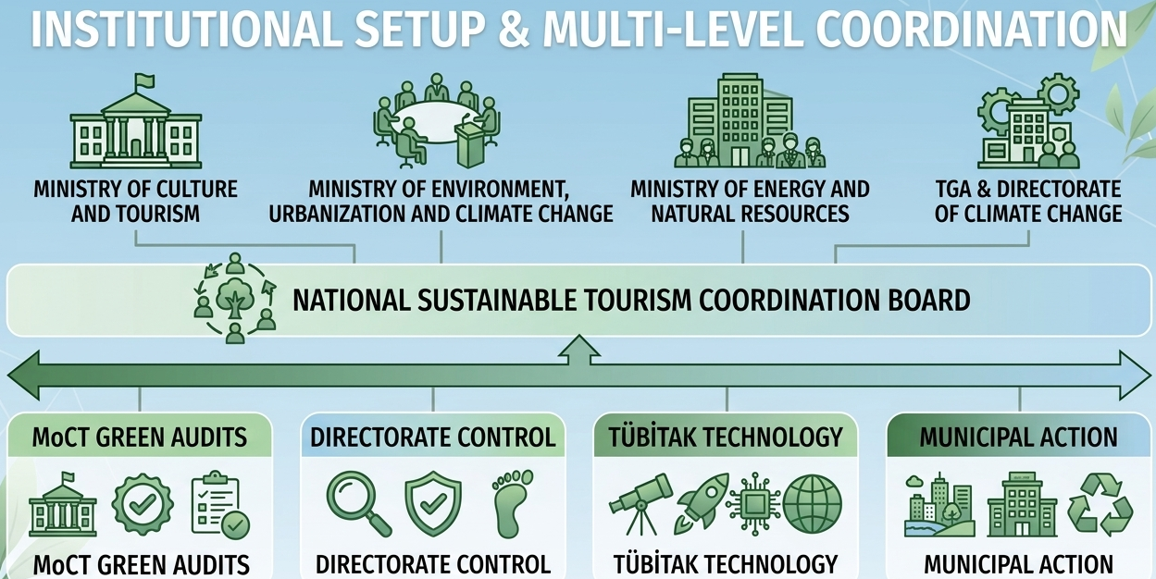
Institutional Setup & Multi-Level Coordination
• Ministry of Culture and Tourism & Tourism Promotion and Development Agency (TGA) direct mandatory green certification frameworks.
• Directorate of Climate Change acts as the primary monitoring, coordination, and Emissions Trading System (ETS) authority.
• Turkish Academy of Sciences (TUBA- TÜBİTAK) channels technological modeling and R&D guidelines straight into state planning.
• Local Municipalities are legally mandated to execute localized climate action plans.
AGENCY MATRIX
MoCT Green Audits
Directorate Control
TÜBİTAK Technology
Municipal Action
Climate Change Strategies for Sustainable Tourism in Türkiye | National Report Perspective
Notes:
Our climate architecture runs on multi-level horizontal and vertical cooperation [1].
While the Ministry of Culture and Tourism coordinates mandatory green certifications, the national Directorate of Climate Change enforces compliance and carbon market trading grids [1].
At the scientific foundation, TÜBİTAK channels technology modeling directly into state planning, while local municipalities execute municipal transit, water preservation, and mandatory local action maps

Slide 22
Conclusion & Actionable Strategic Next Steps
• Climate change is an active structural reality altering seasons and destination suitability.
• Türkiye has built an elite, legally grounded policy foundation via TR-I and the 2025 Climate Law.
• Converting policy momentum into rigorous, district-level enforcement remains the top priority.
• Future competitiveness relies on scaling up green finance and parametric climate insurance.
THE ROAD AHEAD
Enforce TR-I Globally
Deploy Green Capital
Scale Hazard Alerts
Secure 2053 Vision
Climate Change Strategies for Sustainable Tourism in Türkiye | National Report Perspective
Notes:
To conclude, climate change is not an abstract future threat for Turkish tourism; it is an active structural reality altering our seasons and asset baselines [1].
Türkiye has built an elite, legally grounded policy foundation via the TR-I criteria and the 2025 Climate Law [1].
Our future success hinges on converting this policy momentum into flawless district-level execution, scaling up parametric climate risk insurance, and securing aggressive private-sector engagement [1].
Thank you for your time, My colleague will provide you with detailed information about the Türkiye Sustainable Tourism Program

Slide 23





Environmental and Cultural Sustainability Program
Accommodation Facilities (September 2026)
GOALS
By the end of 2023, all accommodation facilities in Türkiye; Receive at least Stage 1 Verification
By the end of 2025, all accommodation facilities in Türkiye; Receive at least Stage 2 Verification
As of 2030, all accommodation facilities in Türkiye; Obtaining a Environmental and Cultural Sustainability Certificate
1
Annual Certificate
42
Audit by Criteria
2023
Stage 1
2025
Stage 2
2030
Stage 3
3 Stage
Ease of Compliance
with Criteria
38
Stage 1 Verified
Accommodation Facility
17.250
Stage 2 Verified
Accommodation Facility
2.583
Environmental and Cultural Sustainability
Certified
Accommodation Facility
Türkiye boasts the highest number of GSTC-certified accommodation facilities in the world.
These slides are the property of TGA with all rights. It cannot be distributed or used without the permission of TGA.

Slide 24


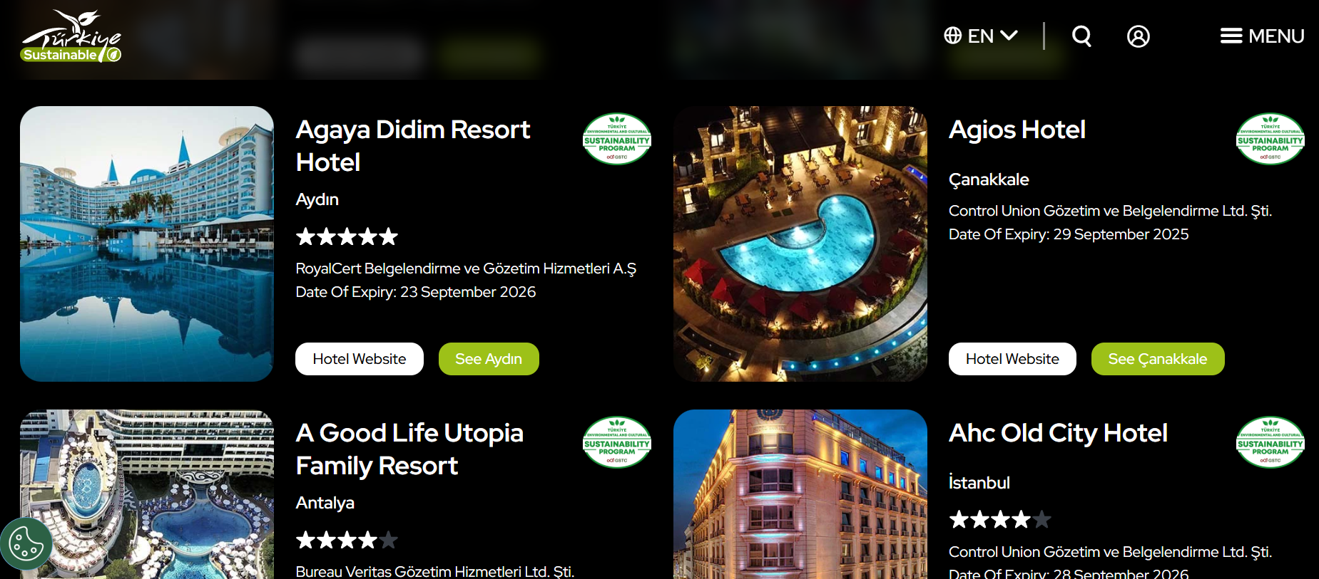
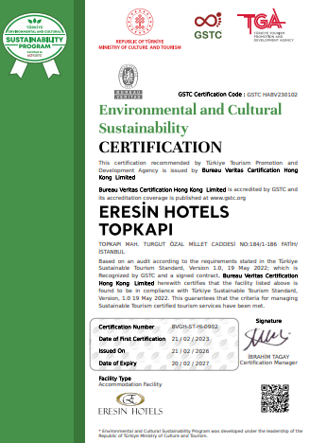
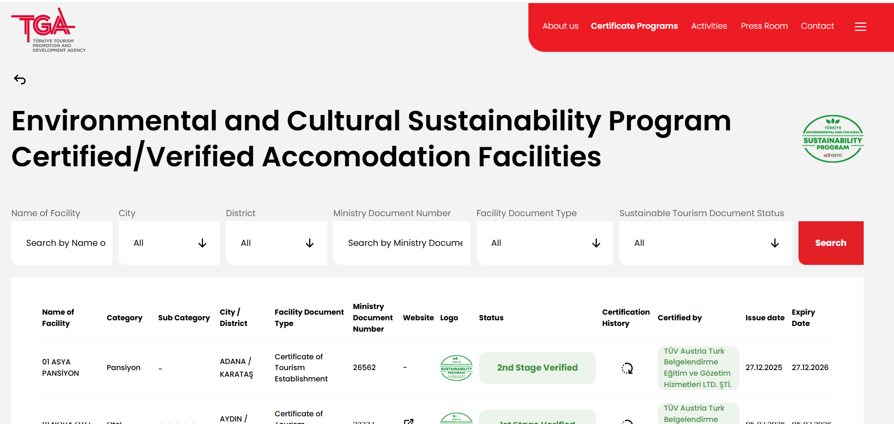
Real-Time Transparent
Listing of
Certified Accommodation Facilities
Certified facilities can find on the TGA’s, the Ministry’s and GoTürkiye websites.

Slide 25
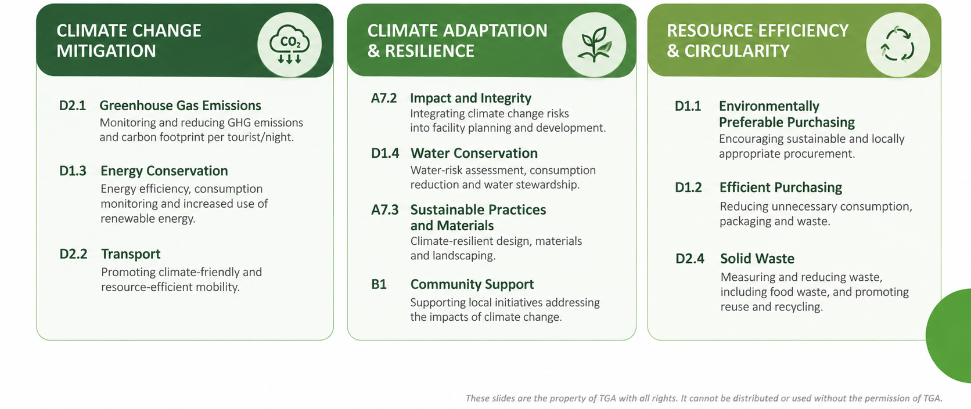
Environmental and Cultural Sustainability Program
Climate Action Related Criteria
These slides are the property of TGA with all rights. It cannot be distributed or used without the permission of TGA.

Slide 26
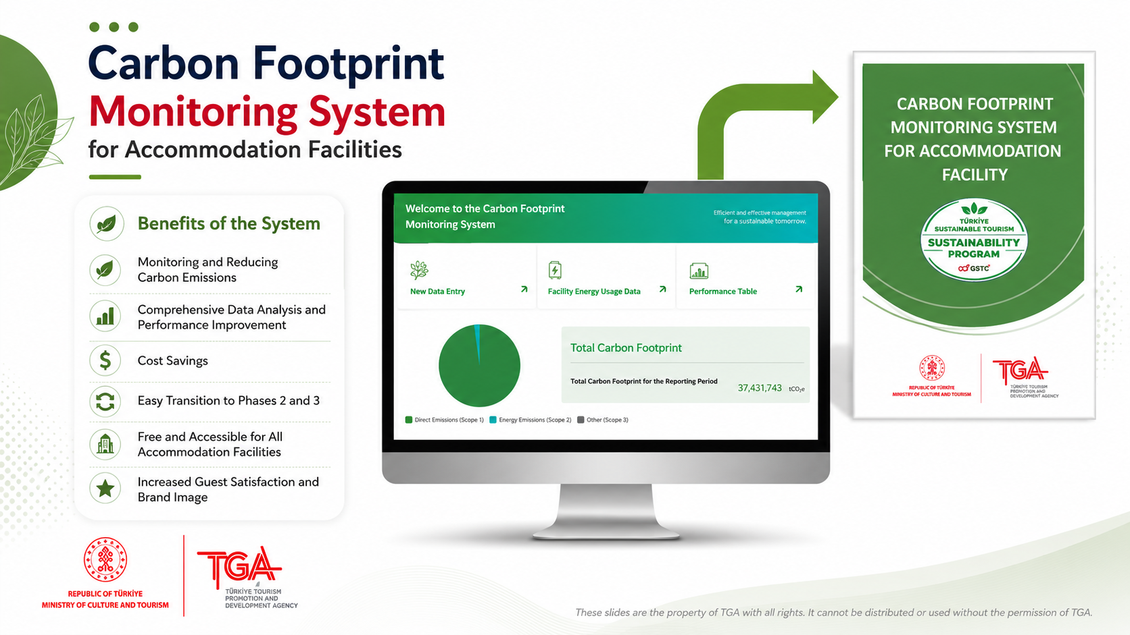
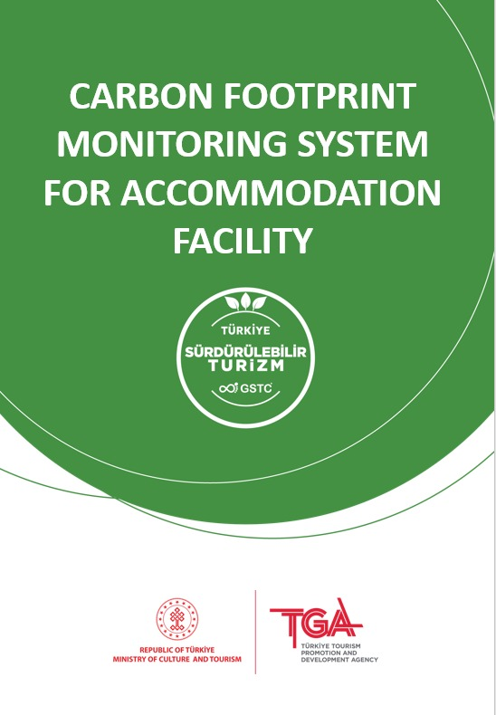
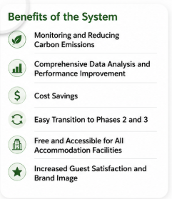

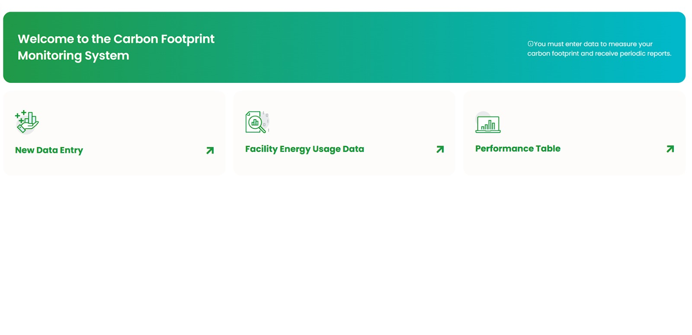
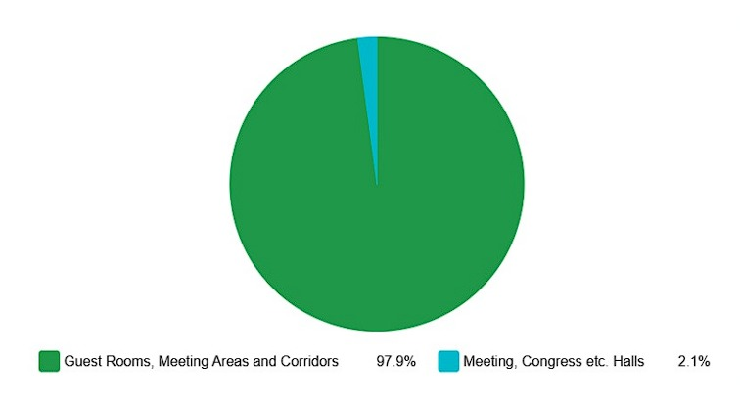

Carbon Footprint Monitoring System
for Accommodation Facilities
These slides are the property of TGA with all rights. It cannot be distributed or used without the permission of TGA.

Slide 27

Climate Change Strategies for Sustainable Tourism in Türkiye | National Report Perspective

