Slide 1



EU PARTNERSHIP FOR
LOCAL CLIMATE ACTION IN TÜRKİYE PROJECT

Slide 2
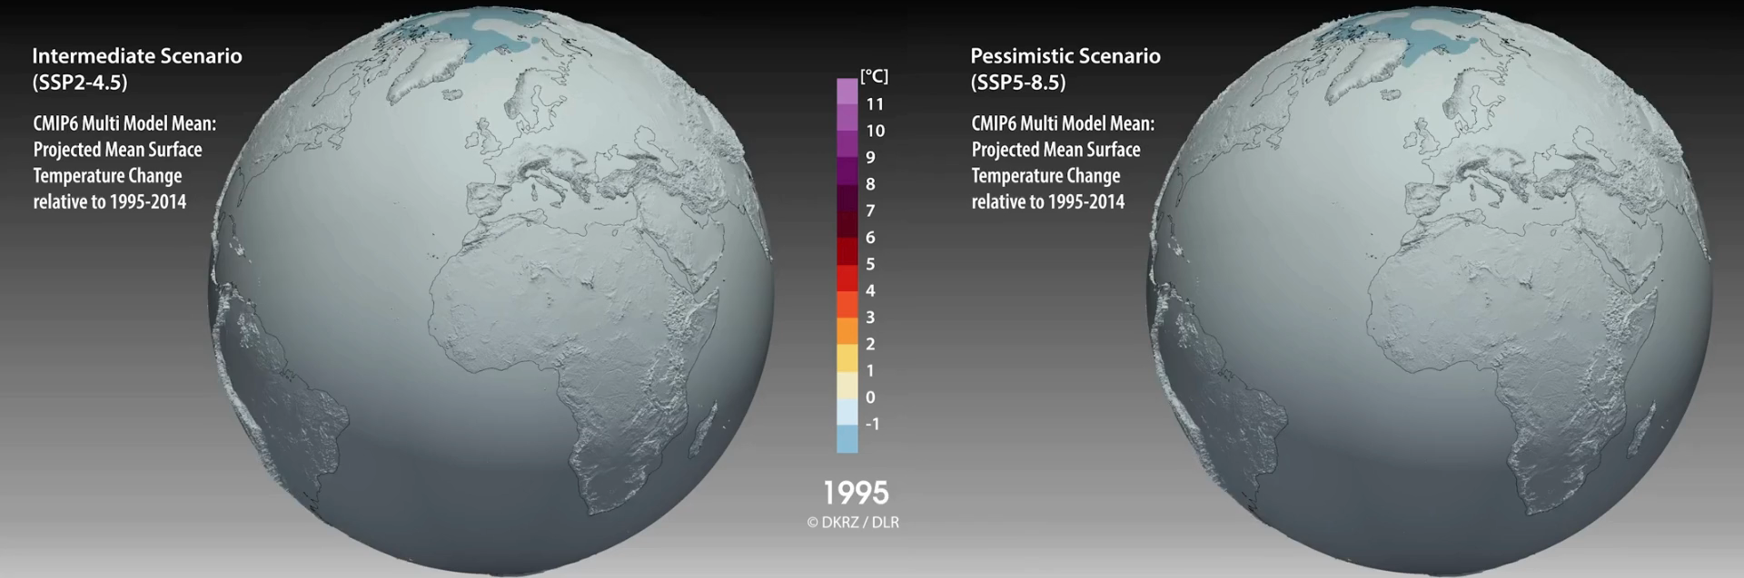

Slide 3
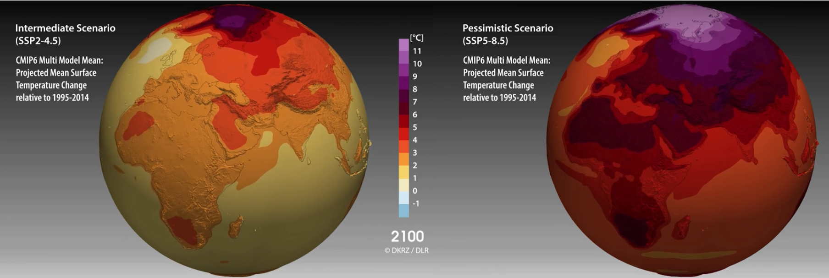

Slide 4
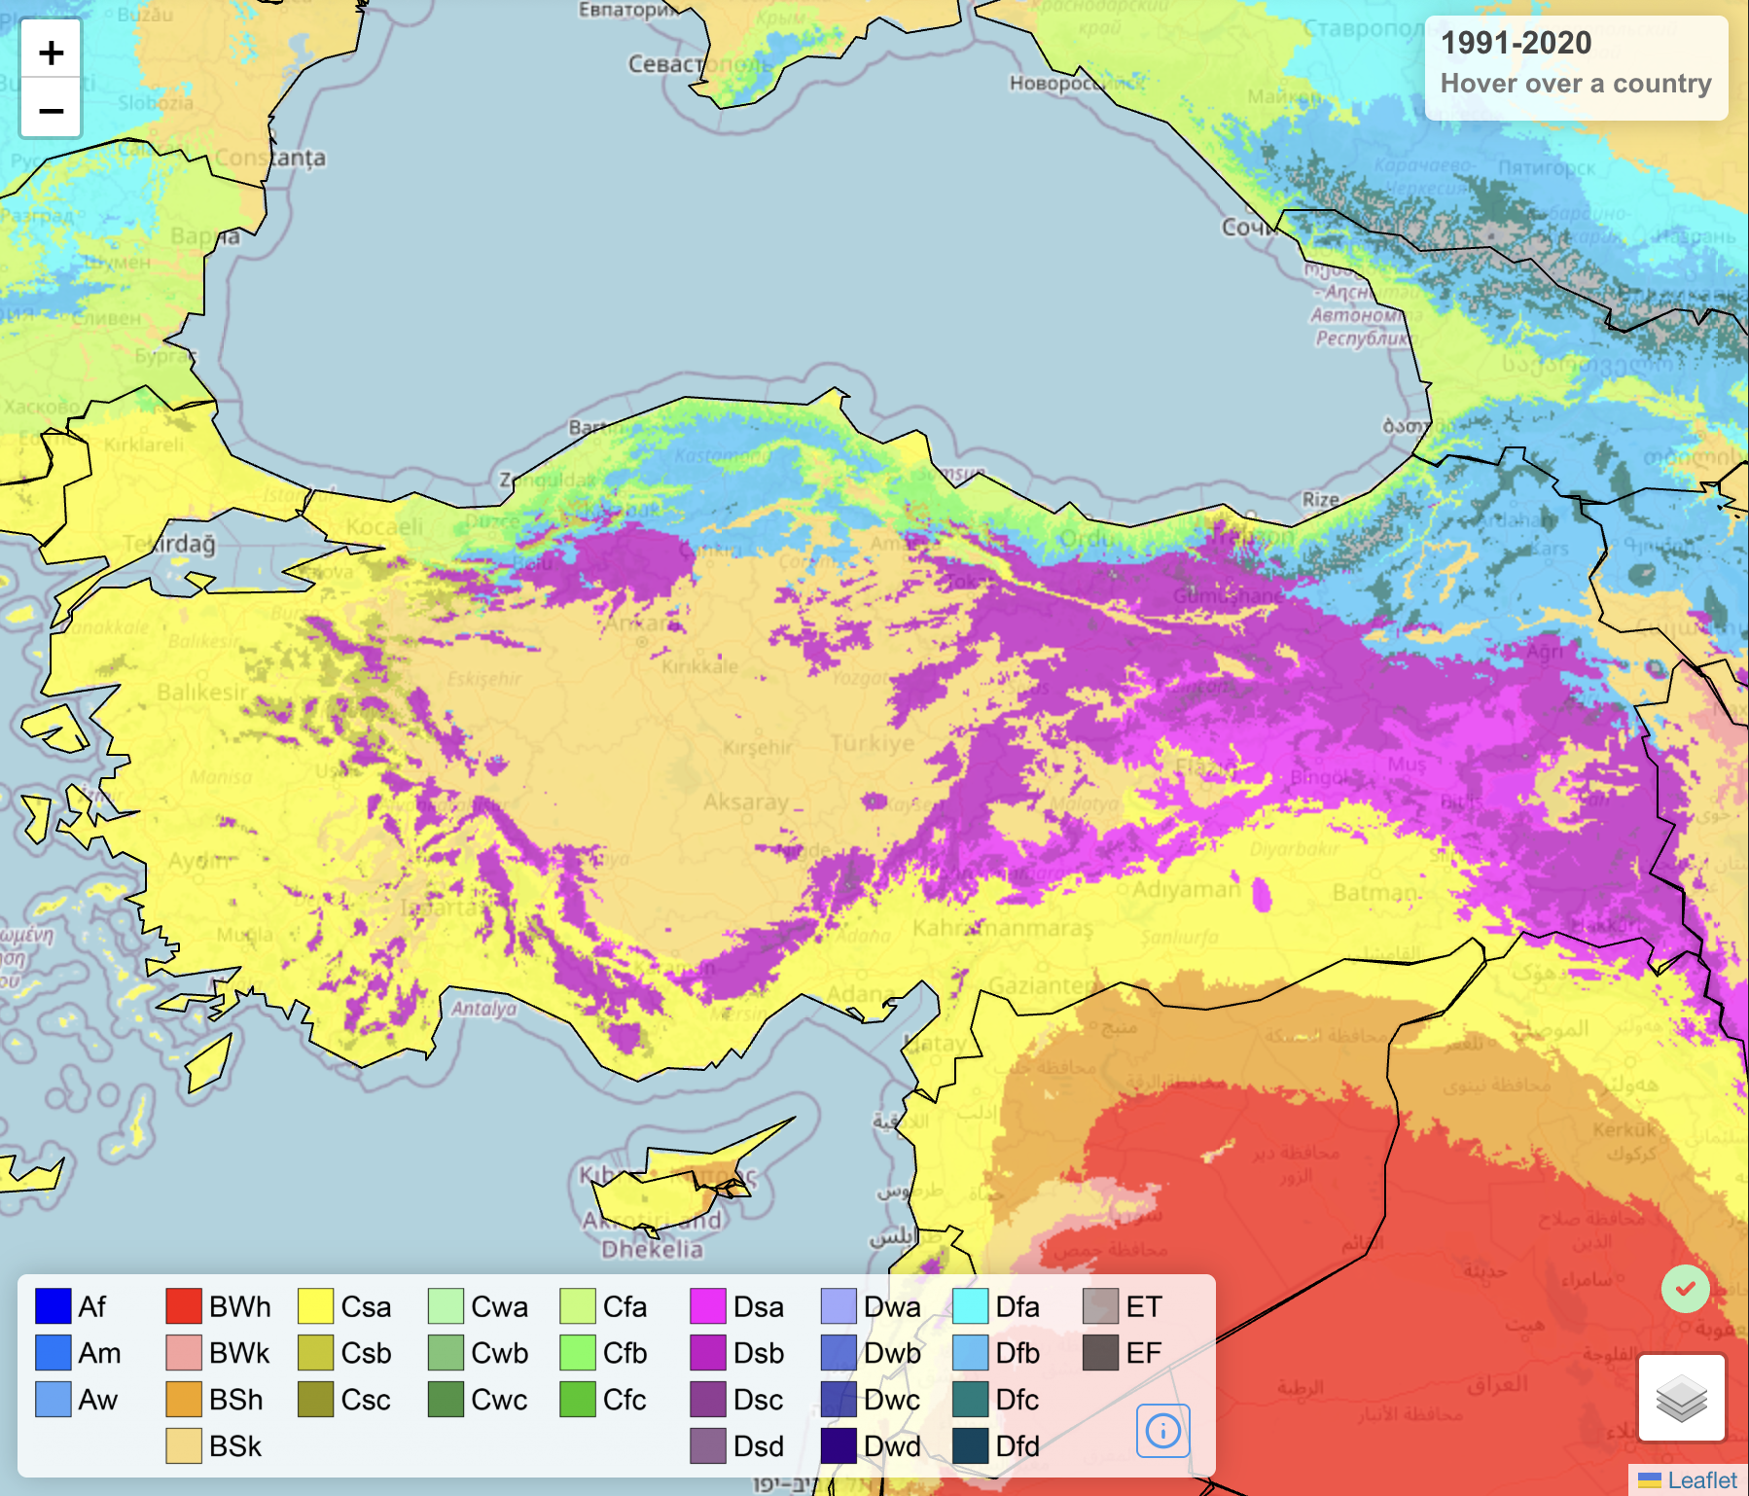
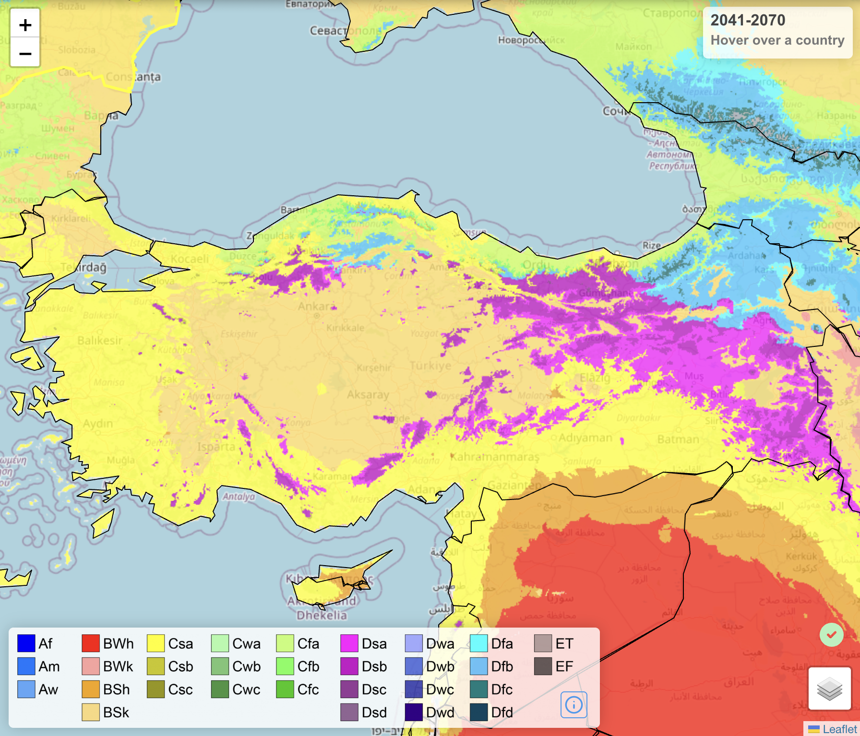
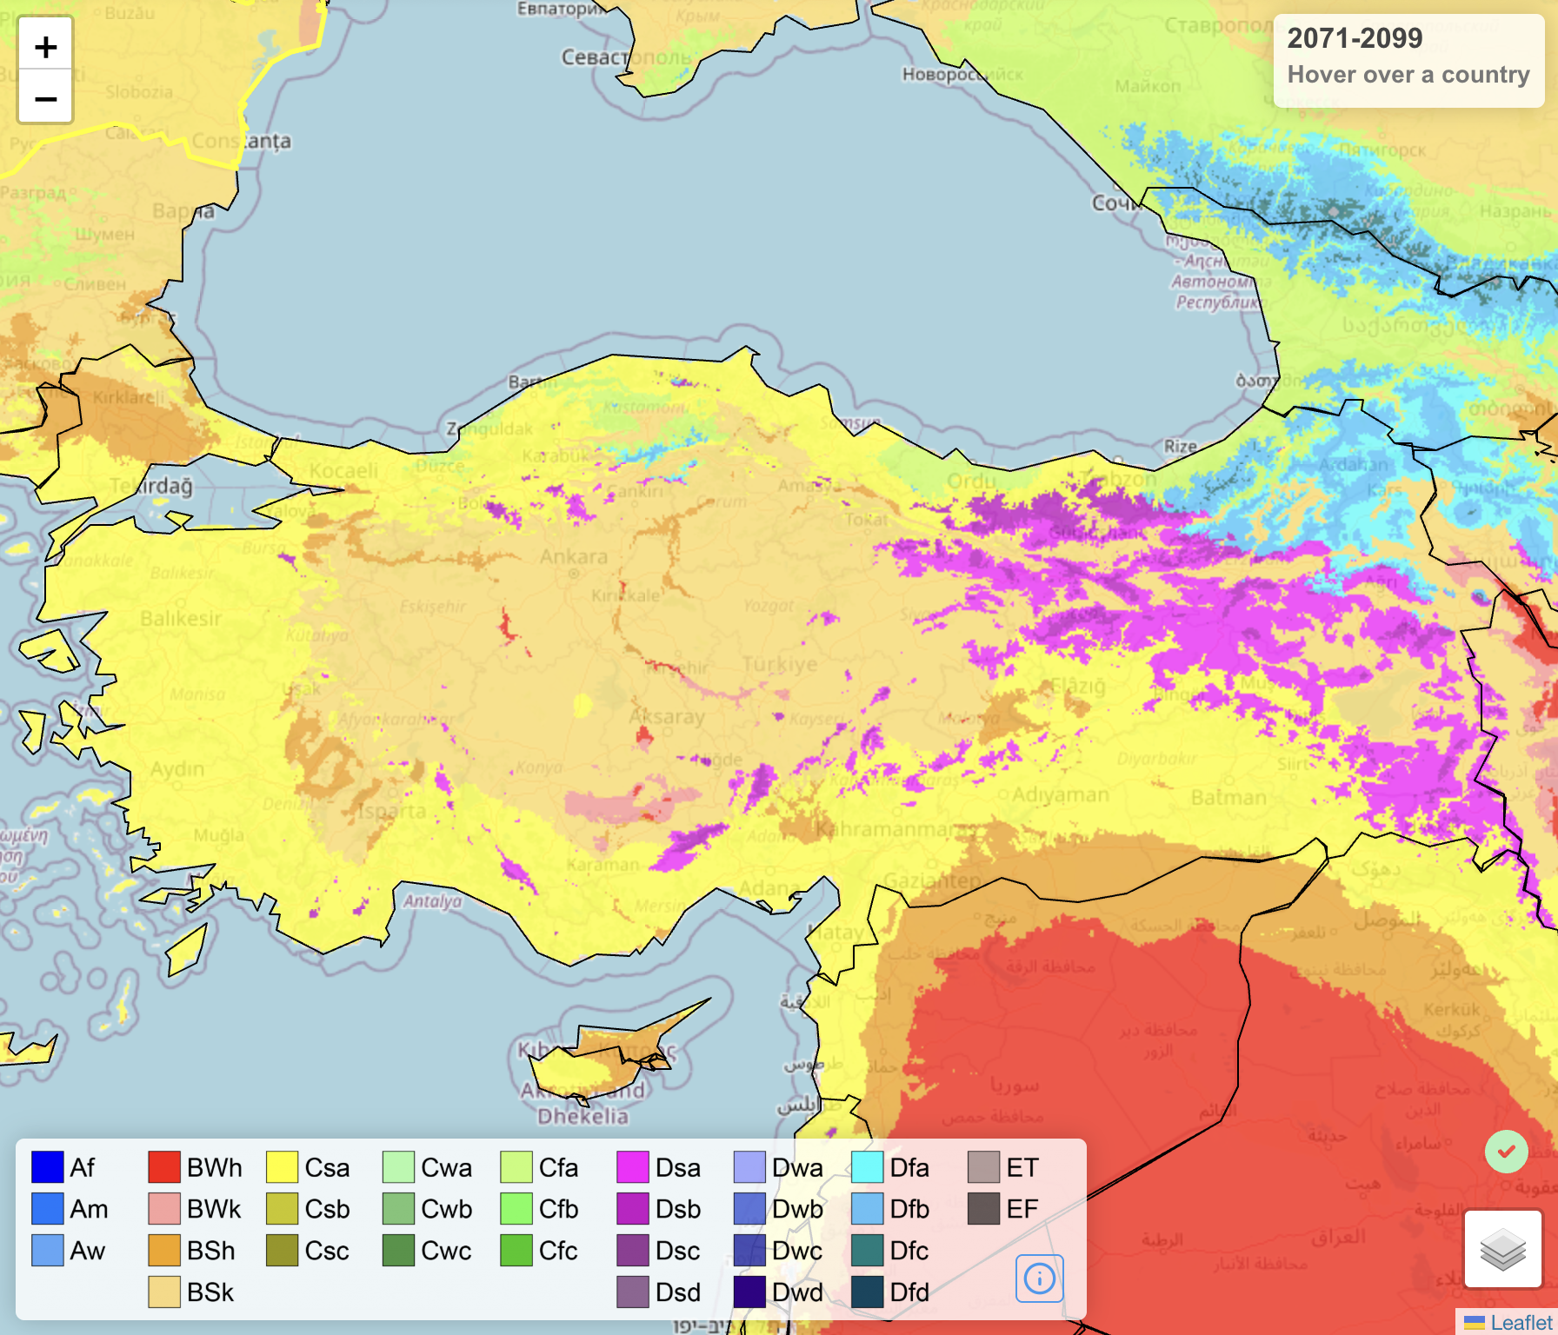
Changes in Climate

Slide 5
Project Introduction
Target Groups
Local authorities, public institutions, NGOs, academia, private sector
Project Duration
01 May 2023 – 01 May 2028 (60 months)
EU PARTNERSHIP FOR LOCAL CLIMATE ACTION IN TÜRKIYE
Purpose
To improve the local mitigation and adaptation capacity
Budget
EUR 7,500,000 (USD 7,986,750)
Objective
Sustainable, low-carbon and climate-resilient development

Slide 6
Trainings
Project Components and Outputs
D
Conferences
Climate Projections
C
A
Events
Capacity Building Plan
Vulnerability and Risk Assessments
Online Interactive Decision-Making Tools
LCCAP Legislation
B
E
LCCAPs for Pilot Cities
Grant Program
e-LCCAP Portal
Urban Climate Finance Mechanisms

Slide 7
Research on Global Climate Models and Shared Socioeconomic Pathways from the CMIP6 archive to select a Global Climate Model
Climate Projections & Vulnerability and Risk Assessment (Component A)
1
2
Dynamic downscaling of the Global Climate Models to 3 km resolution with a regional climate model for Türkiye
From the IPCC's CMIP6 archive, evaluated at the Turkish scale:
  6 Different Global Climate Models
  2 Different Shared Socioeconomic Pathways (SSP) scenarios
  3x3 km
3
Evaluation of current period climate simulations
4
Application of statistical bias correction methods
5
Calculation of extreme climate indices
6
Preparation of climate change impact assessment report

Slide 8
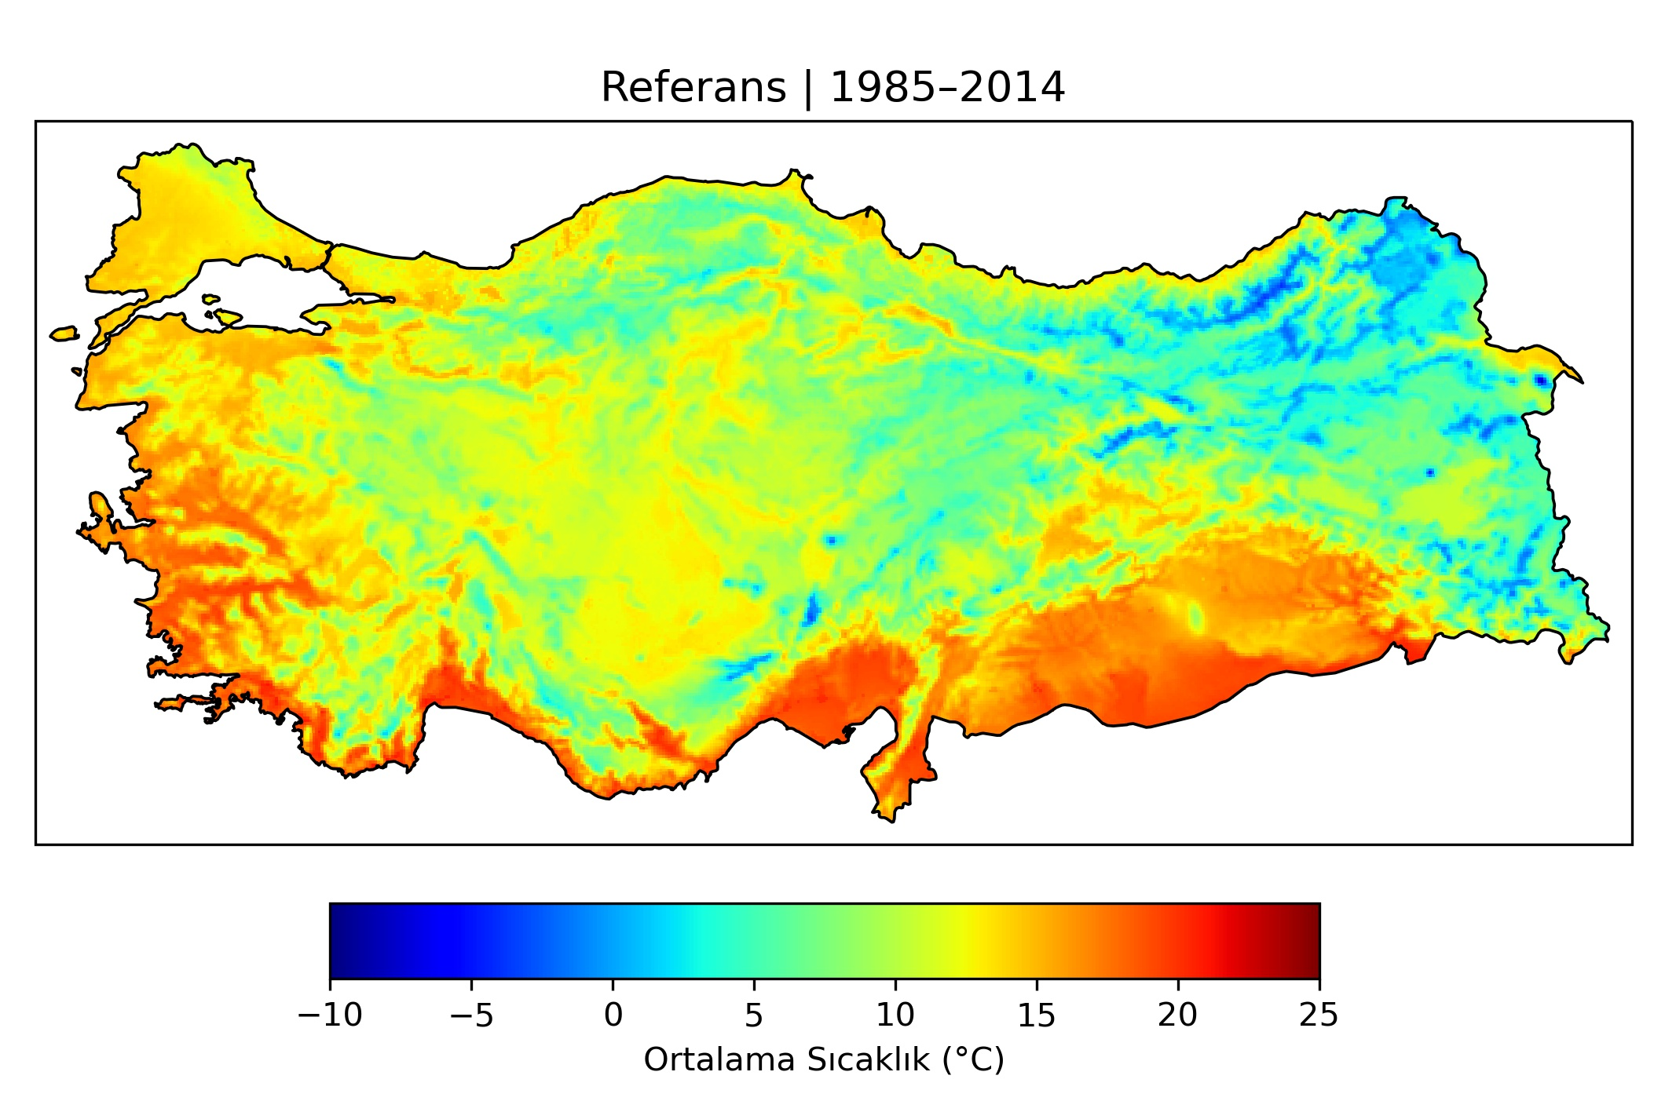
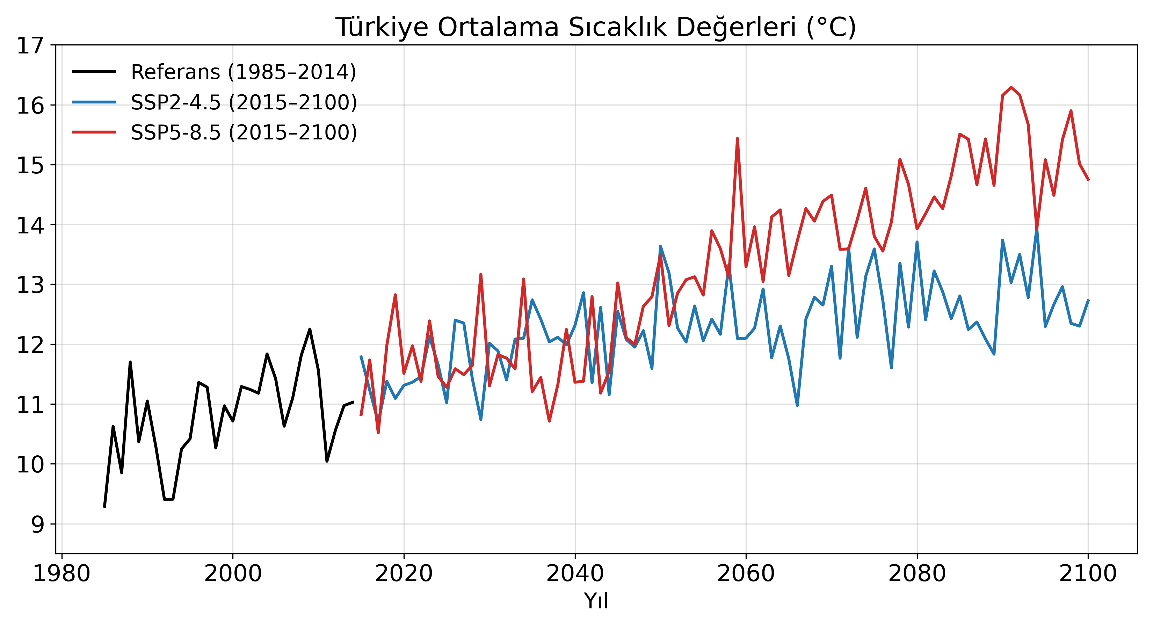
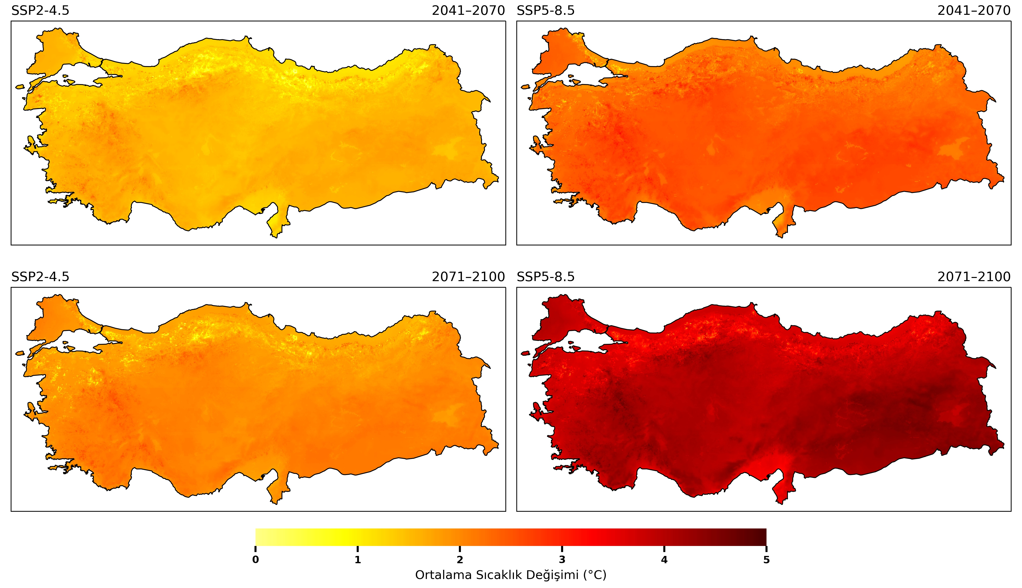
Changes in Climate

Slide 9
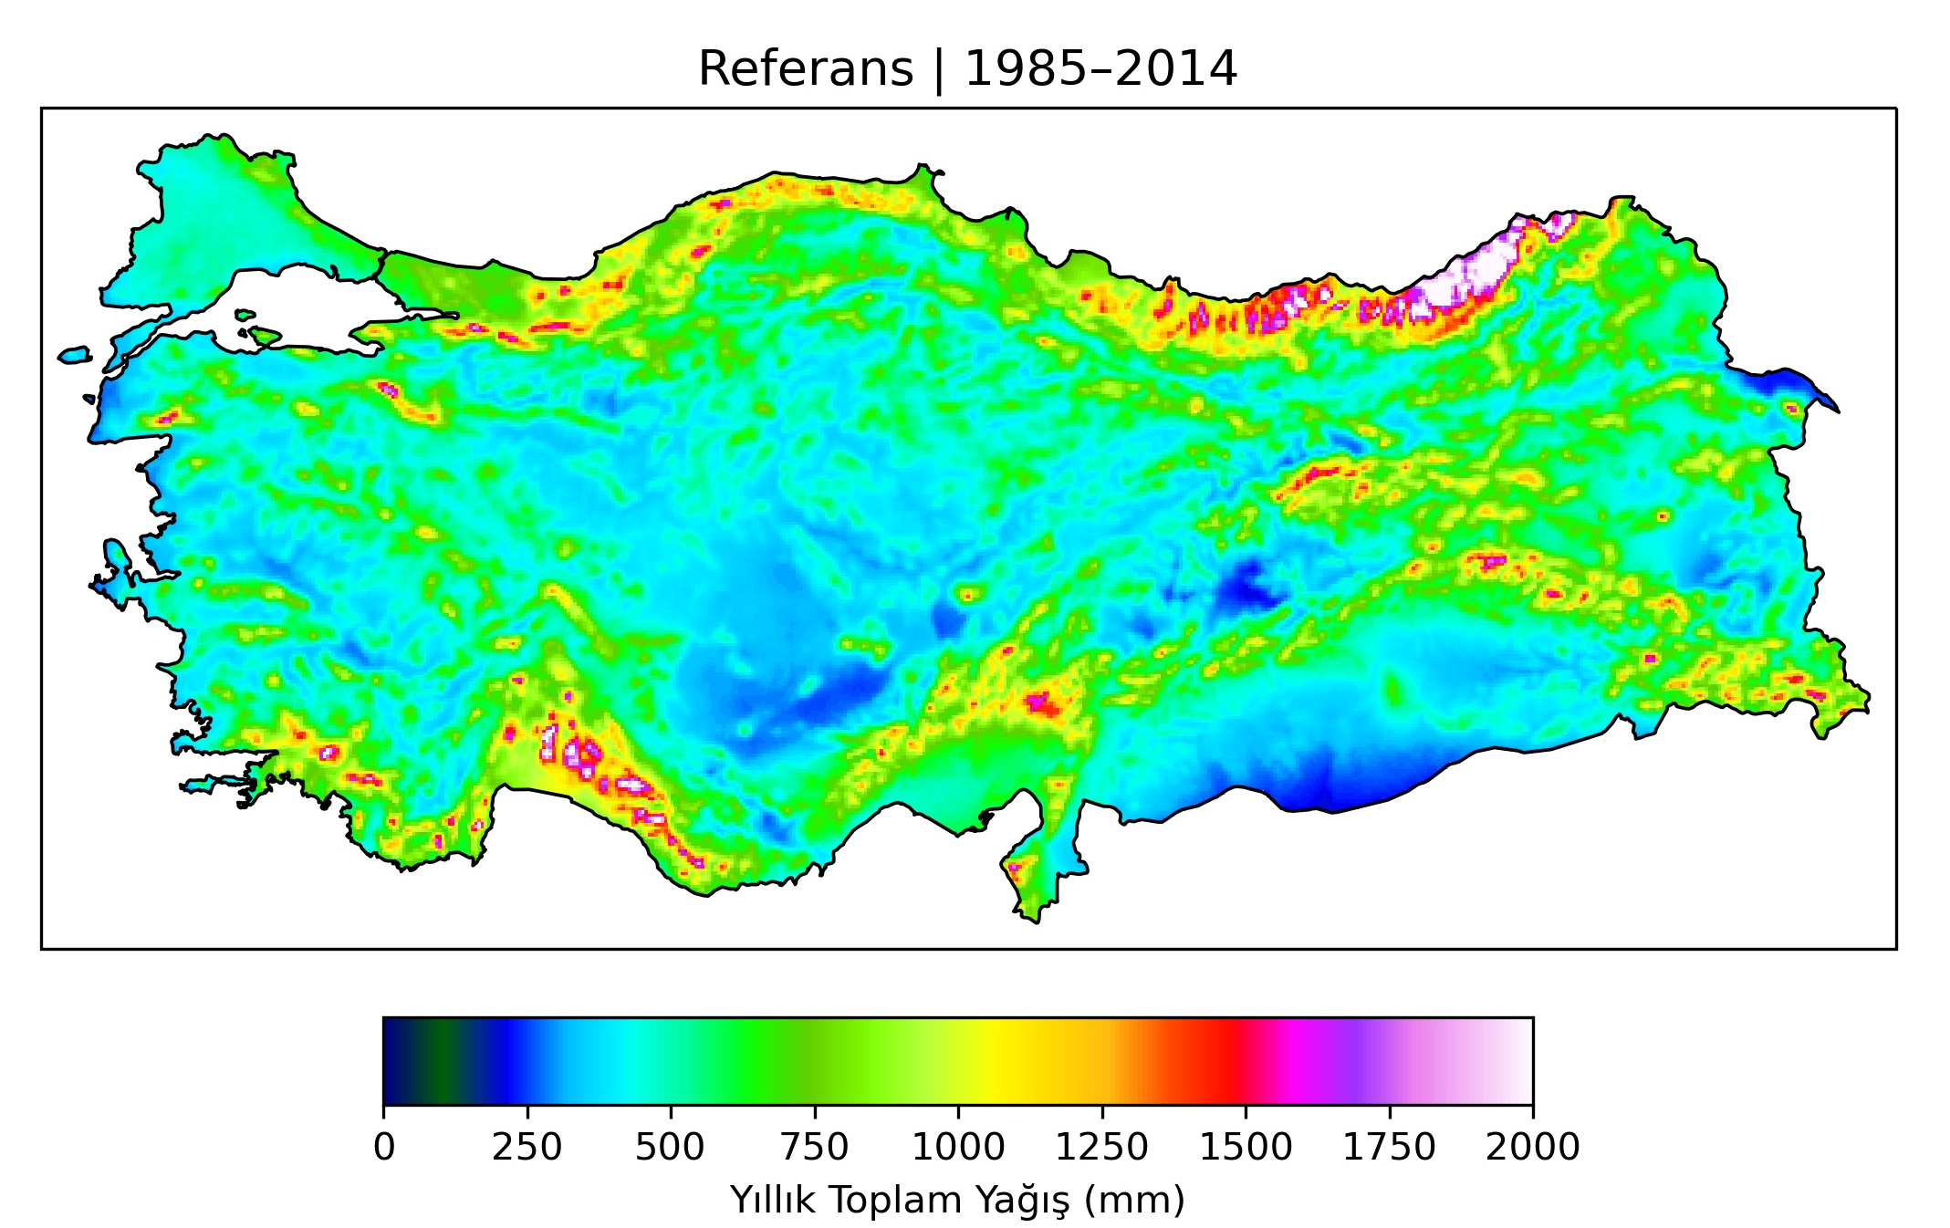
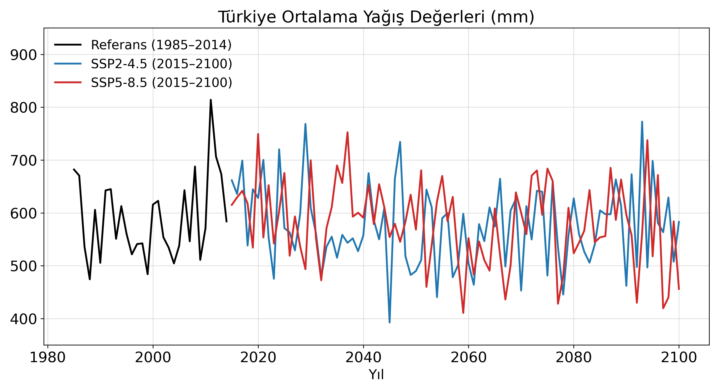
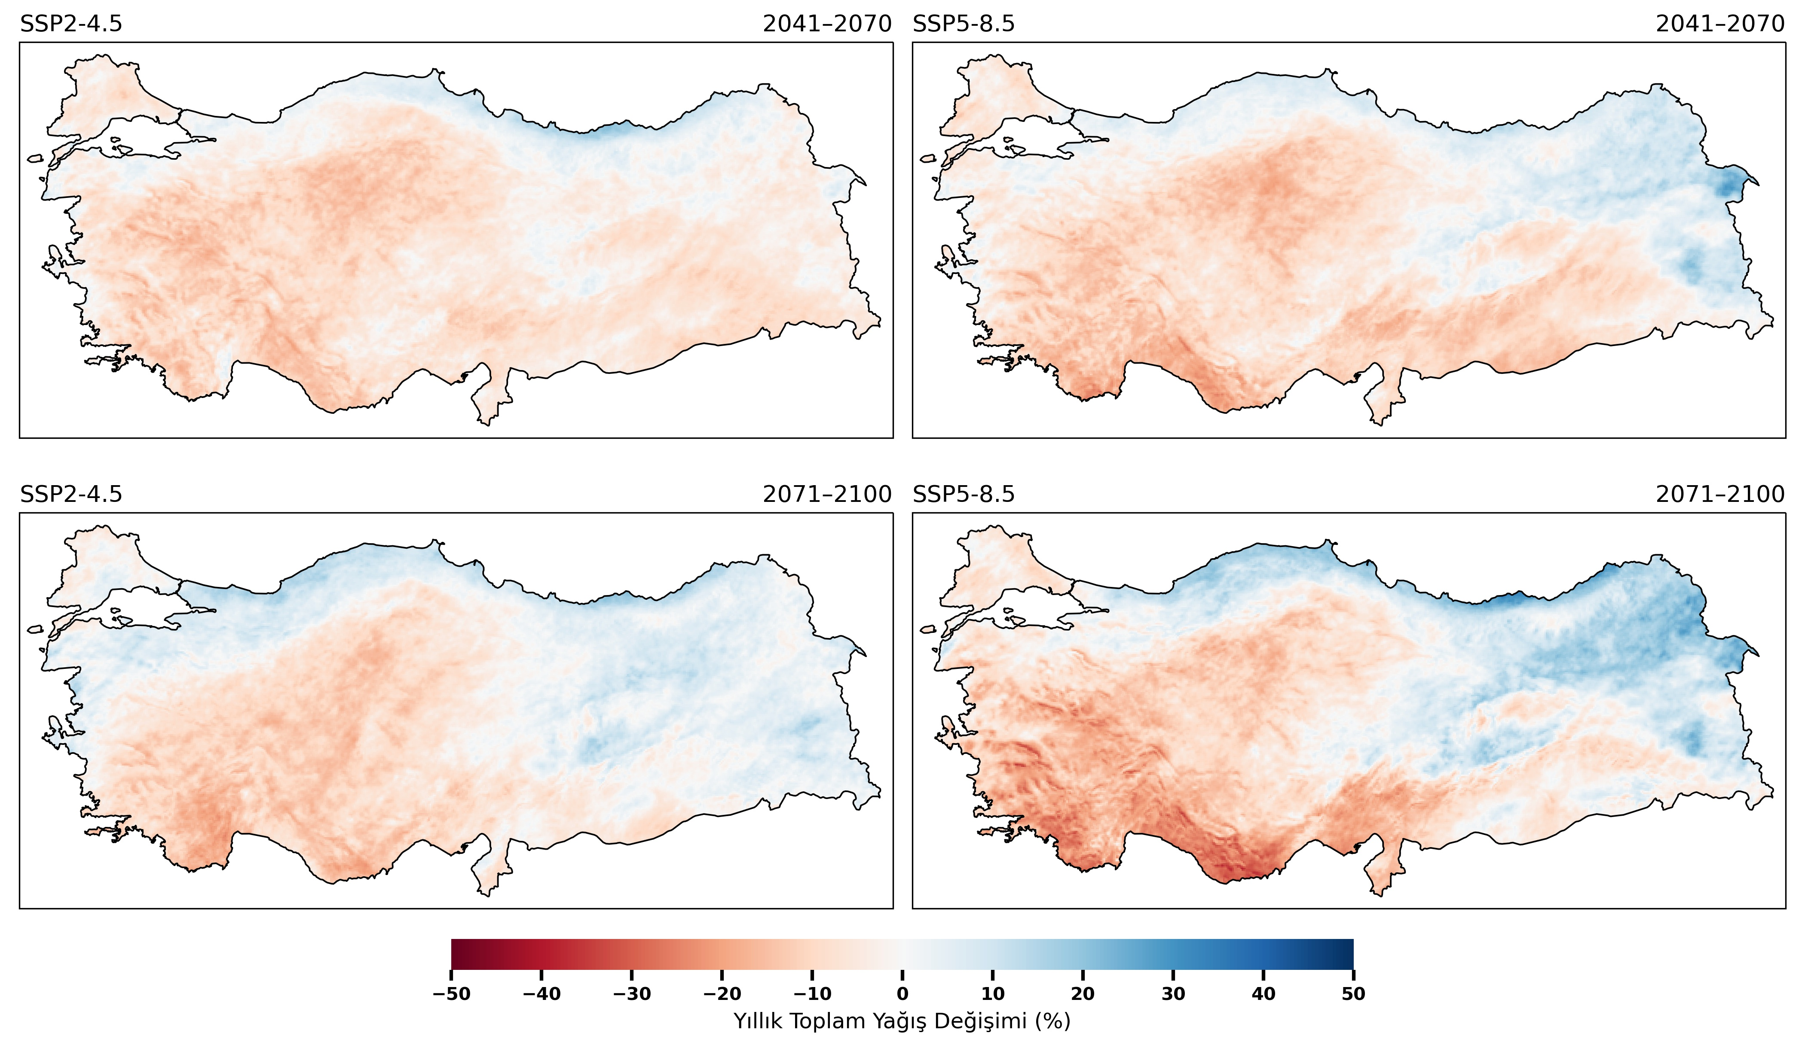
Climate Projections for Türkiye - Precipitation

Slide 10
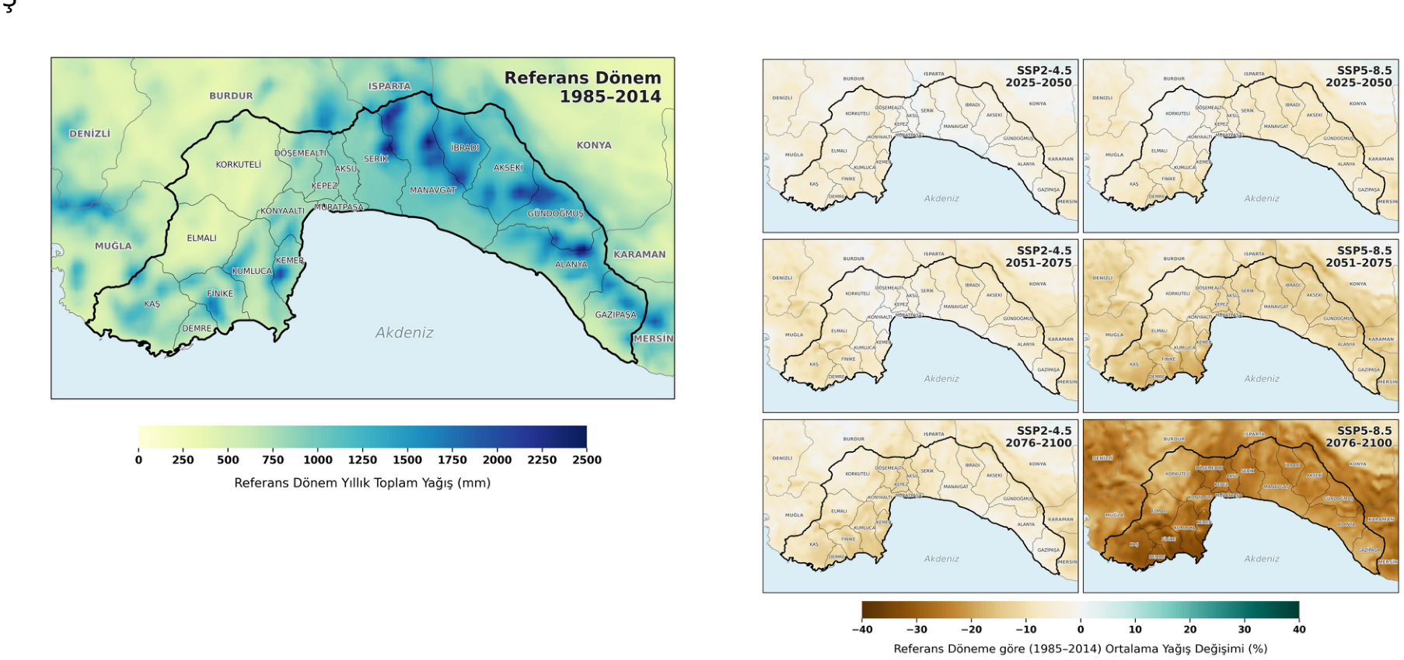
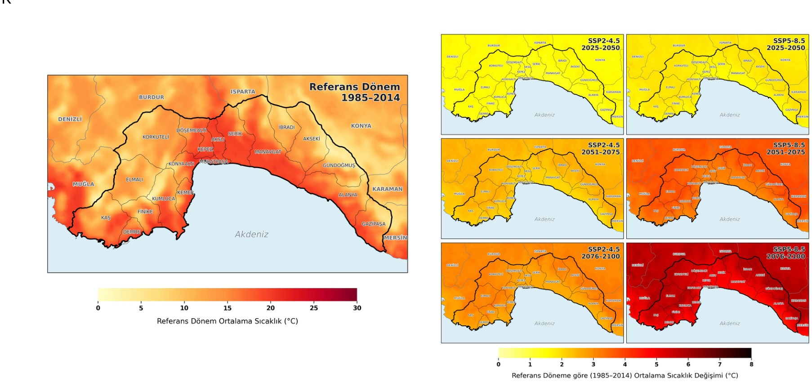
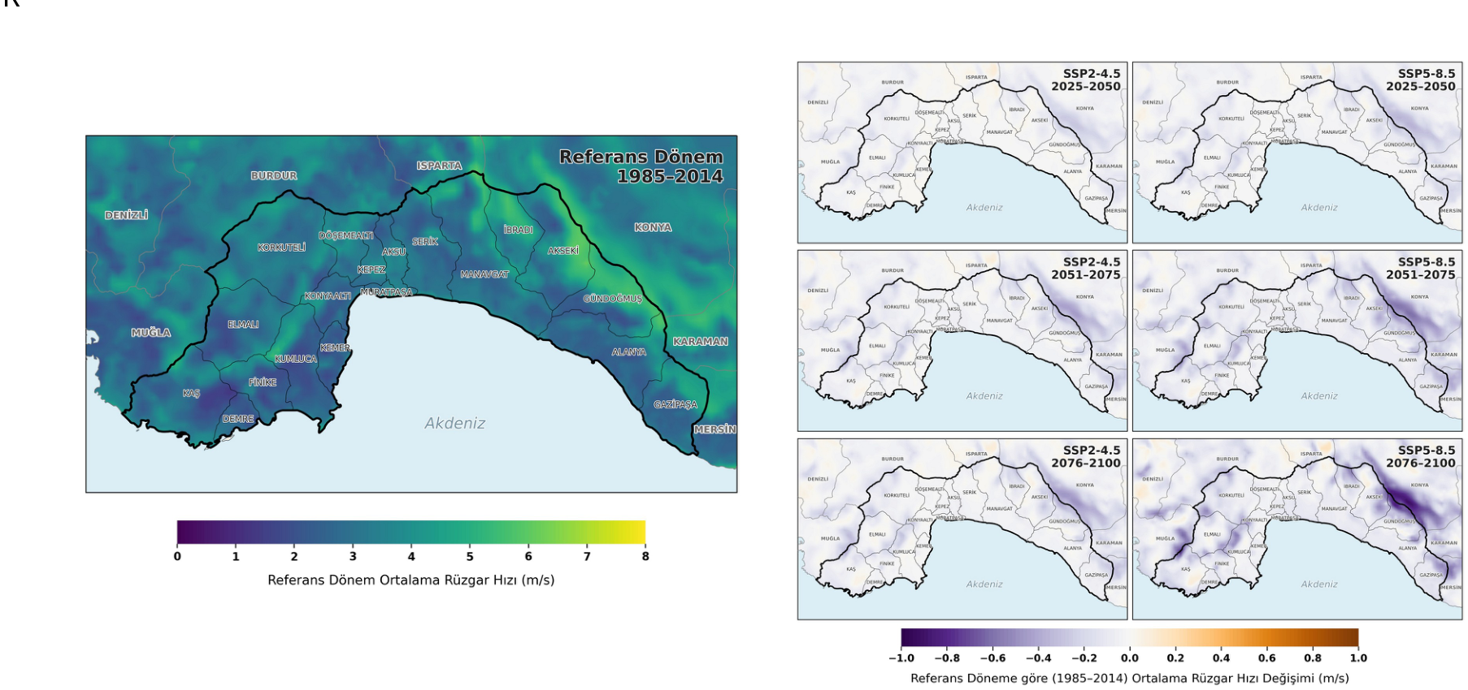
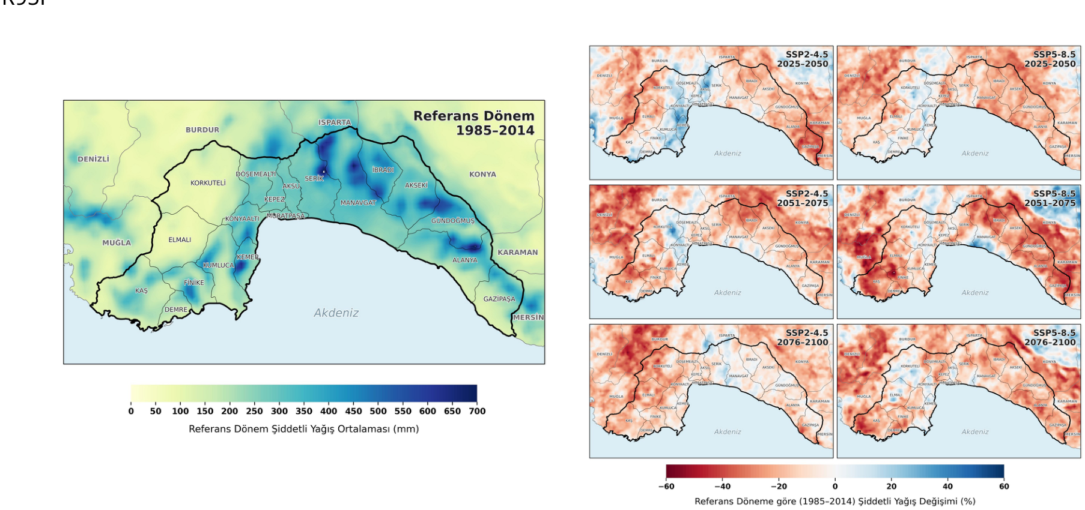
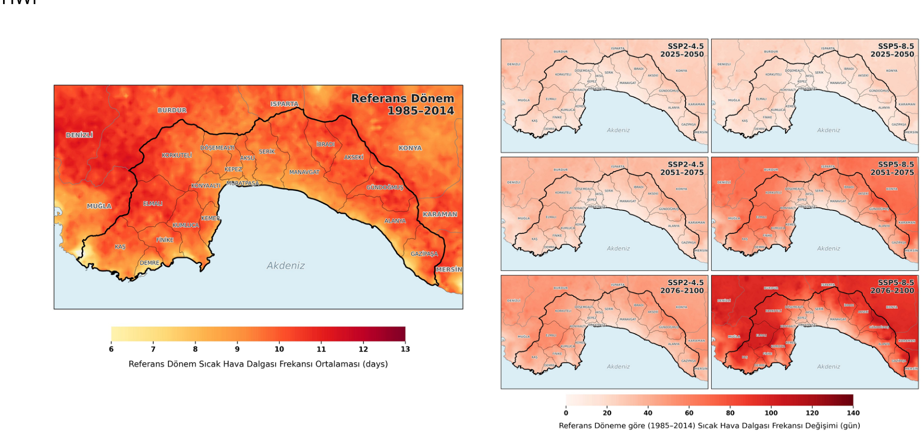
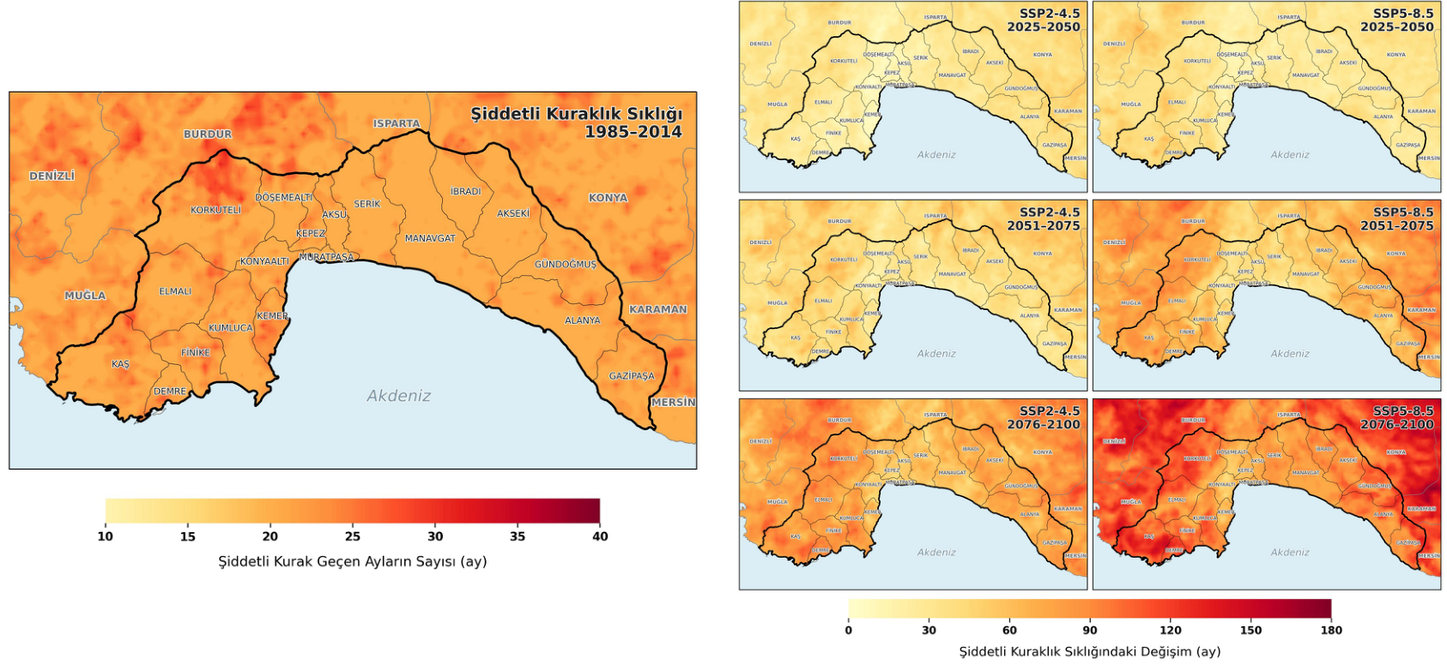
Antalya Case – Change in Climate
PRECIPITATION
TEMPERATURE
WIND
HEAVY PRECIPITATION
HEATWAVE
DROUGHT

Slide 11
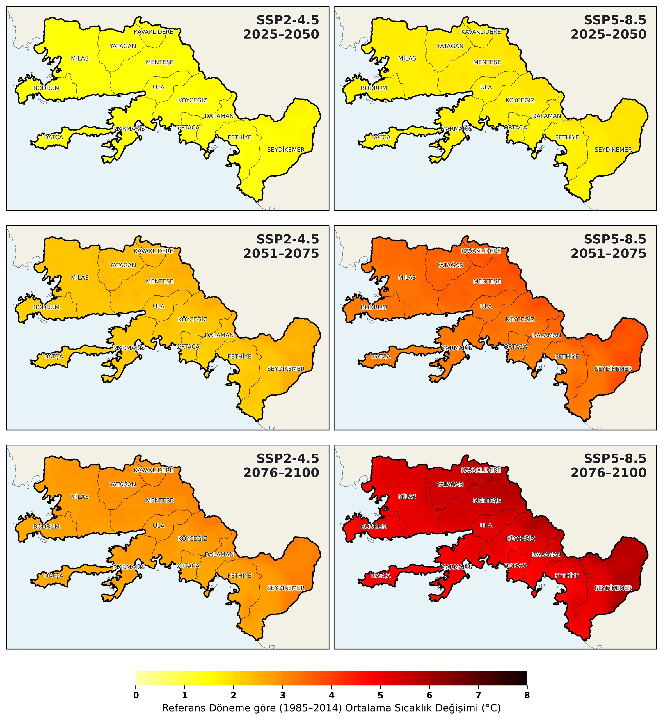
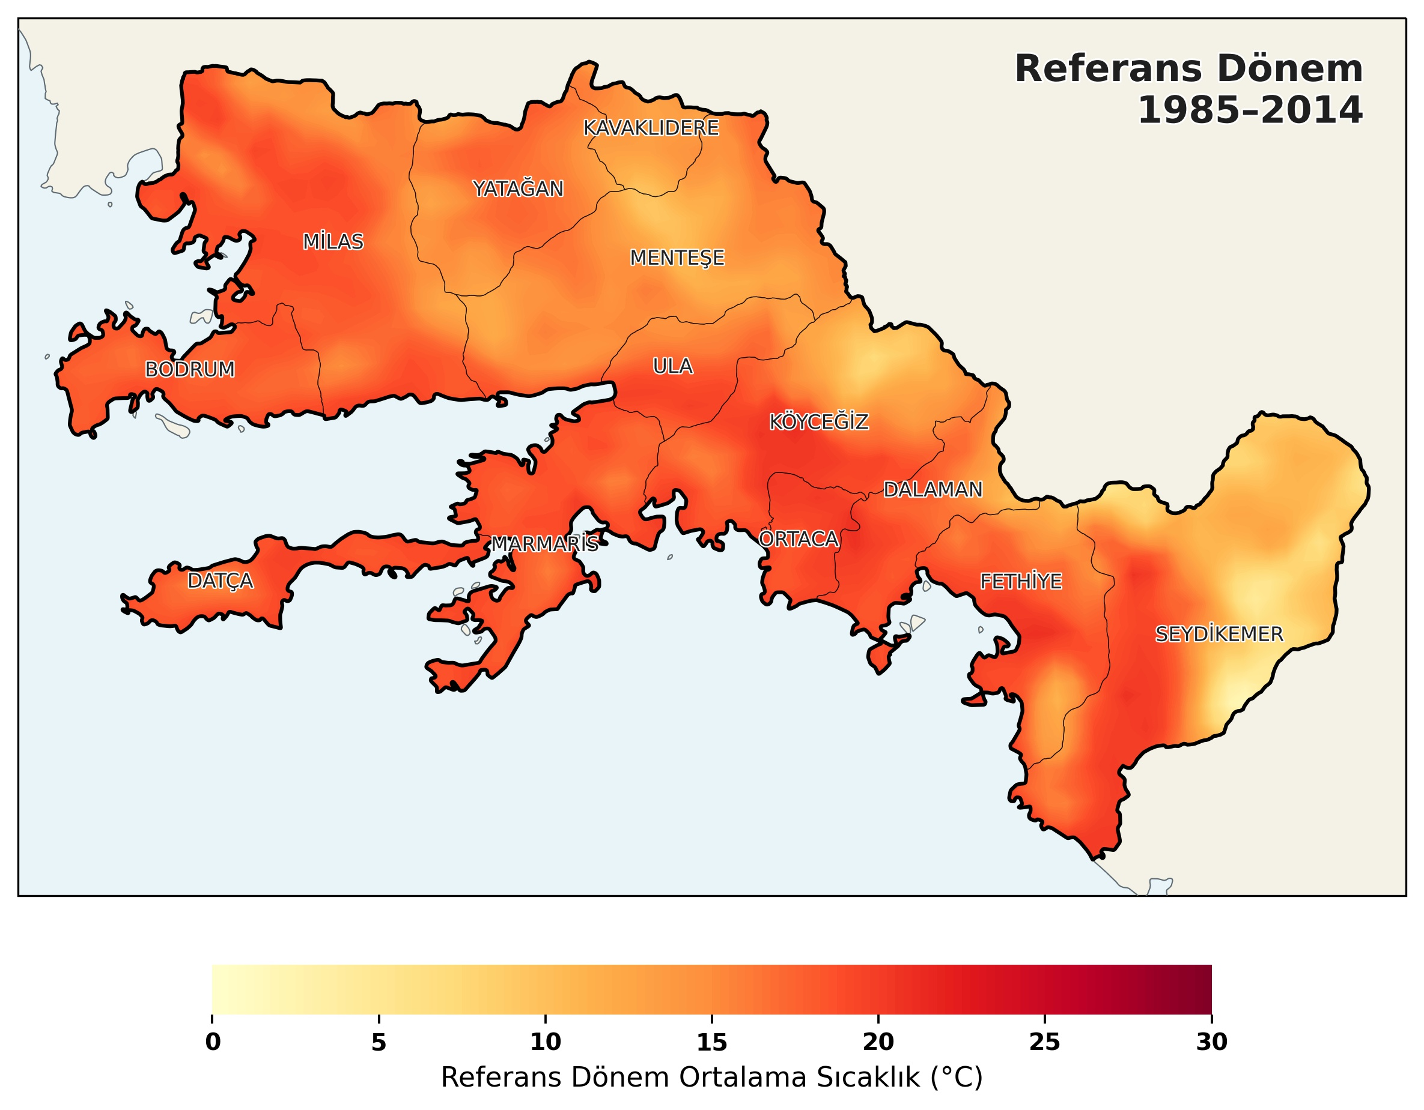
Muğla Case – Change in Climate
Temperature

Slide 12
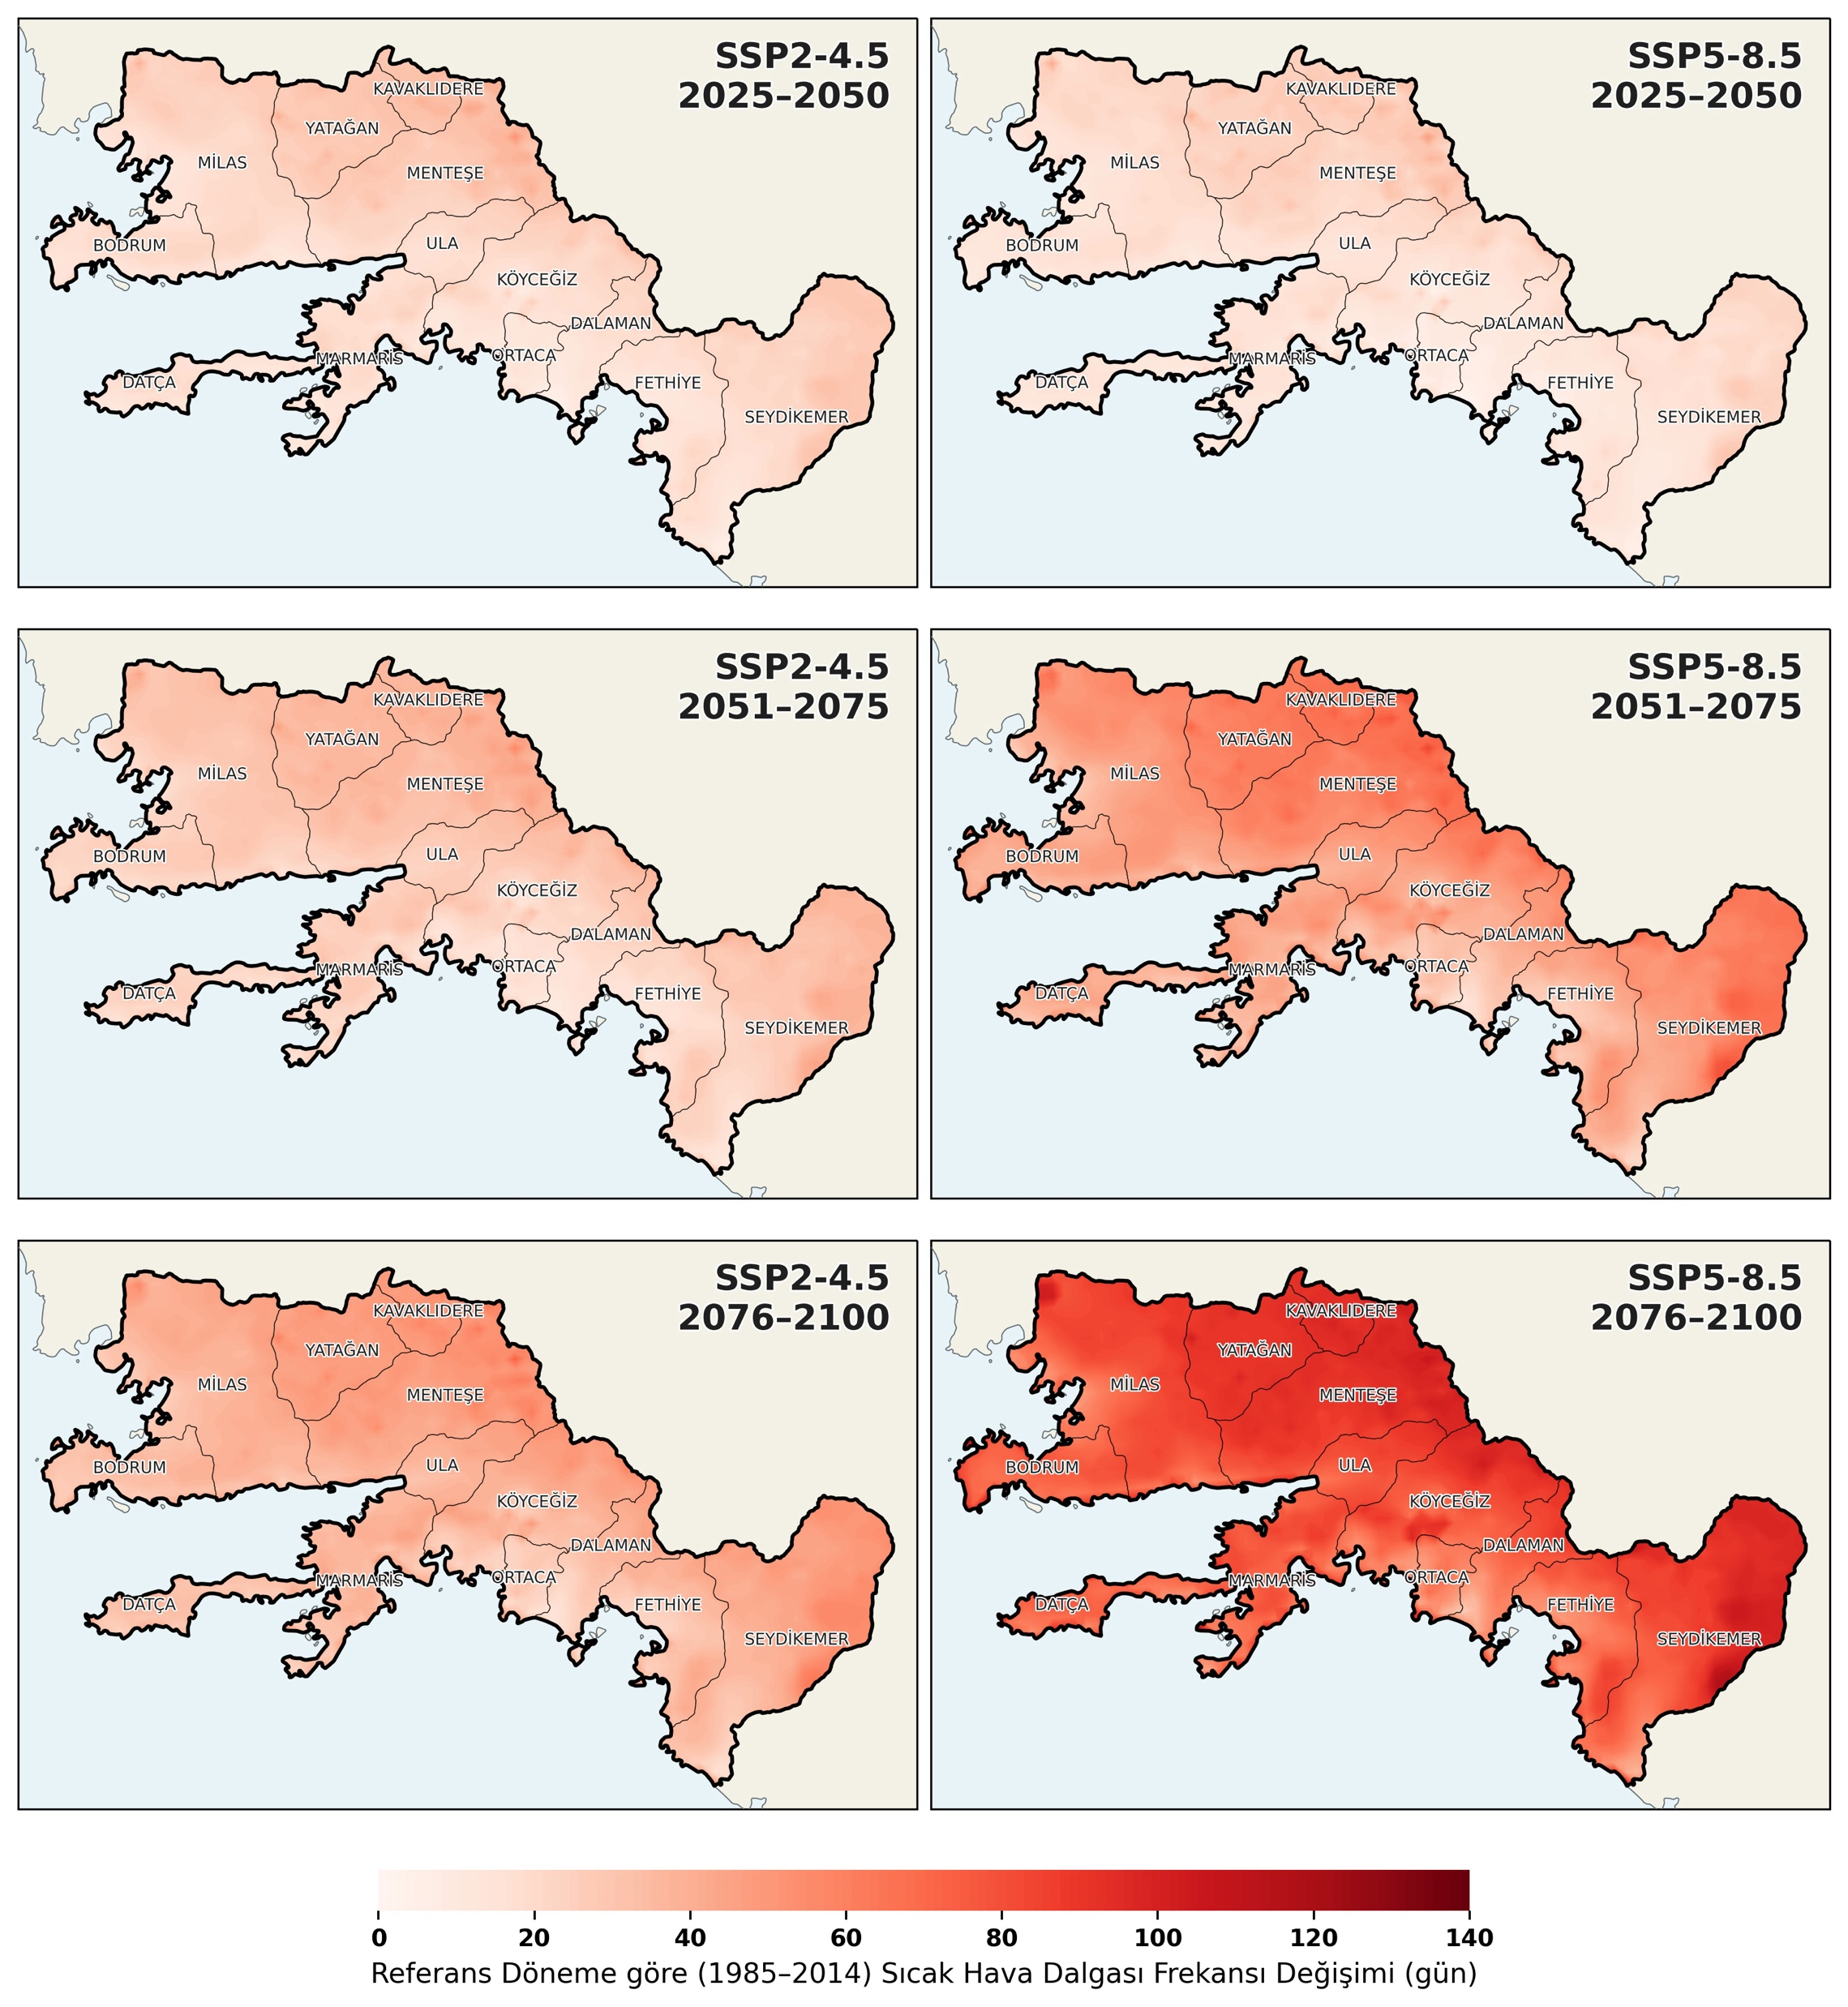
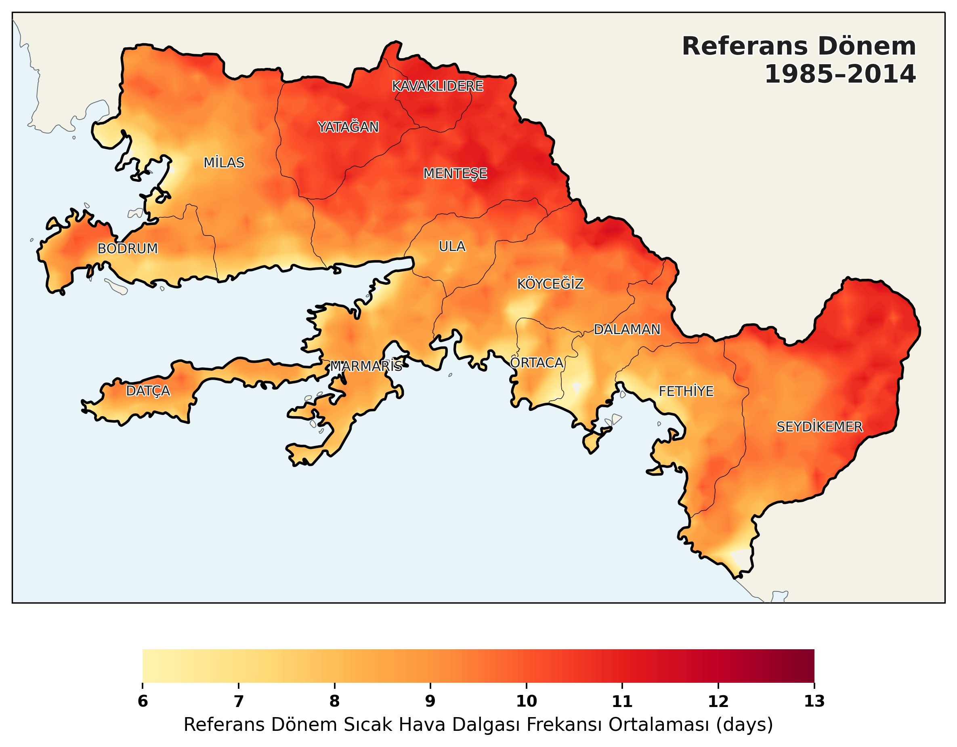
≈
Muğla Case – Change in Climate
Heatwave

Slide 13
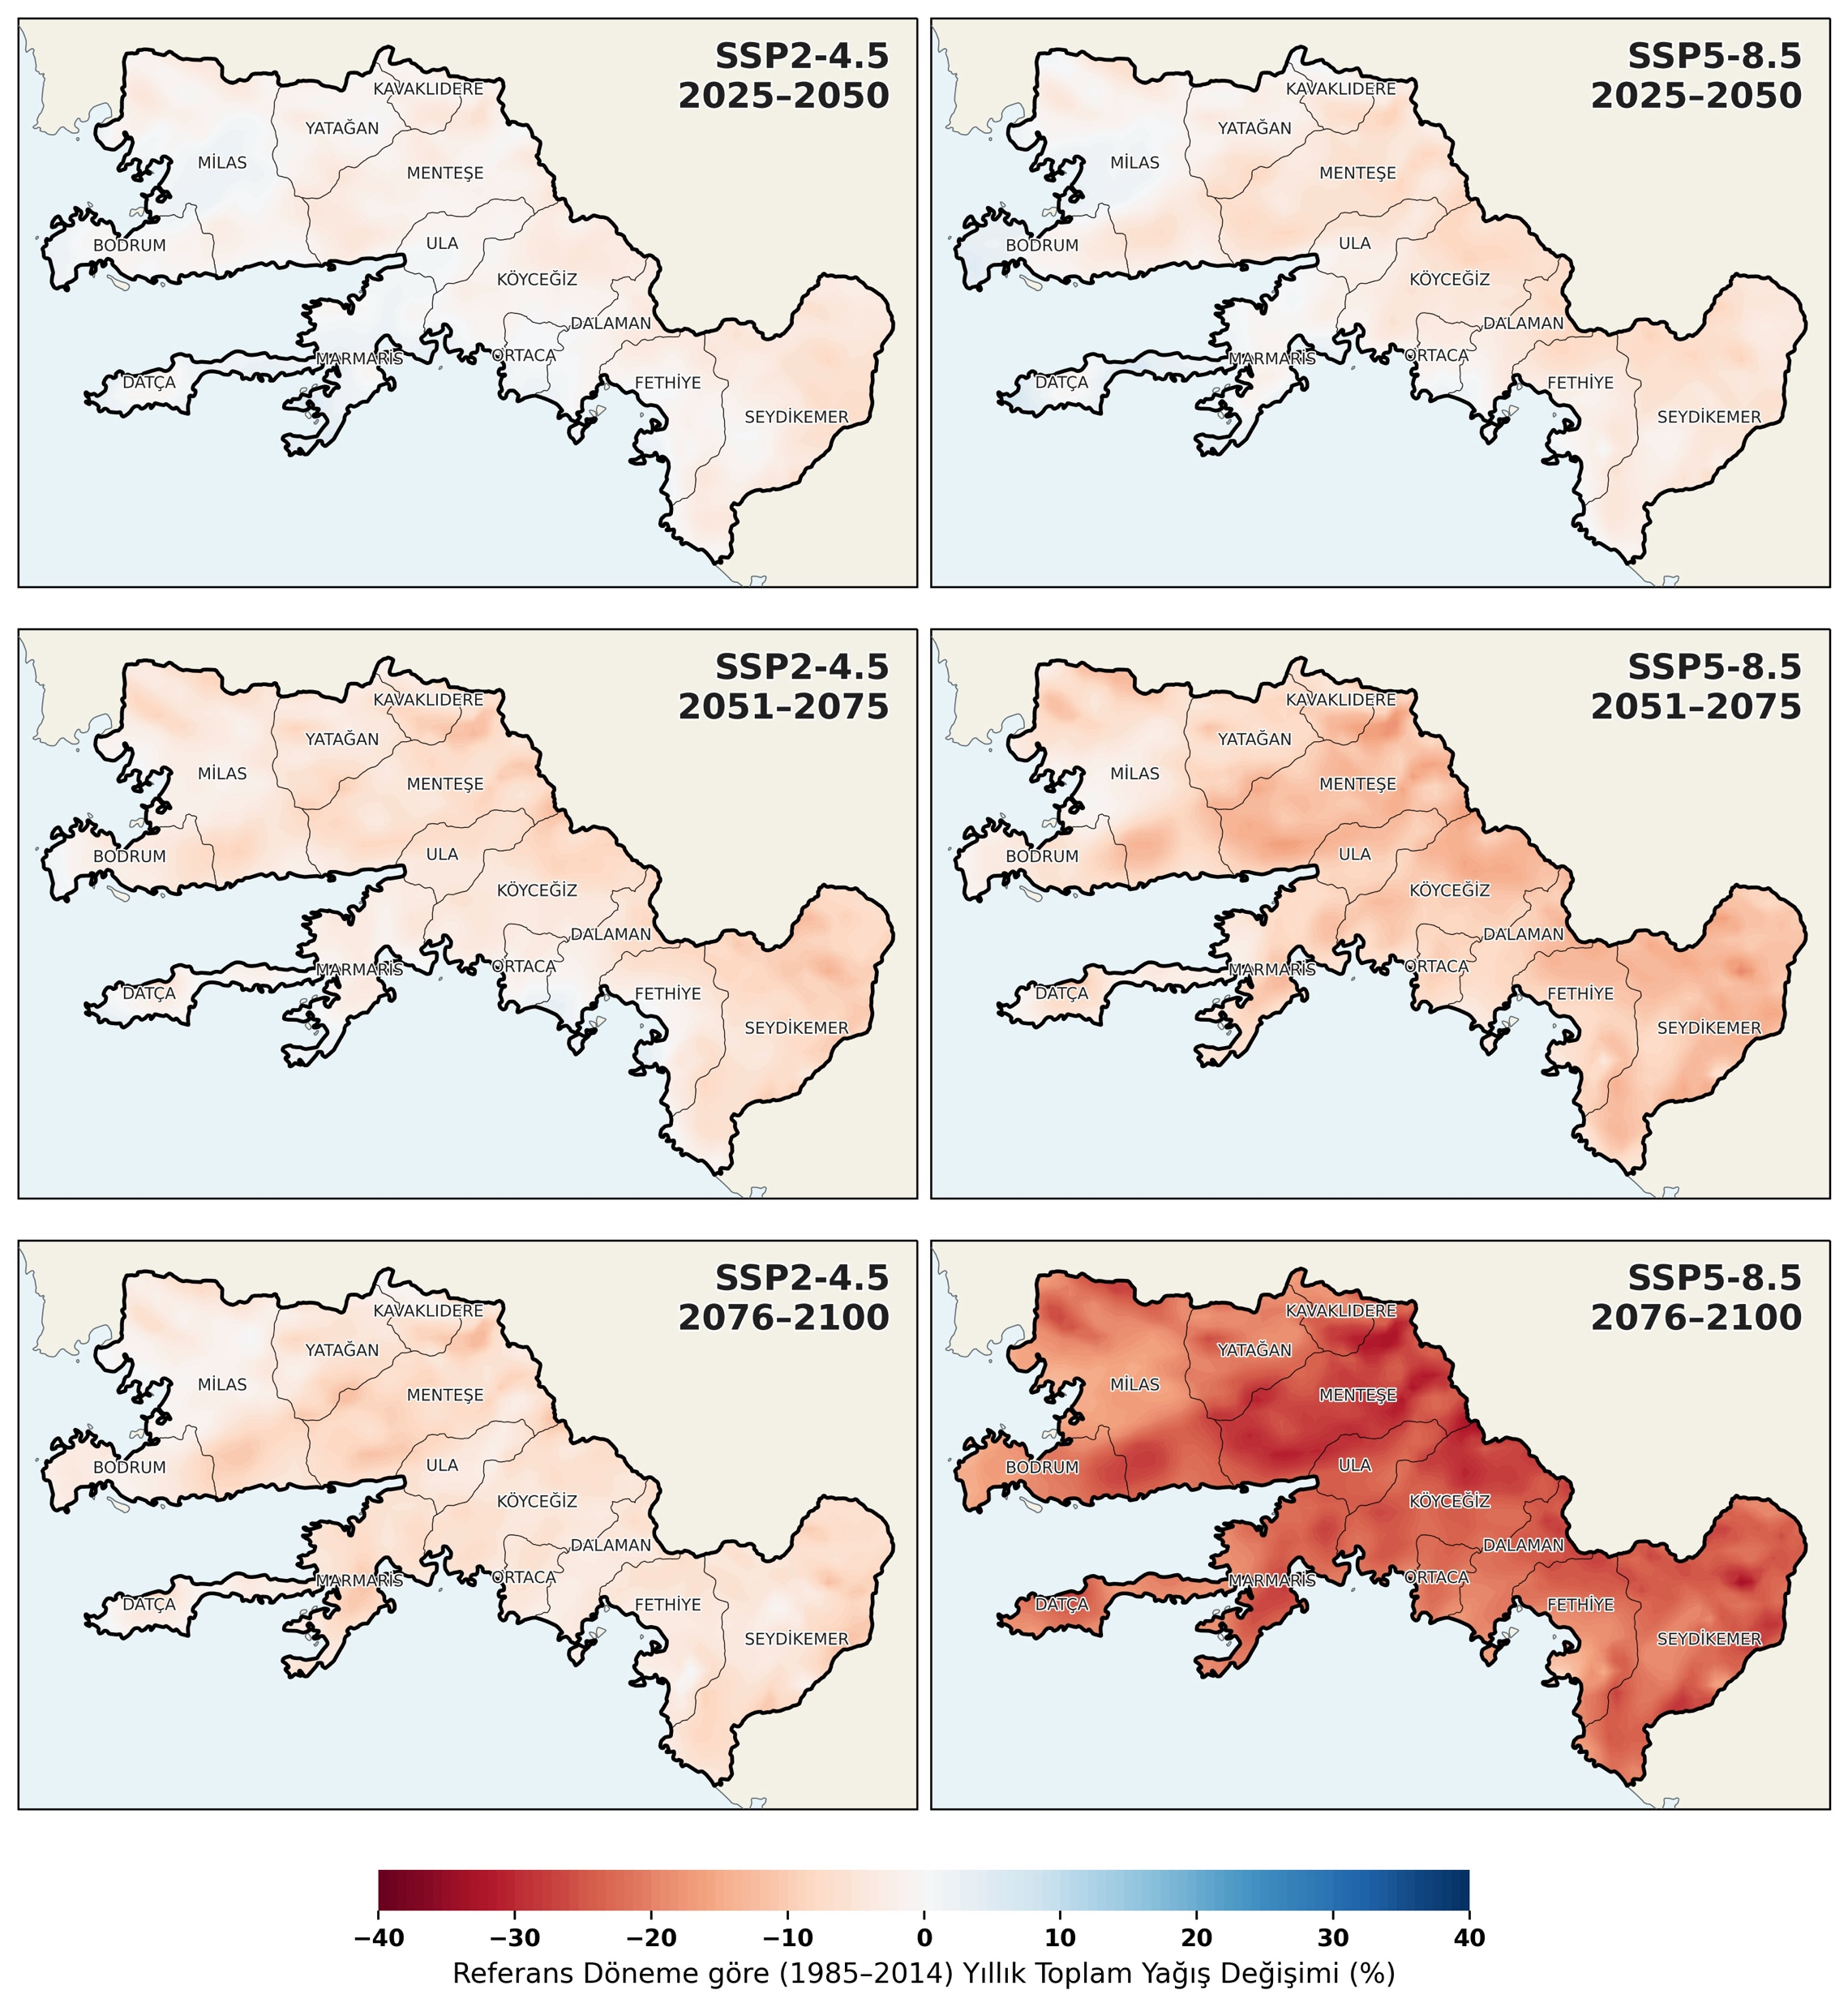
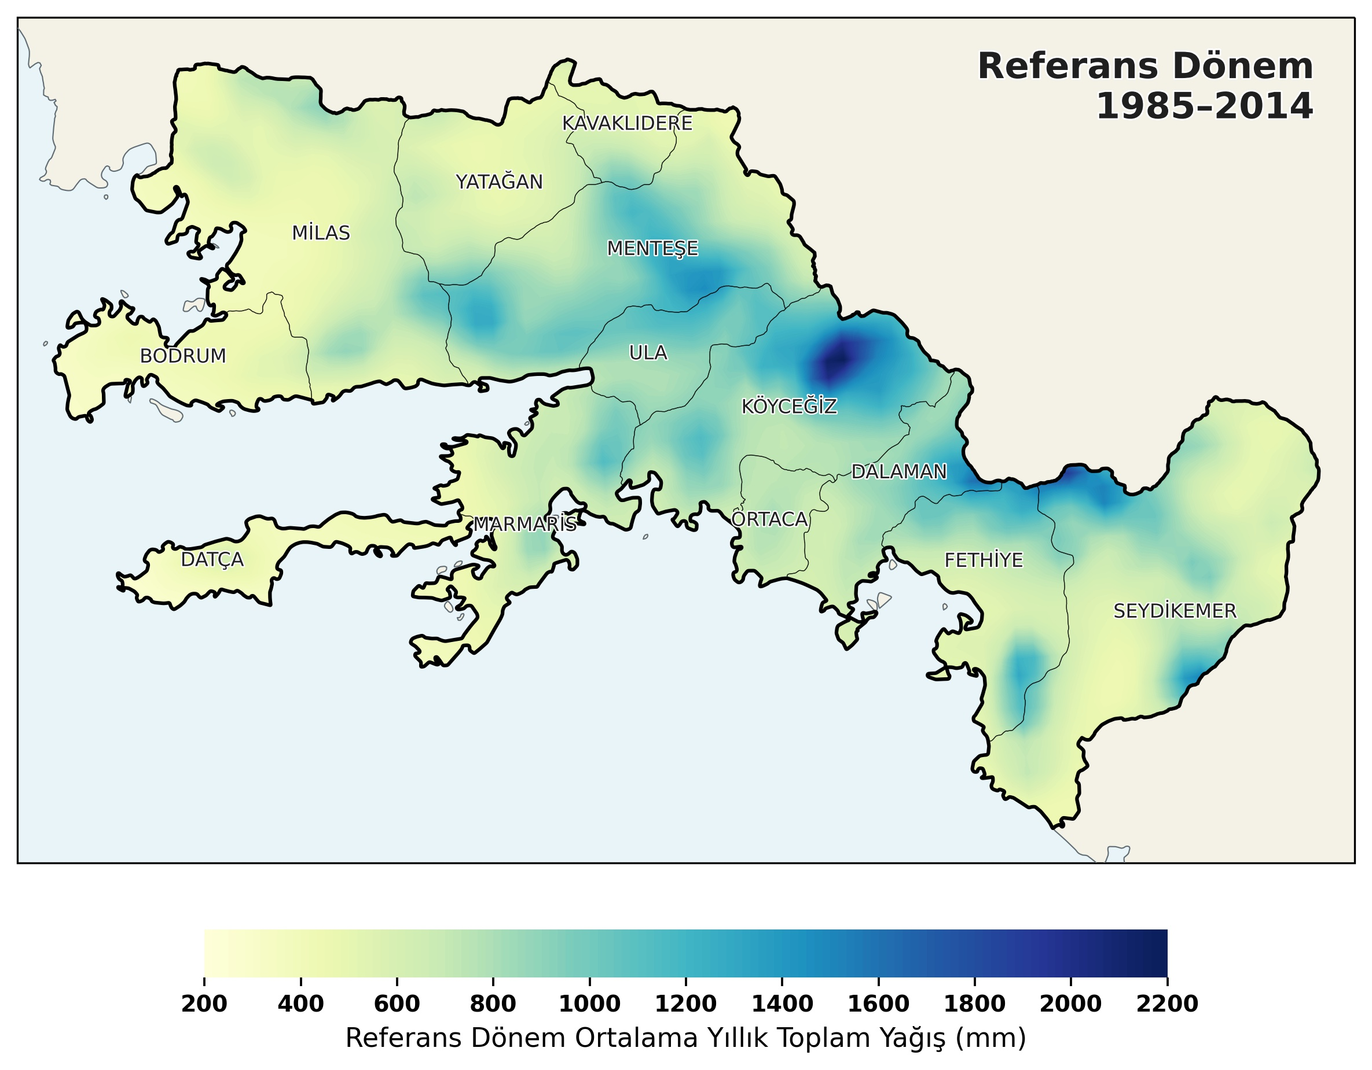
≈
Muğla Case – Change in Climate
Precipitation

Slide 14
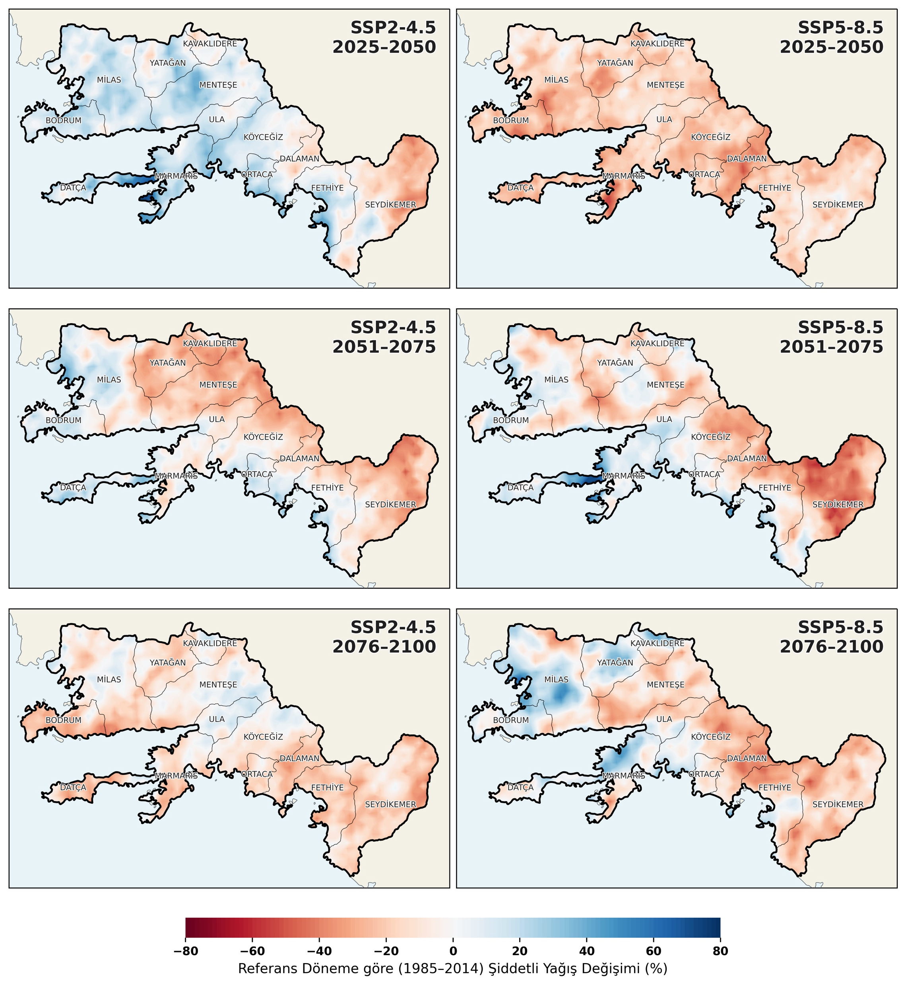
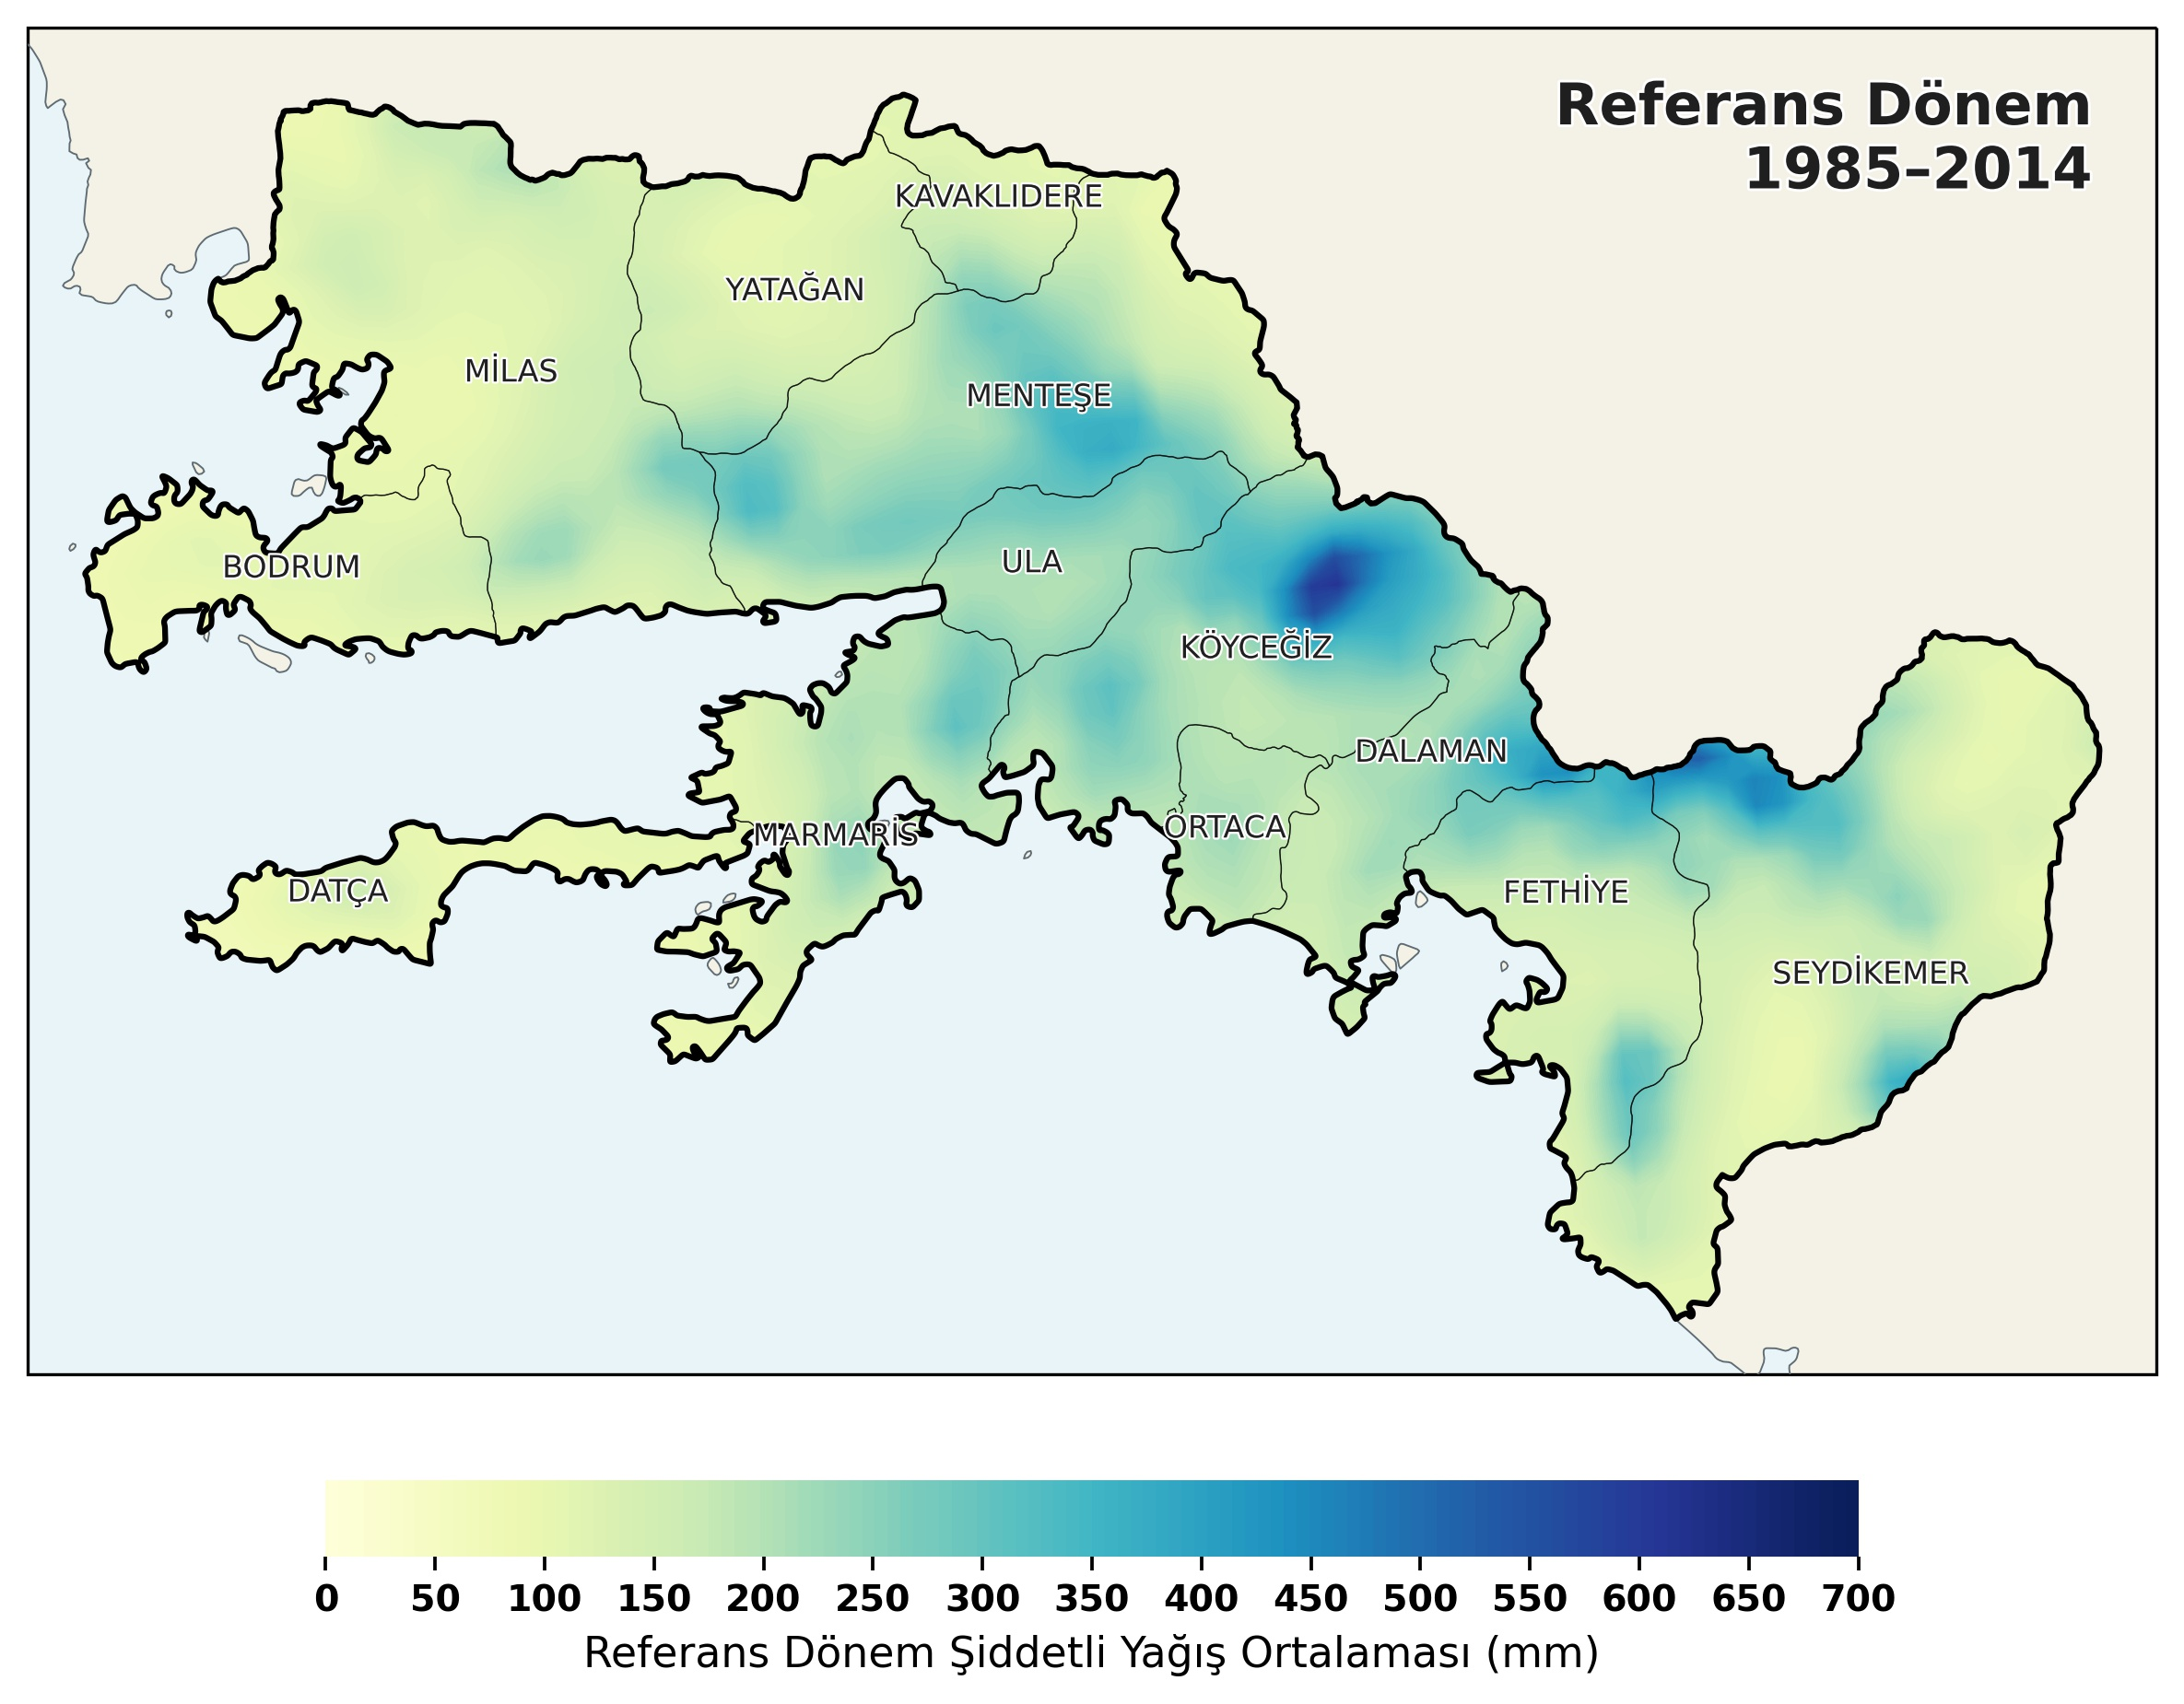
≈
Muğla Case – Change in Climate
Extreme Precipitation

Slide 15
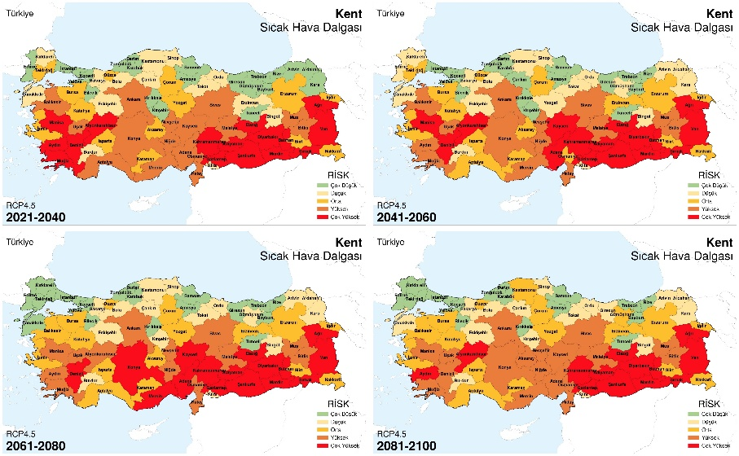
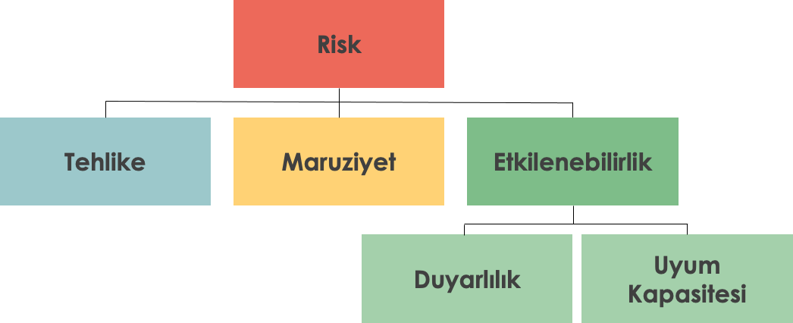
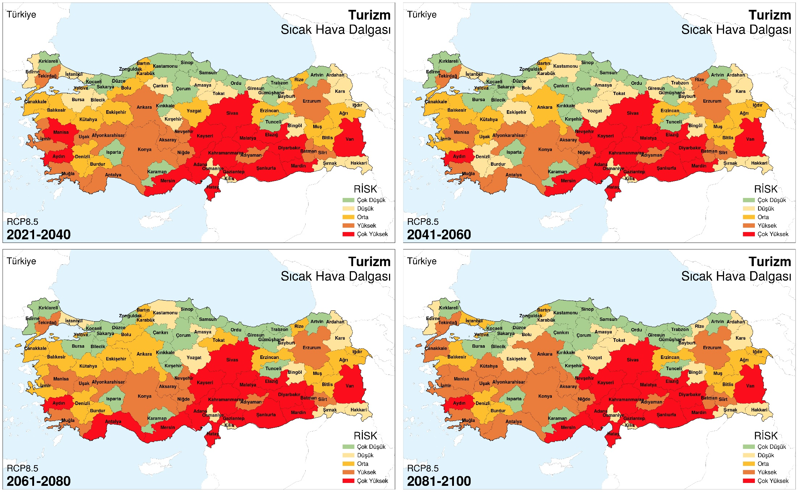
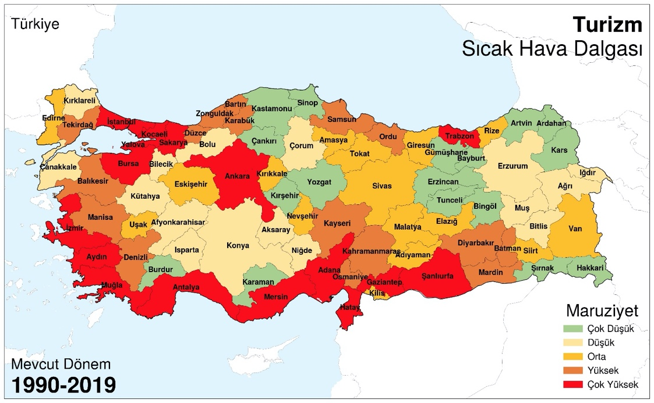
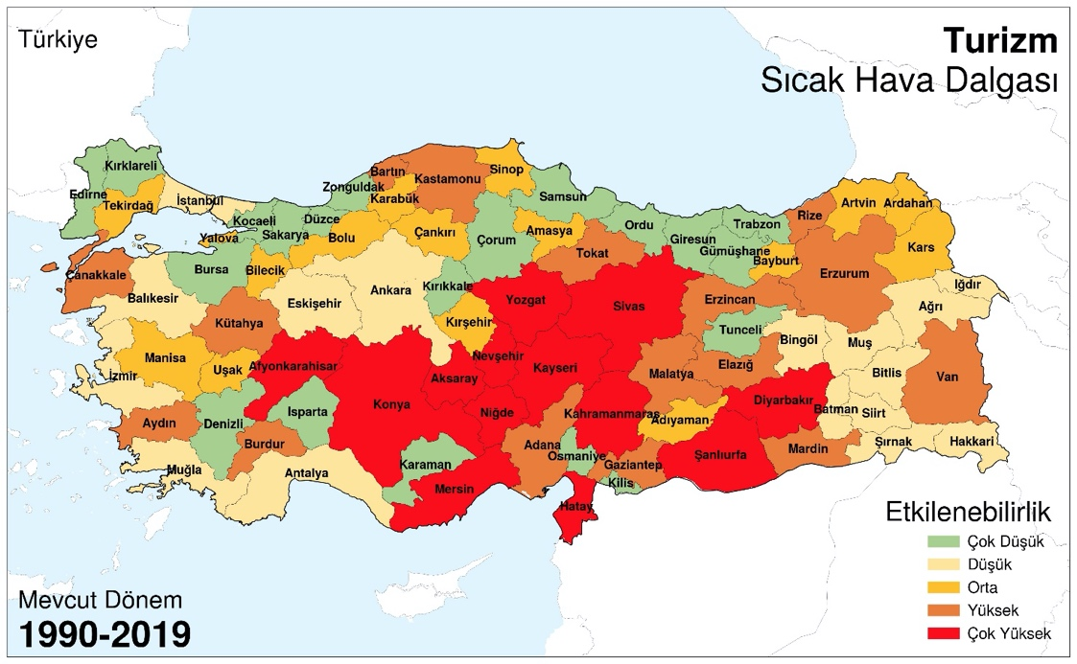
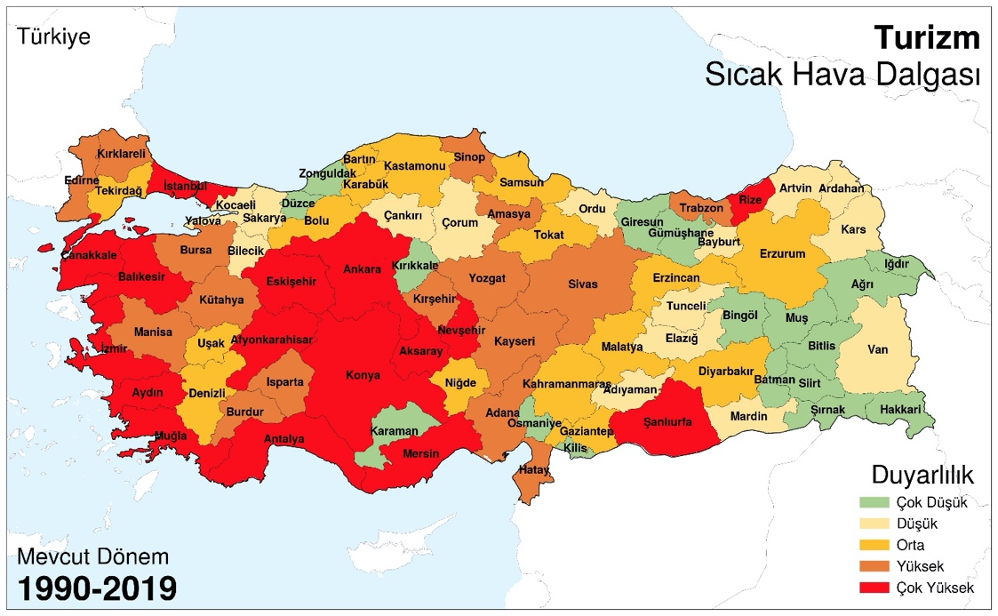
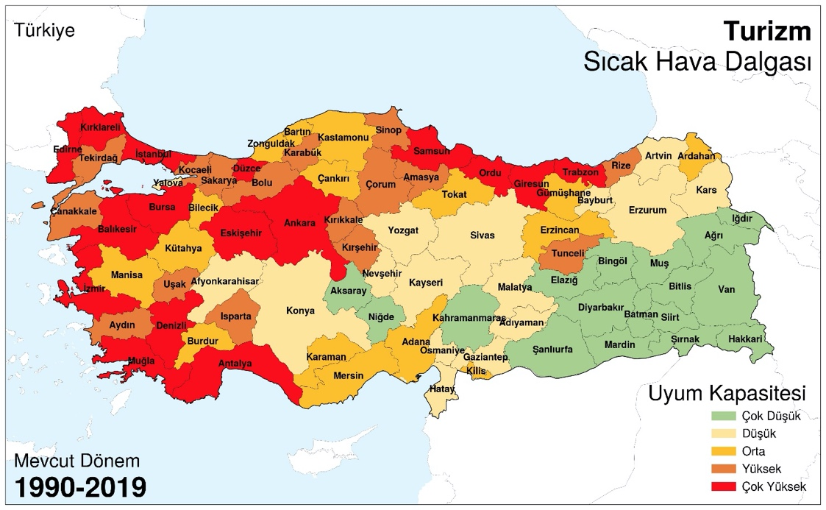
Risk
Hazard
Exposure
Vulnerability
Sensitivity
Adaptive Capacity
Sektörel Etkilenebilirlik ve Risk Analizi (İklime Uyum, 2022)

Slide 16
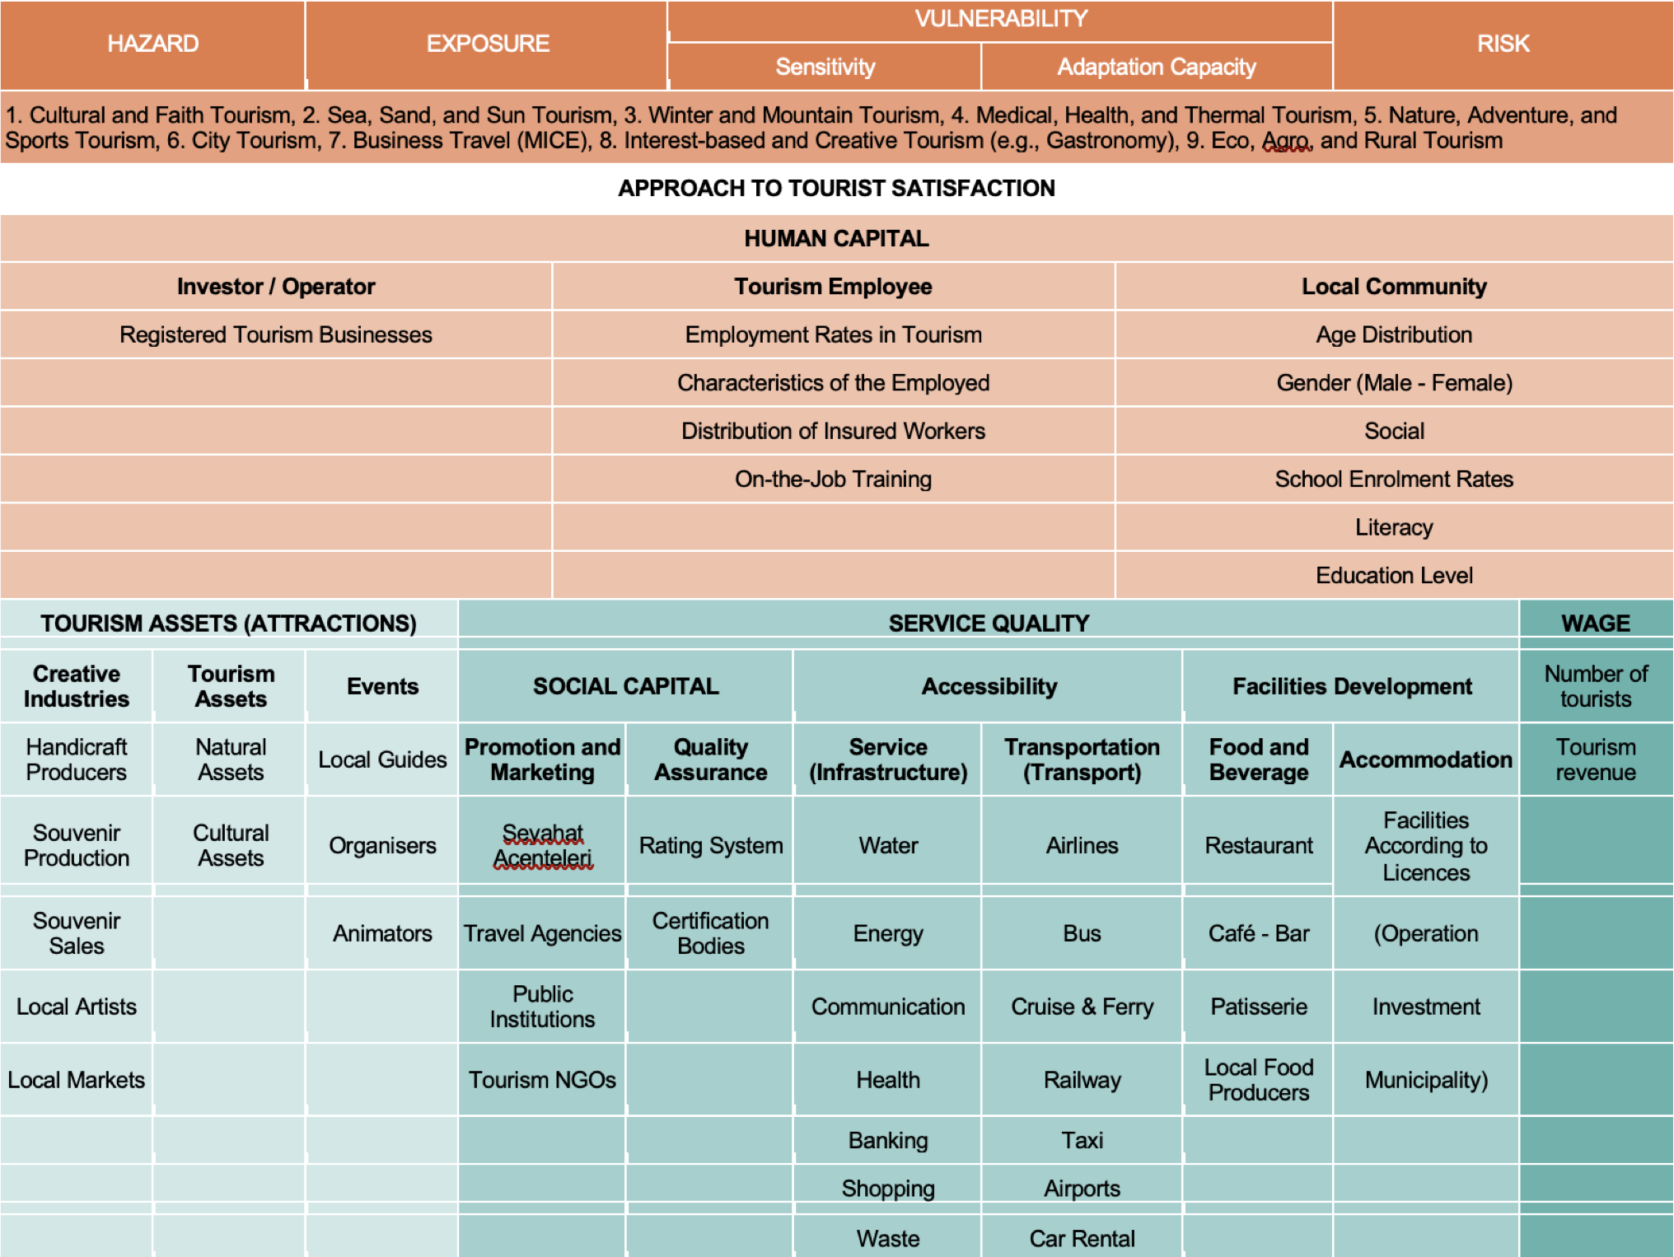
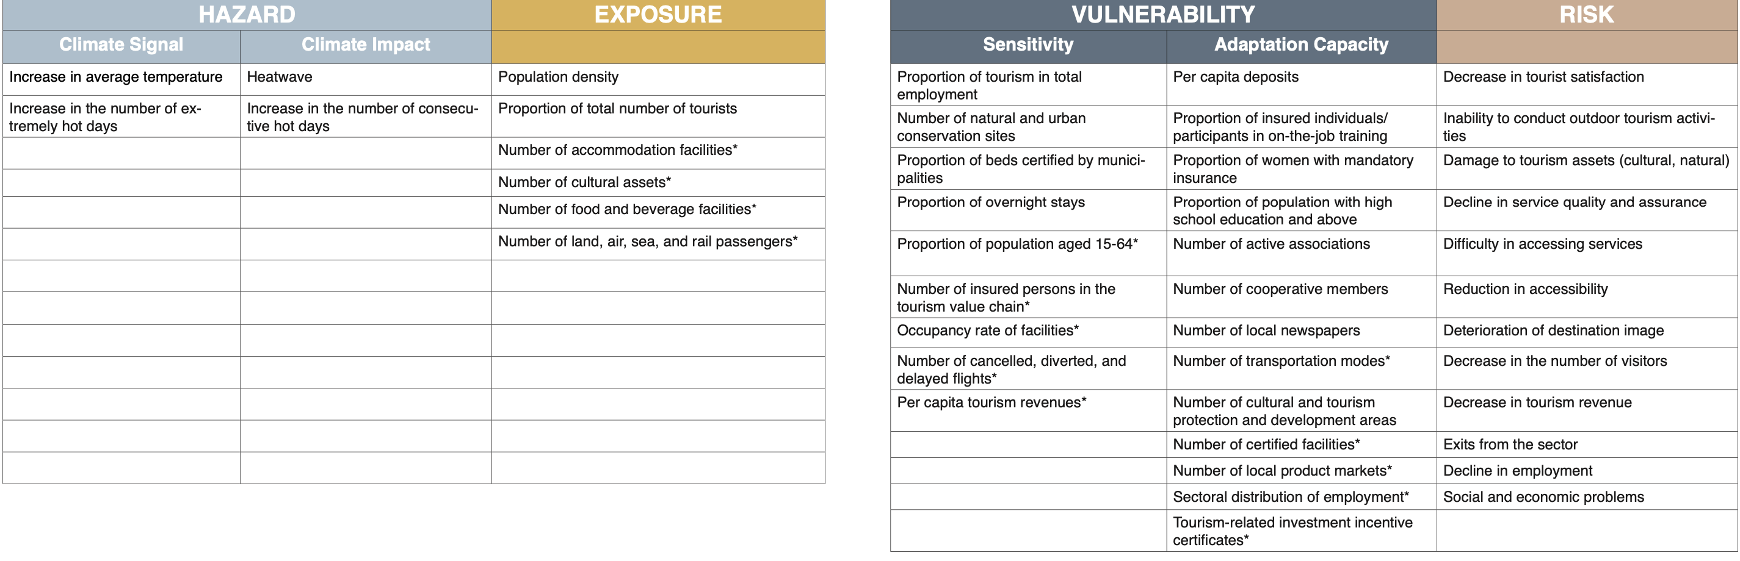
Impact Chain

Slide 17
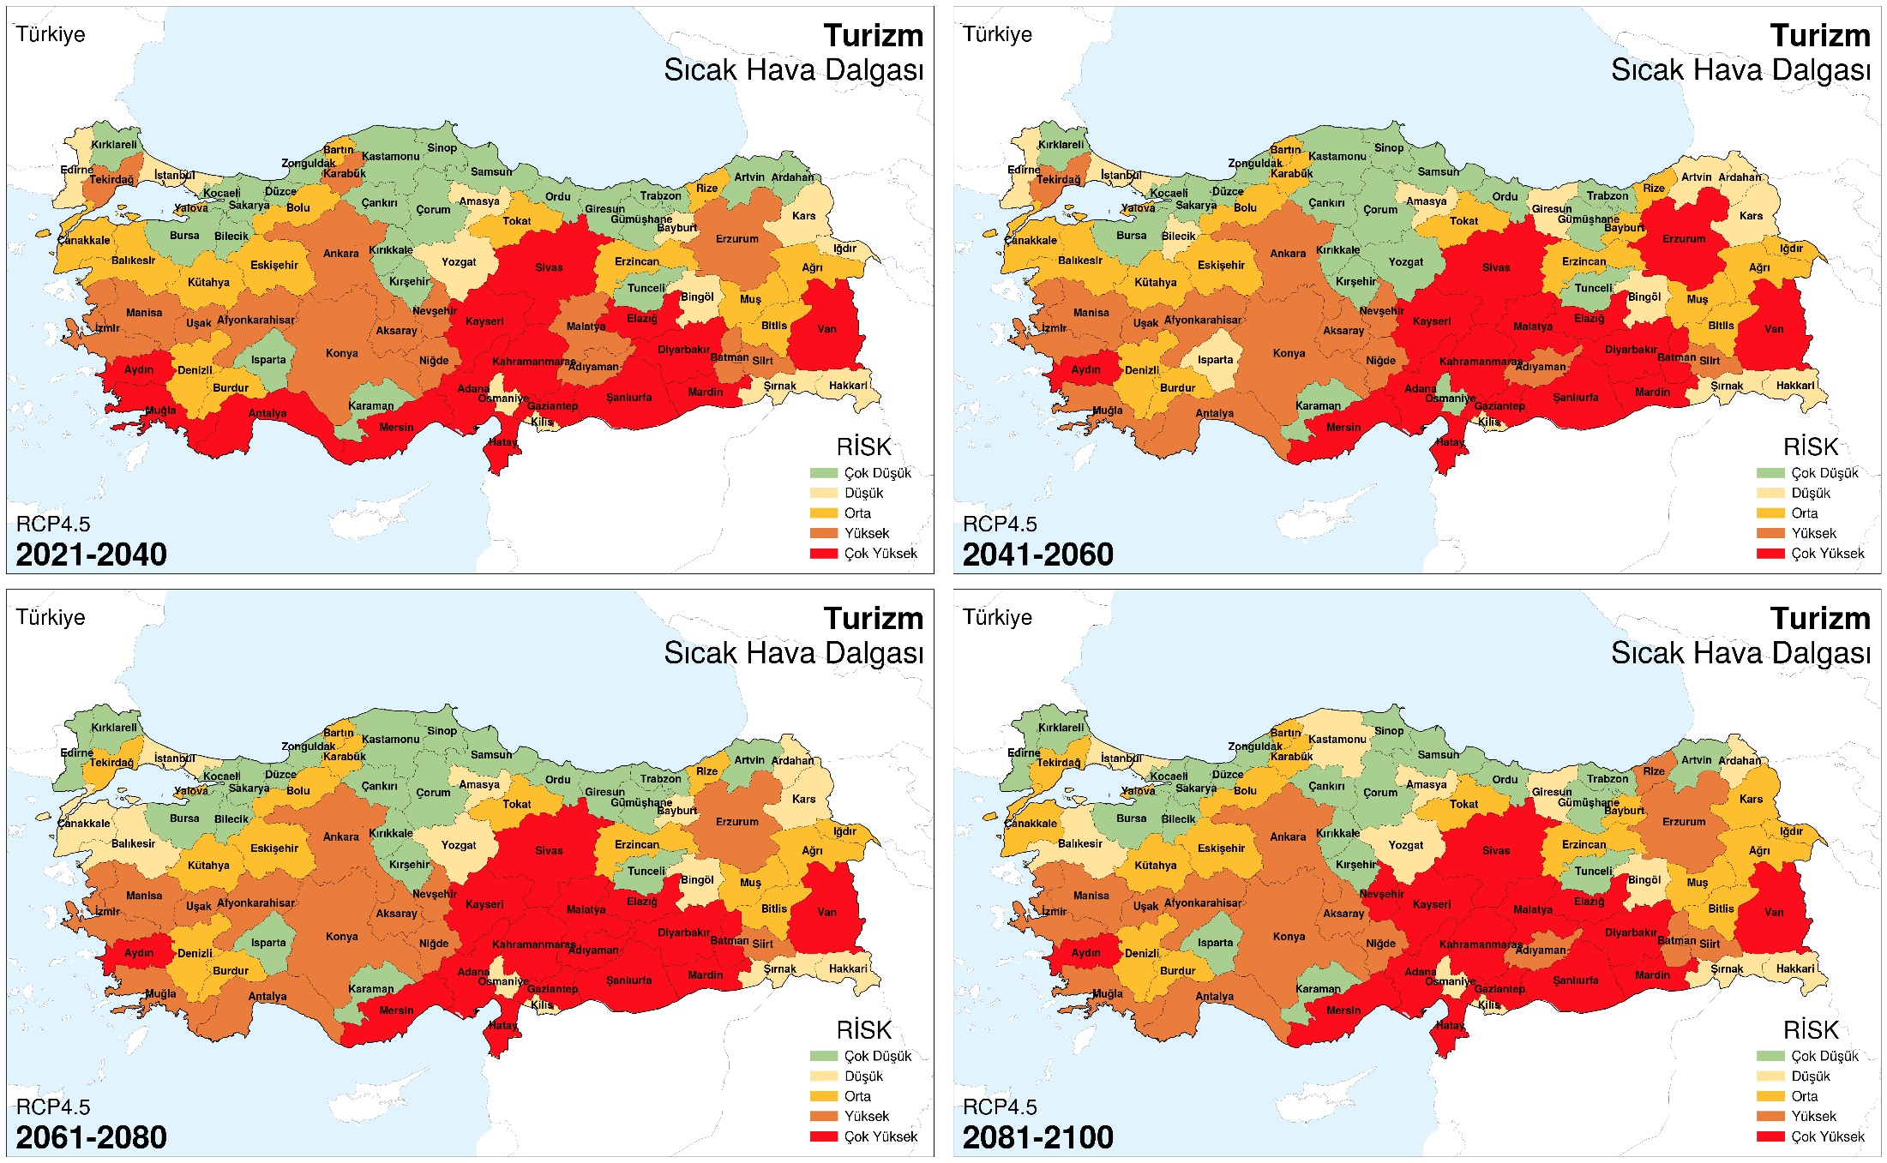
Risk Analysis

Slide 18
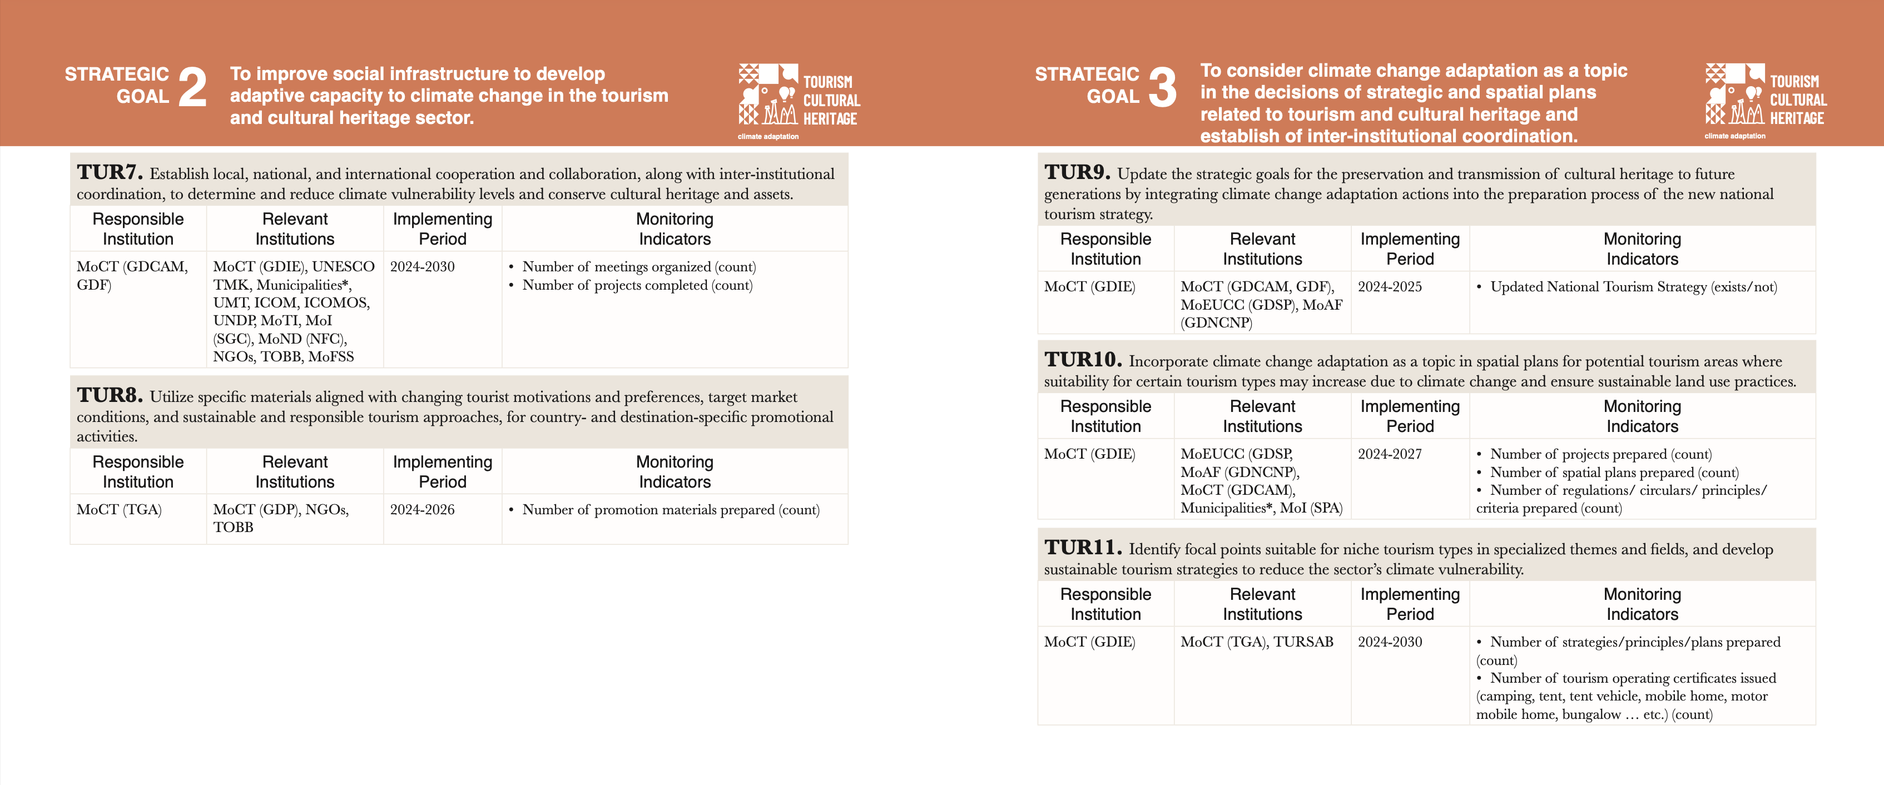
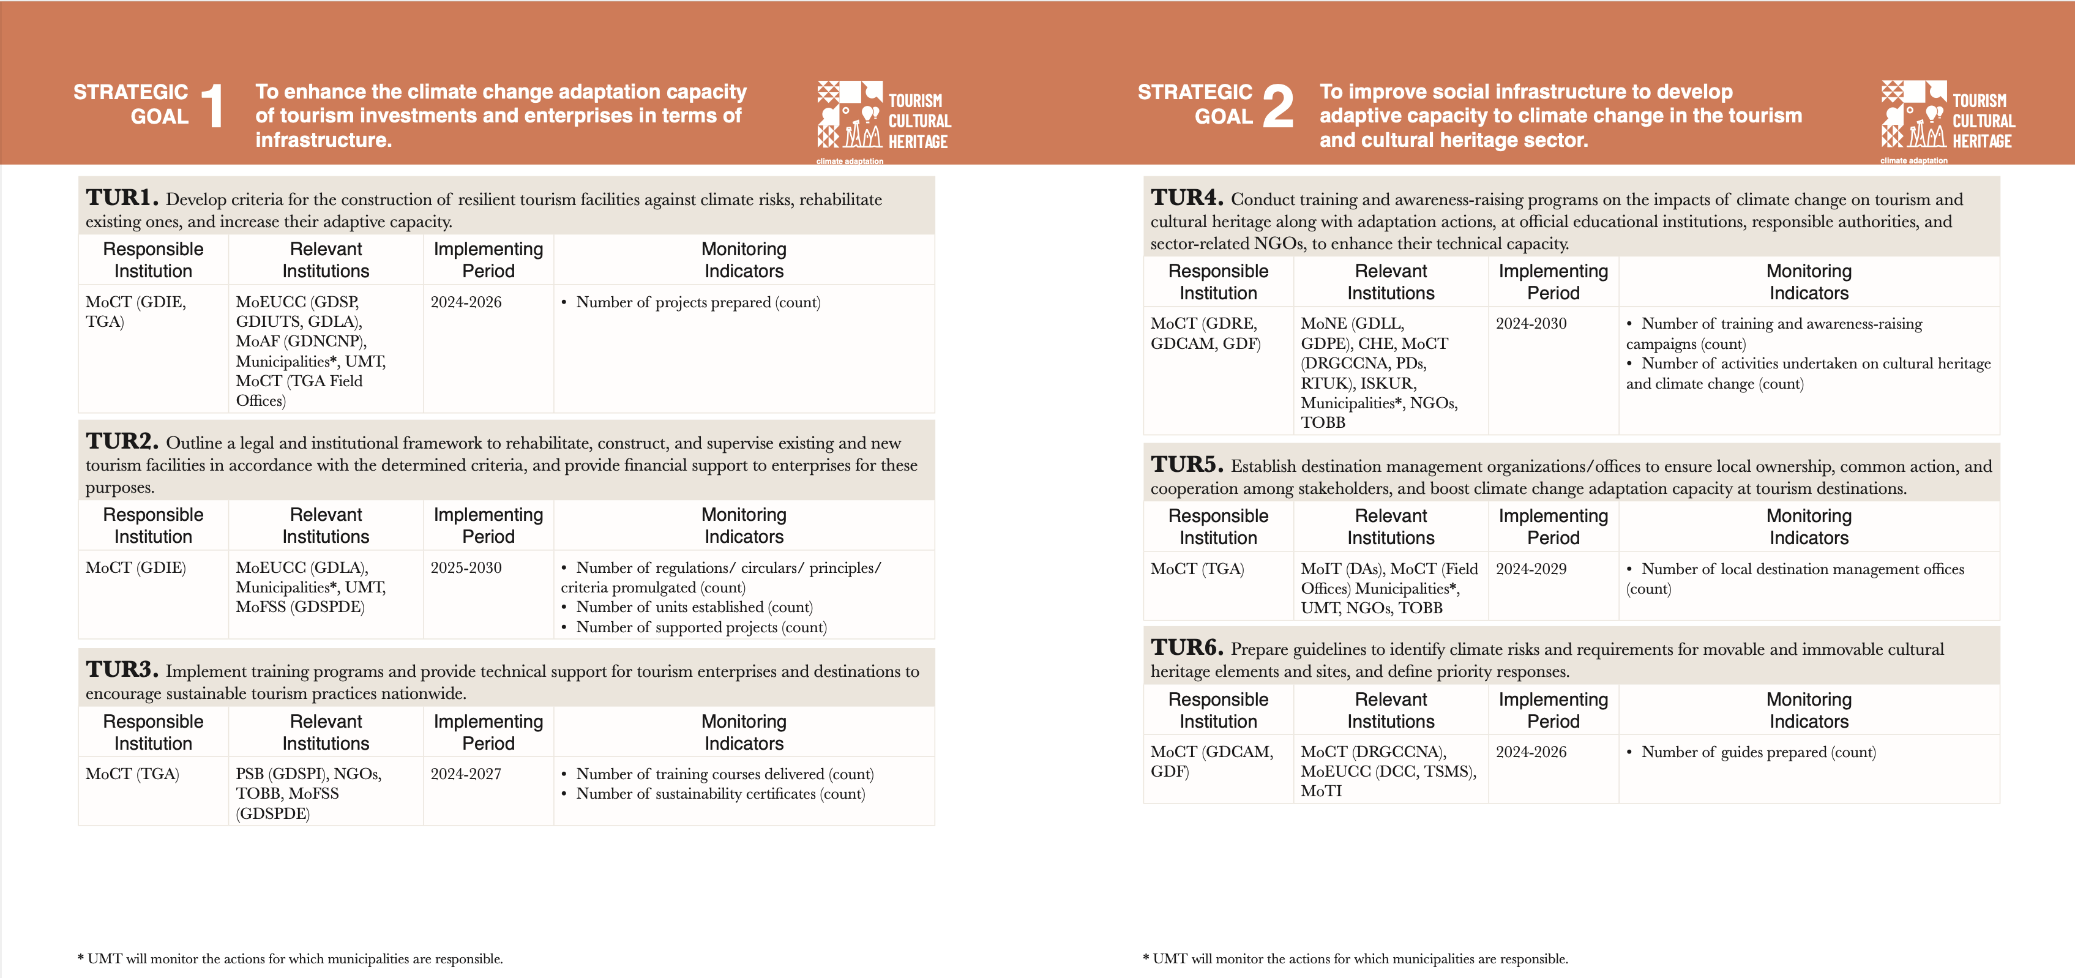
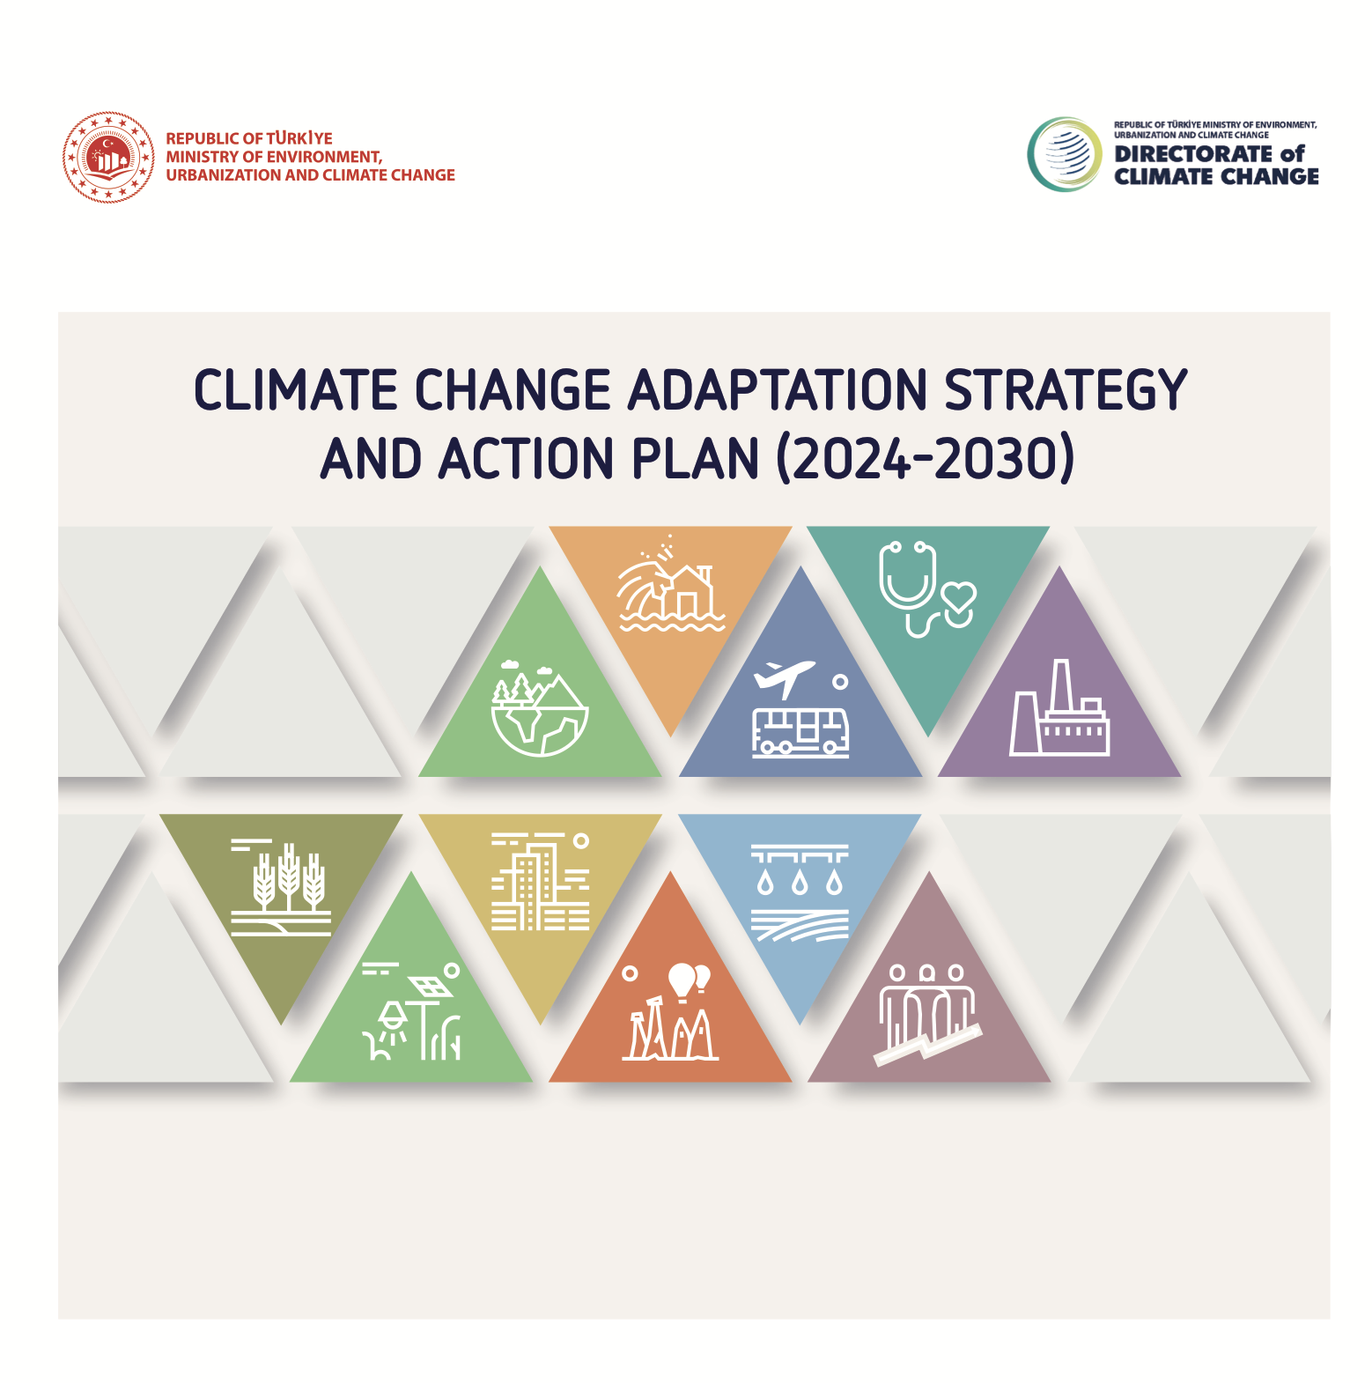
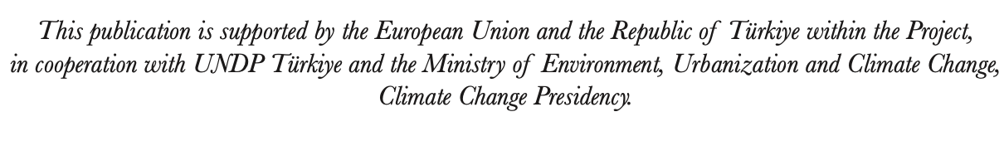
Tourism Sector Adaptation Actions

Slide 19
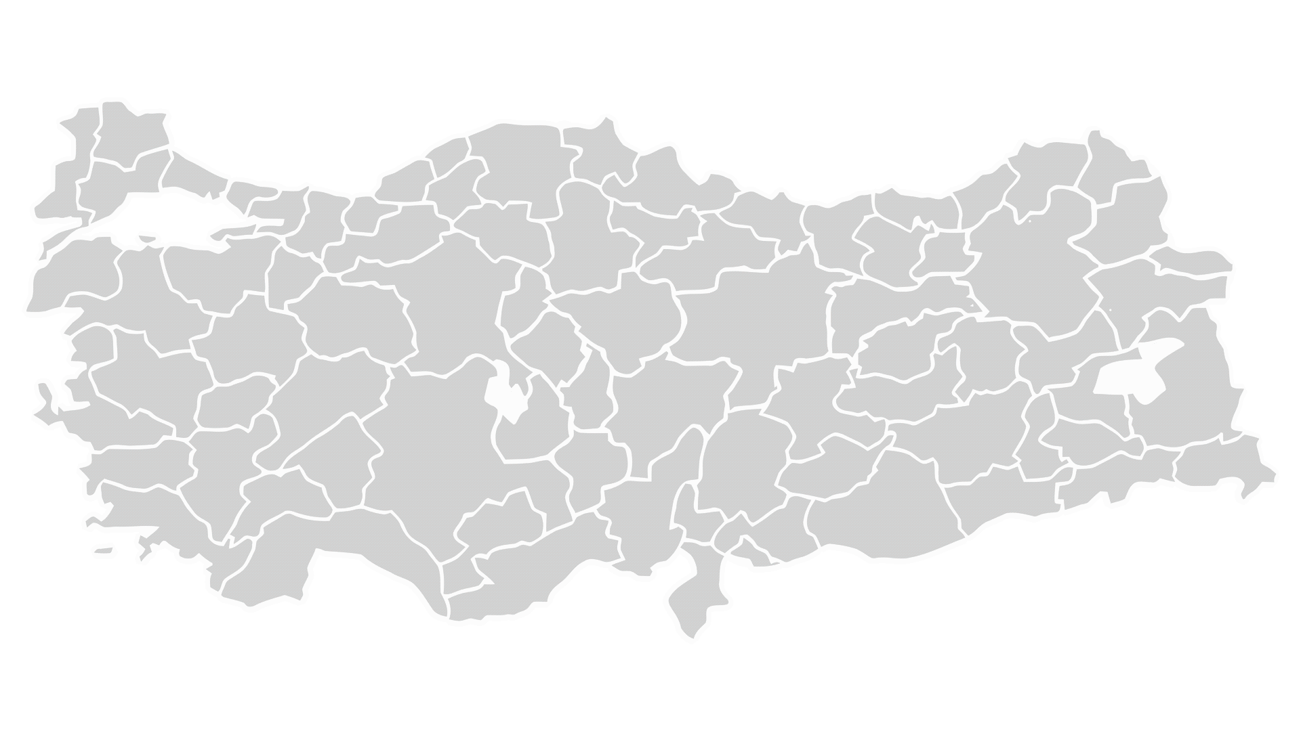
Sectoral Vulnerability and Risk Assessments for 12 NUTS-1 Regions (Component A)
Priority sectors for each region
Outlining the scope of an indicator-based climate change vulnerability and risk assessment for each NUTS-1 region of Türkiye, including a summary of selected sectors, key stakeholders and a methodology in line with IPCC (AR6)
Sectoral Vulnerability and Risk Assessments for 12 NUTS-1 Regions
Estimation of the economic impacts of climate change for each NUTS-1 region
TR1
TR2
TR8
TR9
TR4
TRA
TR5
TR7
TRB
TR3
TRC
TR6

Slide 20
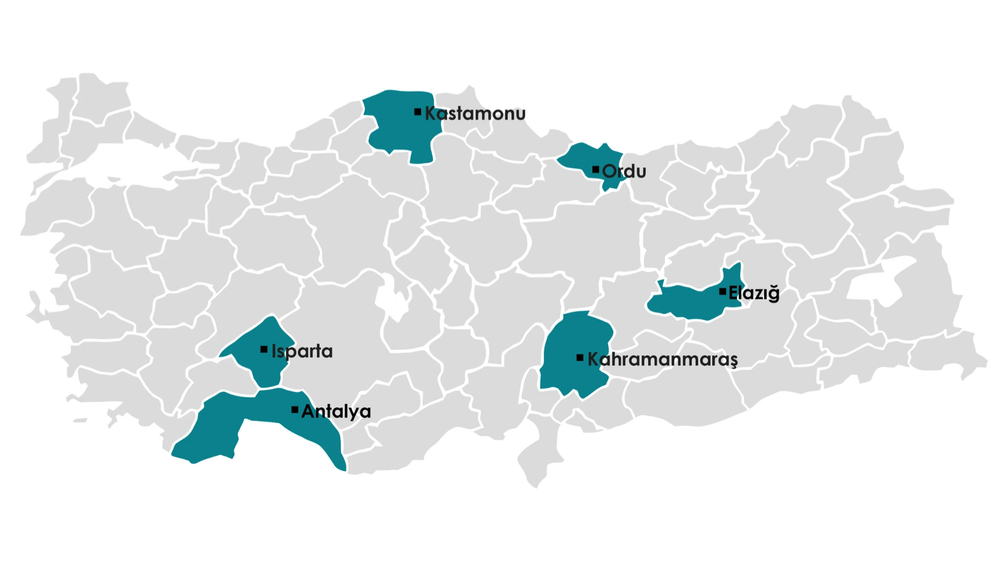
Pilot Cities for LCCAP Preparation (Component B)

Slide 21
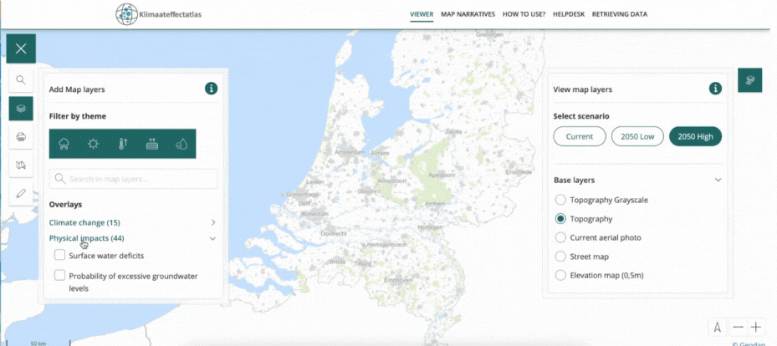
Interactive Decision Support Tools
Benefits
Large user base
Accessibility
Ease of use
Integration with other tools
Up-to-date data infrastructure
Planned Tools
Climate Impact Mapping Tool
Climate Impact Assessment Tool
GHG Emissions Modellin Tool for Municipalities
Nature-based Solutions Tool
Cost-Effective Climate Actions Tool for Cities
Netherlands Adaptation Platform – Climate Atlas
Wildfire, Urban Heat Island Effect and Drought

Slide 22
EU PARTNERSHIP FOR
LOCAL CLIMATE ACTION IN TÜRKİYE PROJECT
6 February 2026

