Slide 1
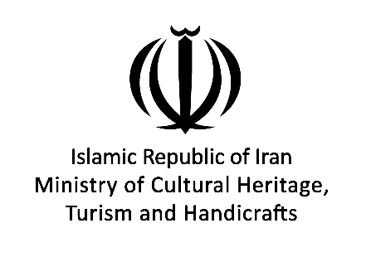
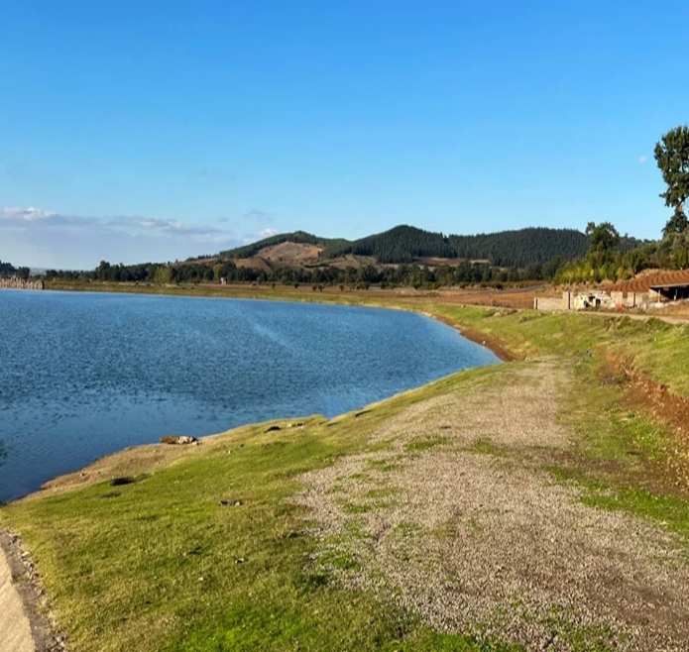
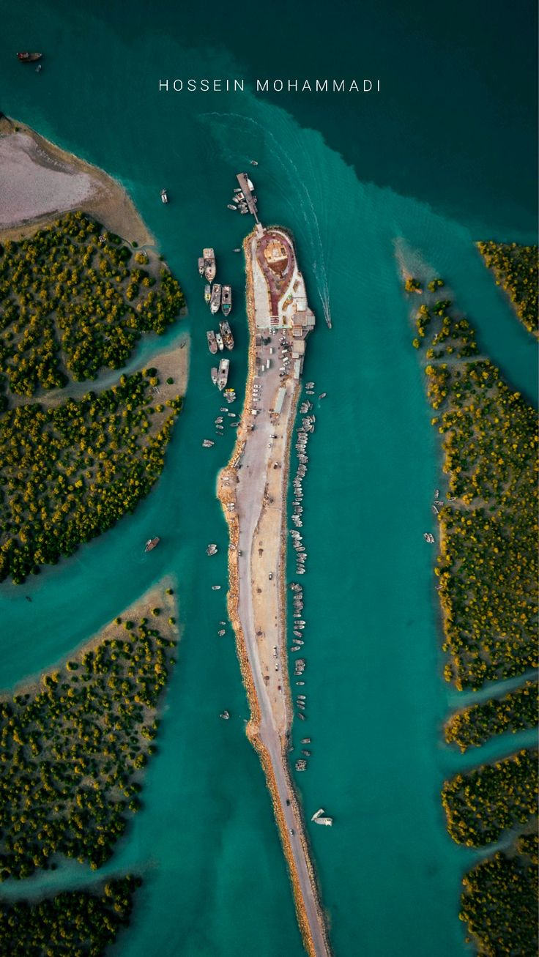
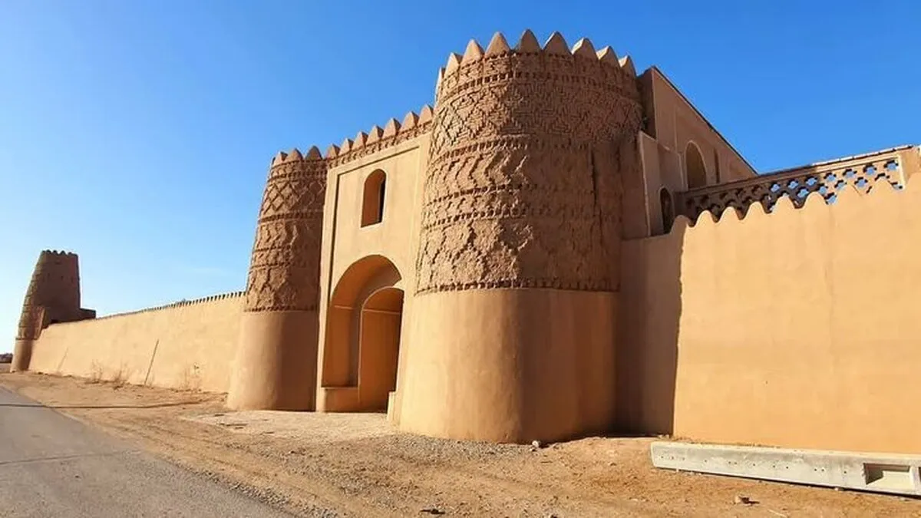
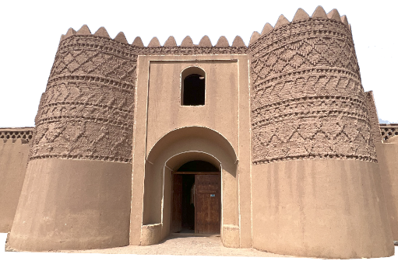

Impacts of Climate Change and Mitigation Strategies for Sustainable OIC Tourism
Ministry of Cultural Heritage, Tourism and Handicrafts
Bita Sadegh zadeh
IRAN Focal Point COMCEC
www.visitiran.ir

Slide 2
INTRODUCTION
IRAN
&
how, through the participation of local people, respect for nature, and intelligent planning, threats can be turned into opportunities.
CLIMATE CHANGE
When climate change becomes a national challenge
Iran is experiencing a changing climate that is increasingly affecting its most vital resources water, land and communities.
WATER
LAND
HEAT
FLOODS
Water
Stress
Drought
Extreme
Heat
Flood
Risk
Understanding Iran’s climate risks is the first step toward building resilience.

Slide 3
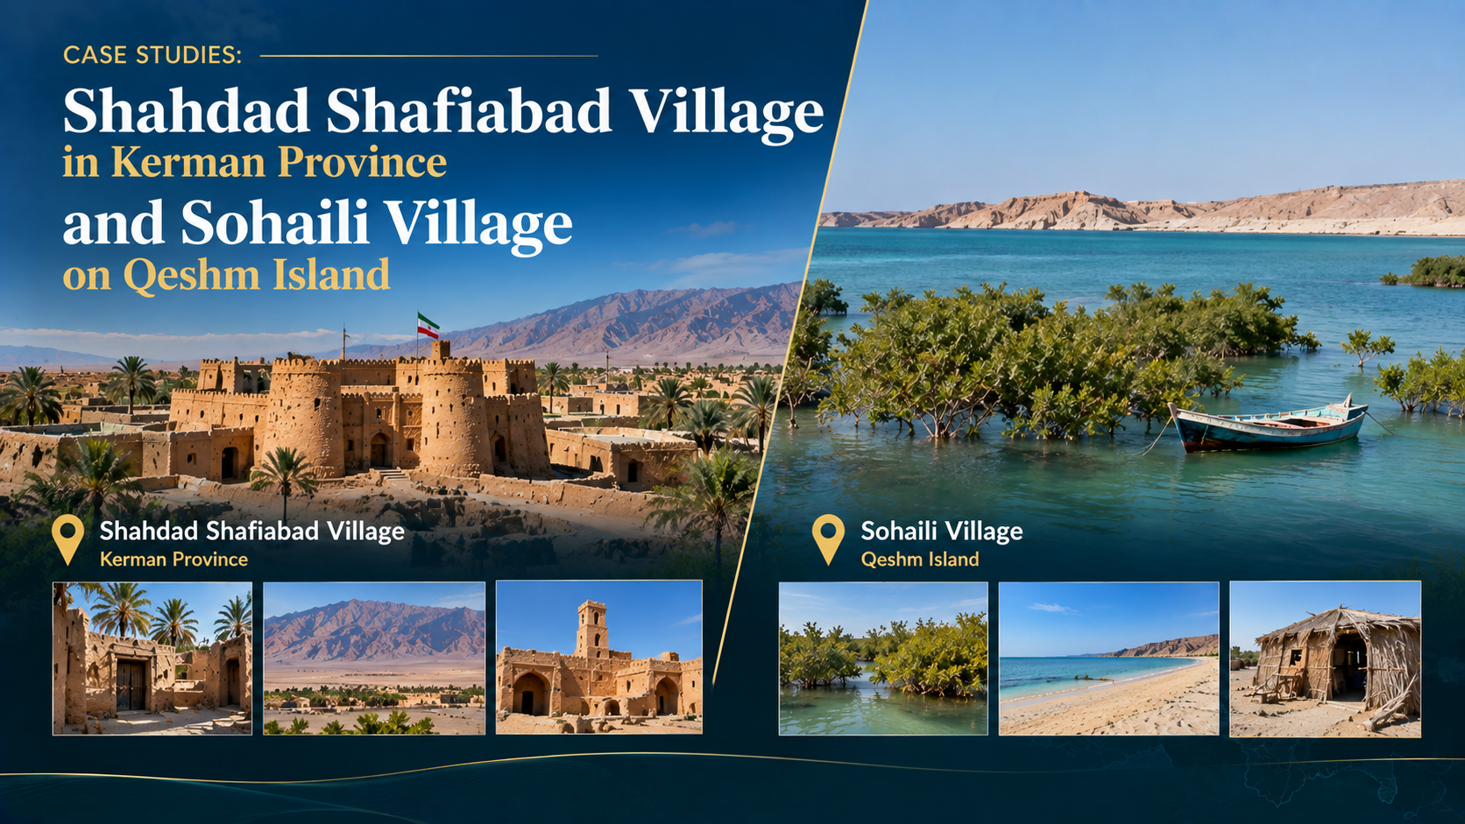

Slide 4
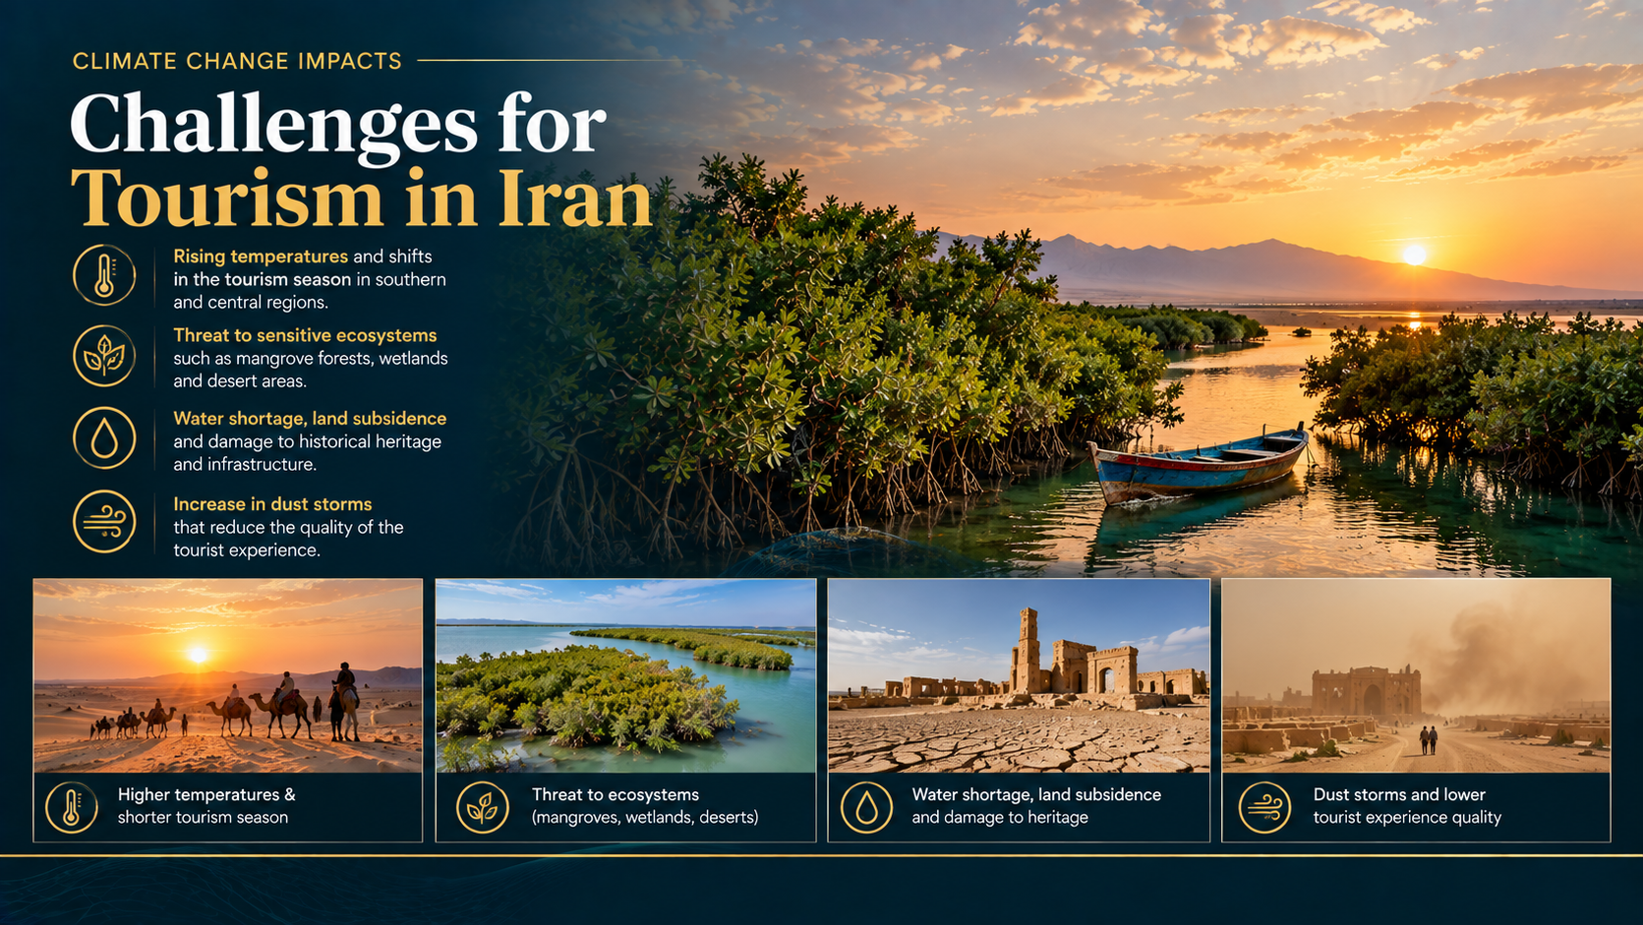

Slide 5
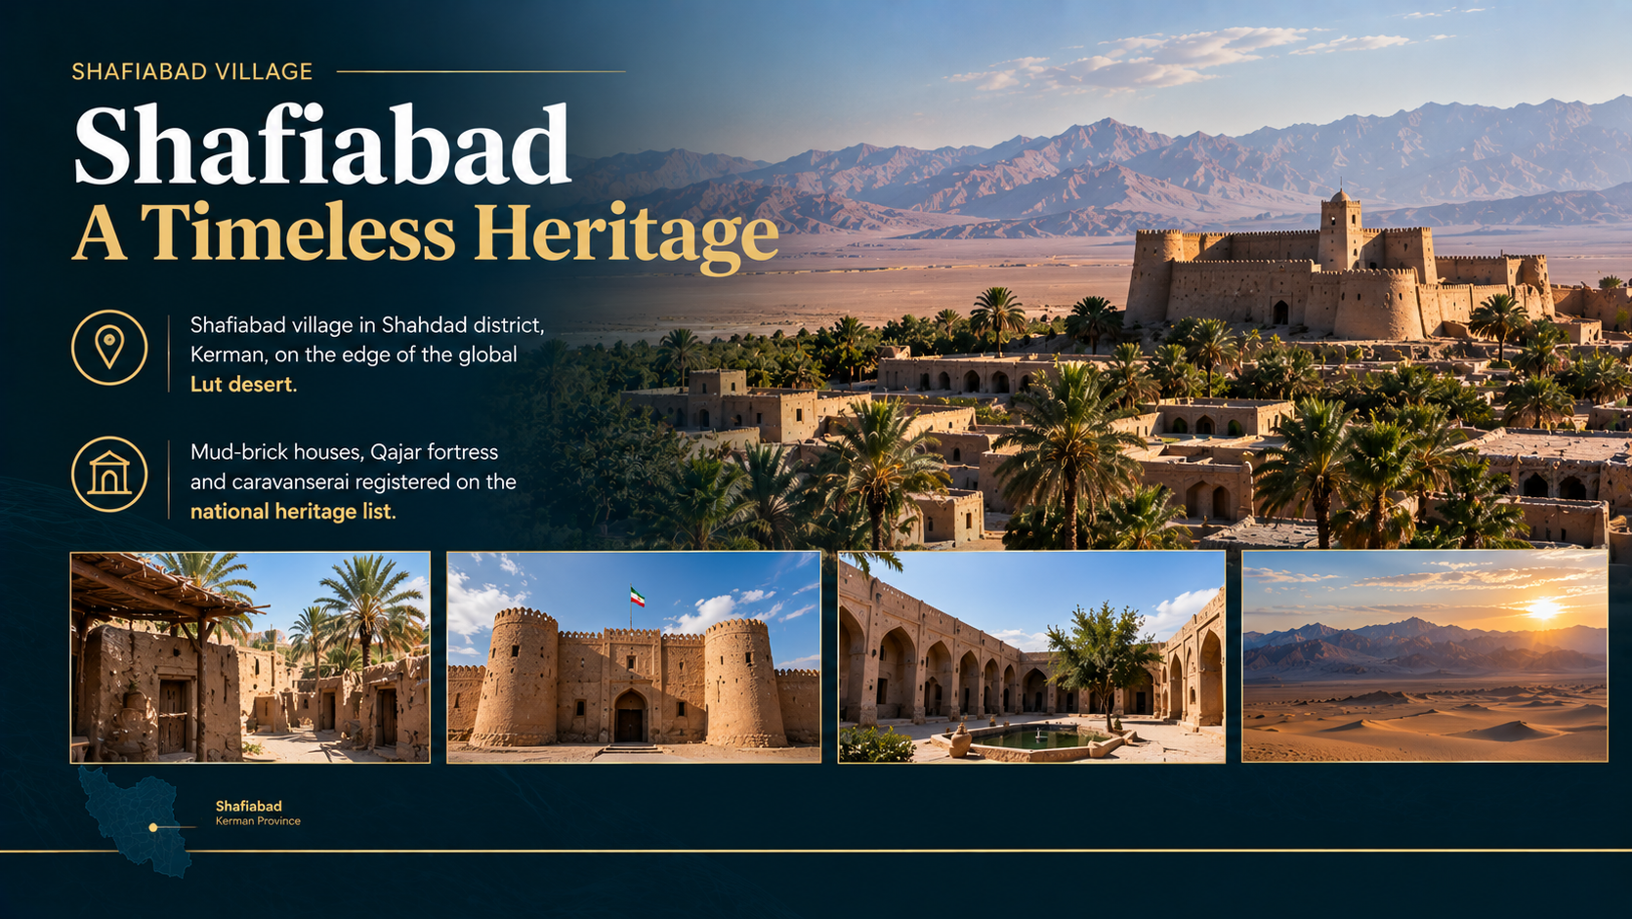

Slide 6
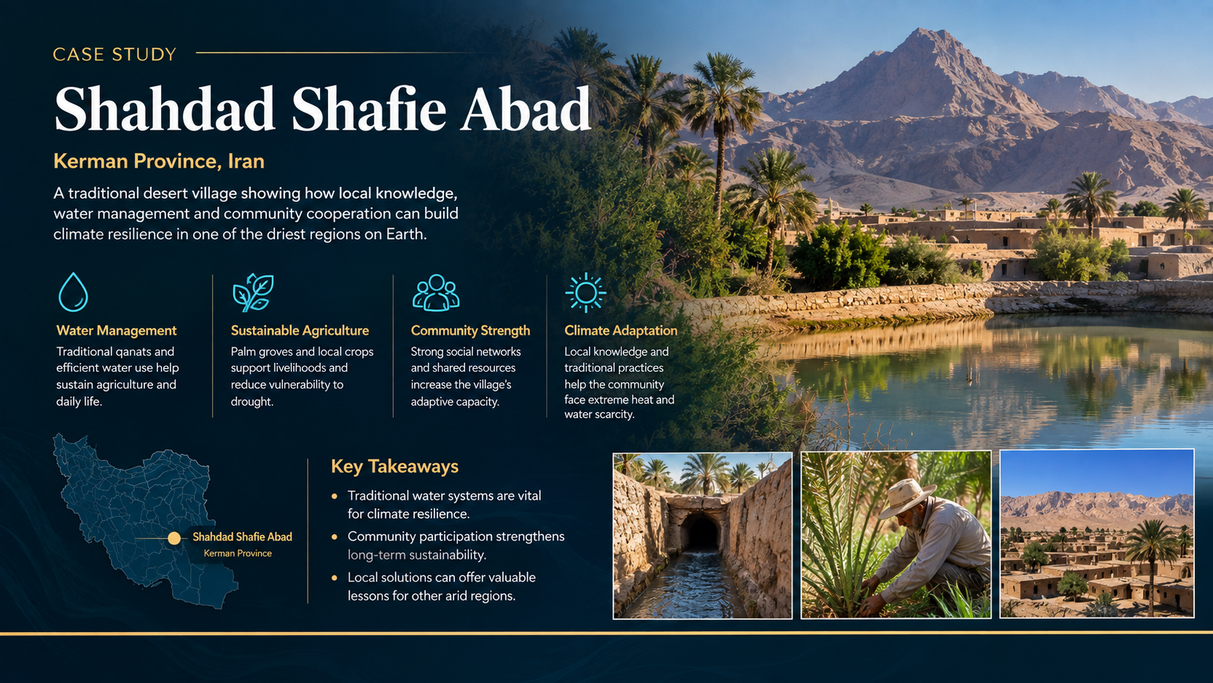
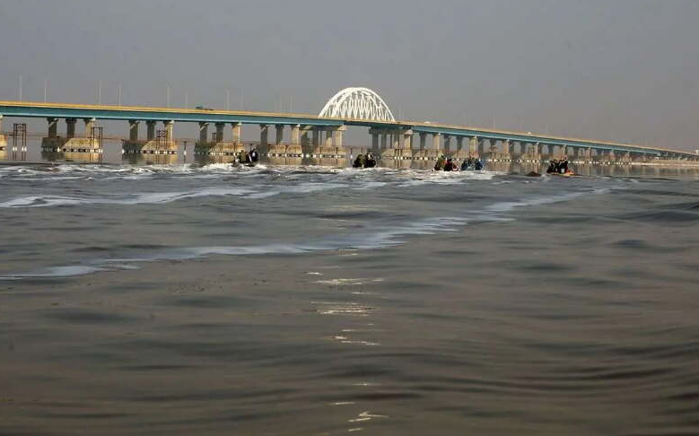
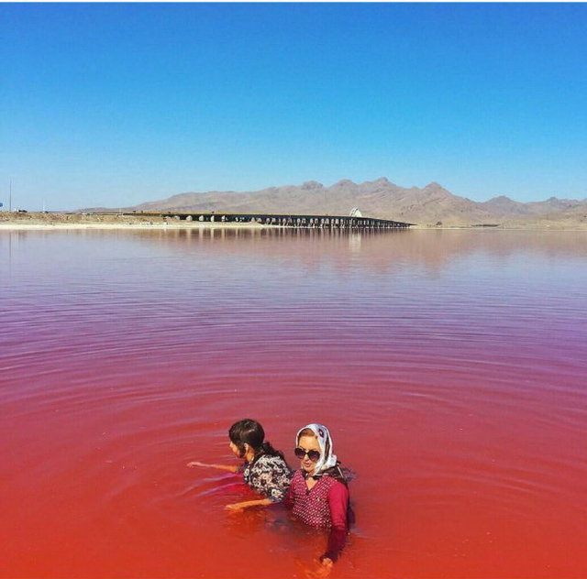
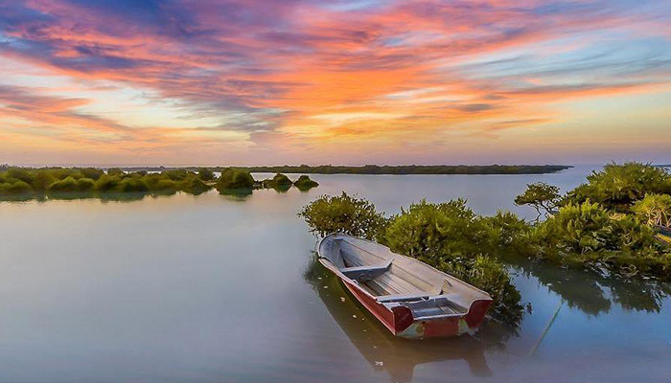
Case One: Lake Urmia
Let us begin the first case with a lake that was once the largest lake in the Middle East and the sixth-largest saline lake in the world: Lake Urmia.
Over the past few decades, a combination of climate change, successive droughts, uncontrolled dam construction on the inflowing rivers, and unsustainable agricultural development has brought this lake to the brink of destruction — the lake lost more than 90 percent of its water, and its dried bed became a focal point for salt and dust storms that threatened the health of millions of residents of East and West Azerbaijan

Slide 7
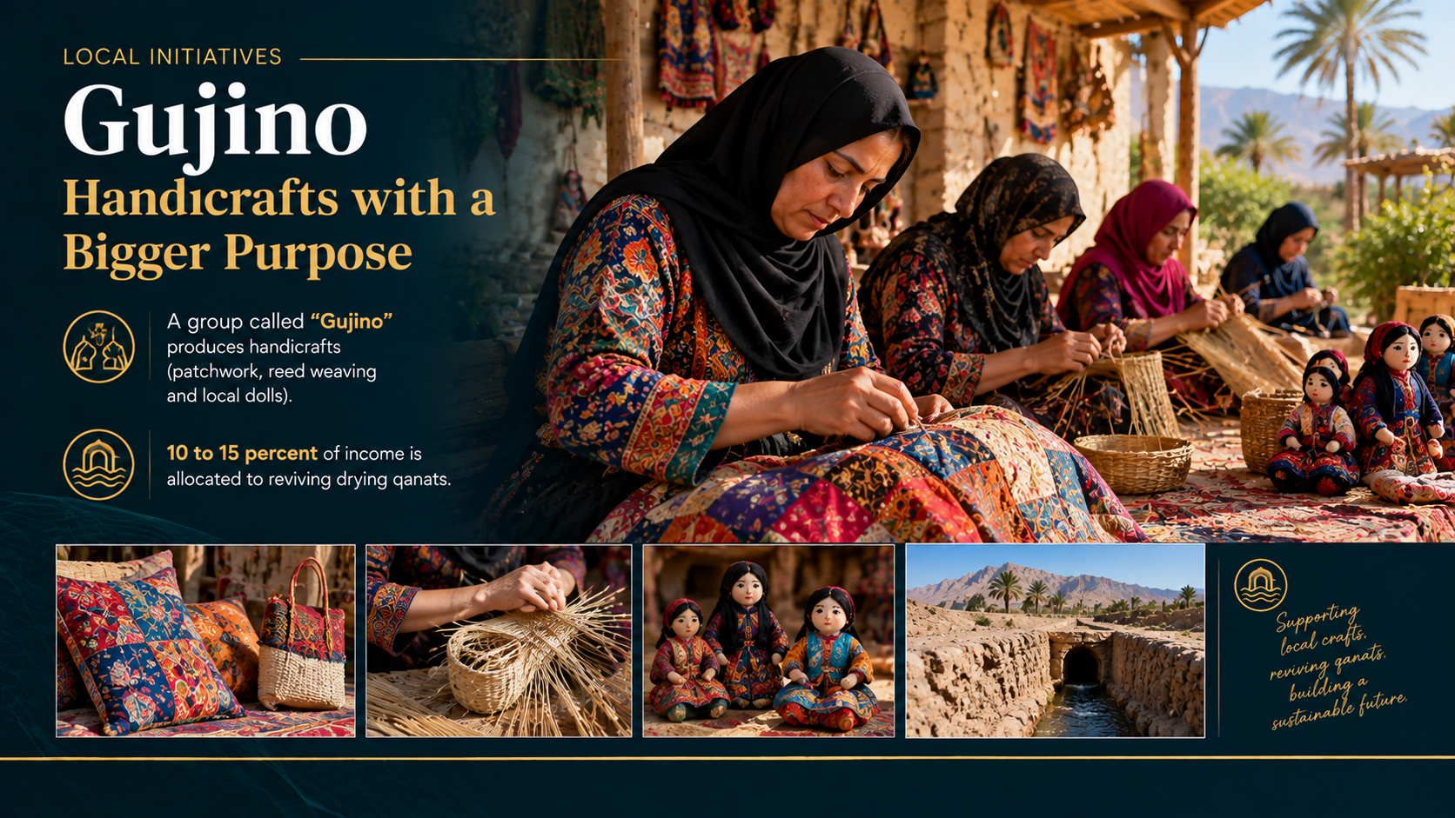

Slide 8
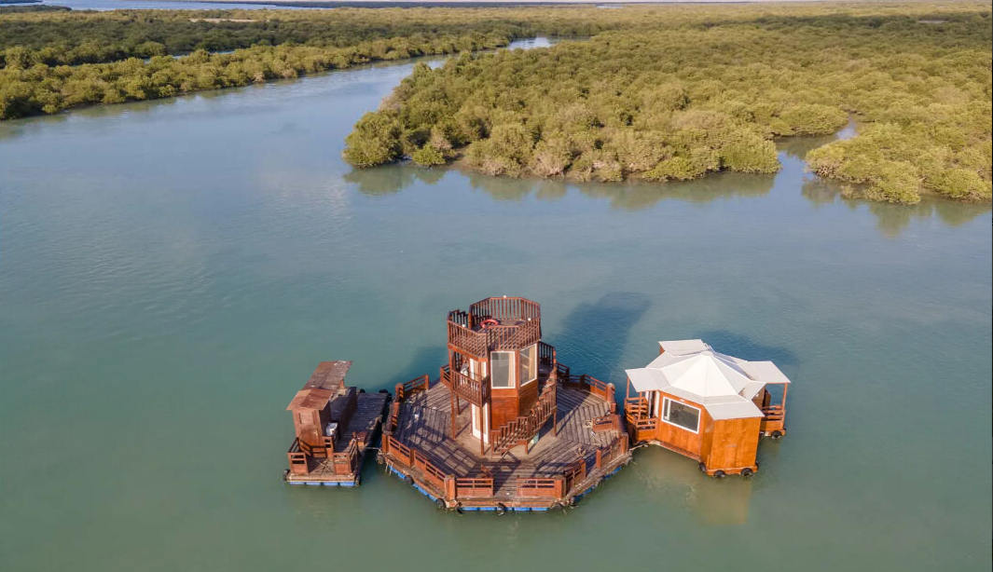
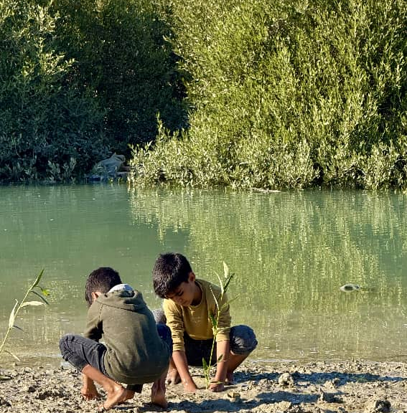
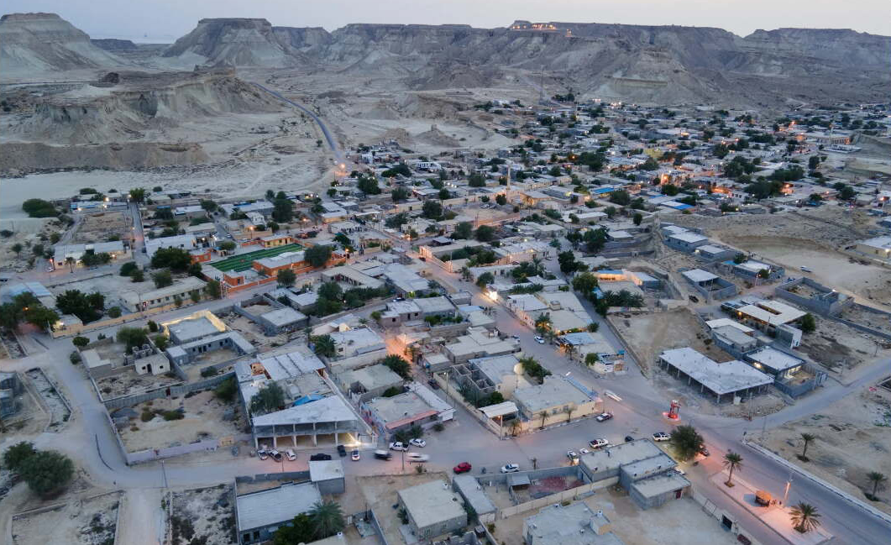
The Village of Sohaili, Qeshm
in the Haray district of Qeshm Island, with a population of approximately 2,200 to 2,400 people, is a shining example of human coexistence with nature. This village is located adjacent to mangrove forests (a biosphere reserve and part of the global Qeshm Geopark). The residents have replaced noisy and polluting motorboats with floating platforms and low-noise boats, minimizing damage to the ecosystem.

Slide 9
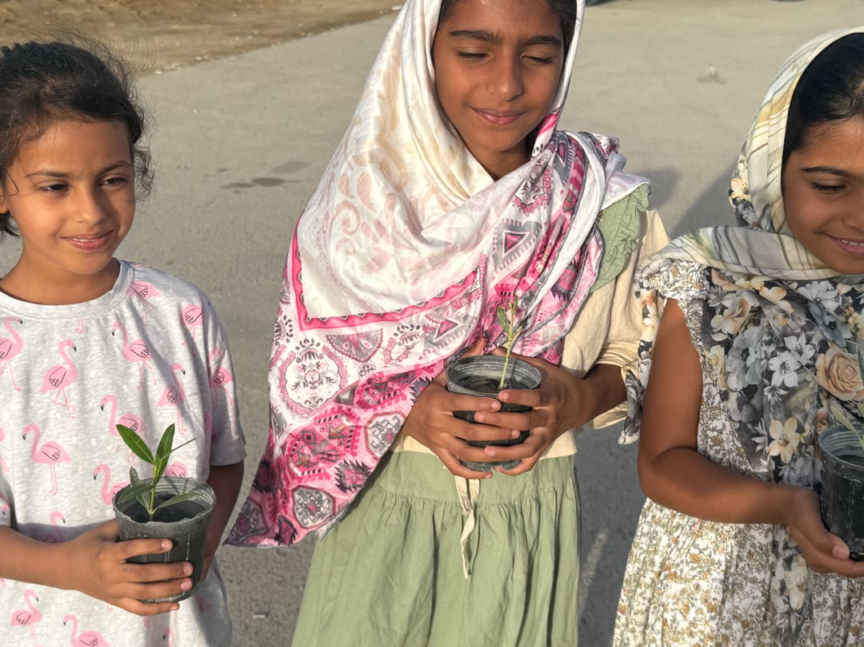
The Village of Sohaili, Qeshm
Each year, approximately 200,000 mangrove seedlings are planted by families. More than 40 to 47 homestays, local restaurants, multi-purpose piers, and handicraft stalls have been established, providing direct employment for nearly 940 people. In Mehr 1404, the World Tourism Organization recognized Seheli as one of the best tourism villages in the world. This success resulted from the real participation of the local community, especially women and young people, and respect for nature

Slide 10

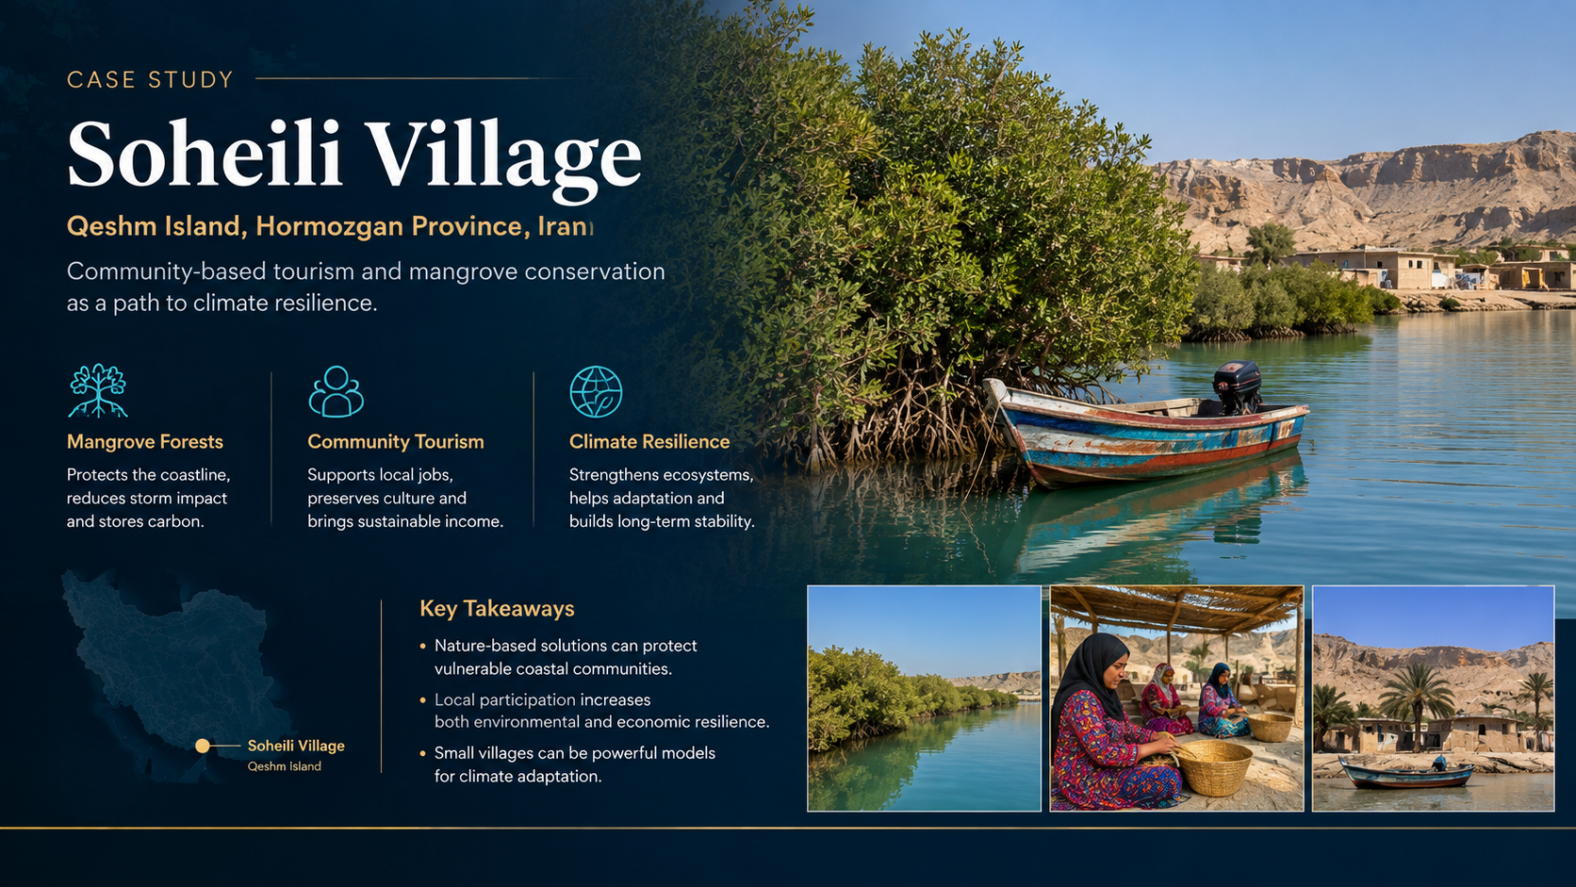
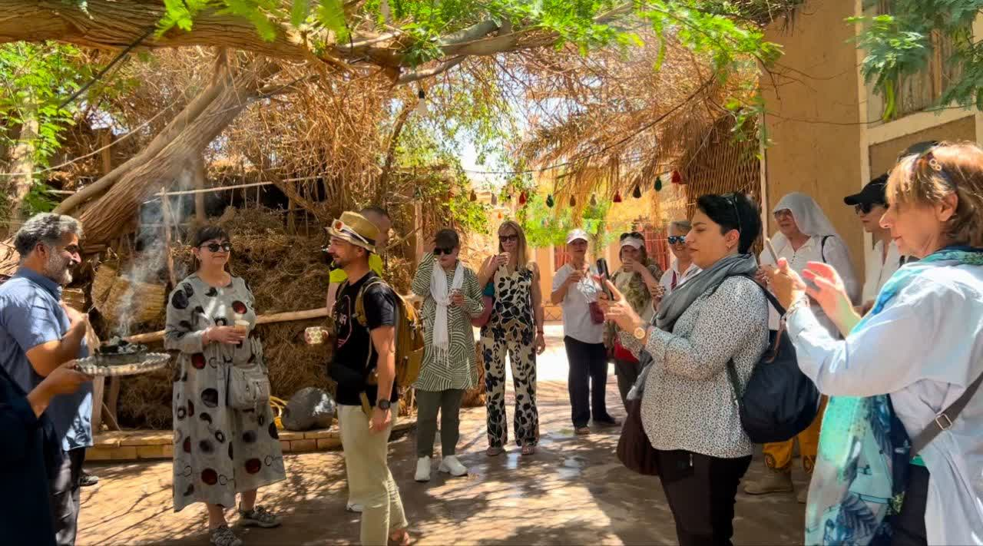
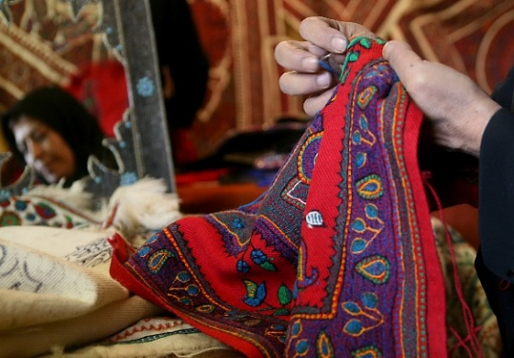
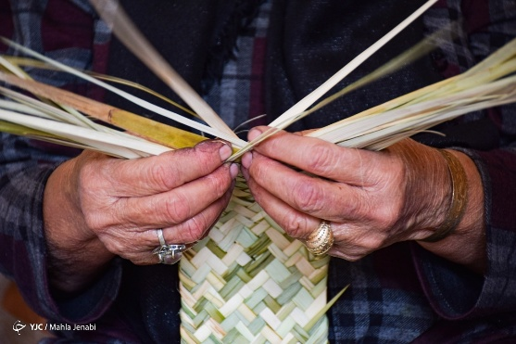
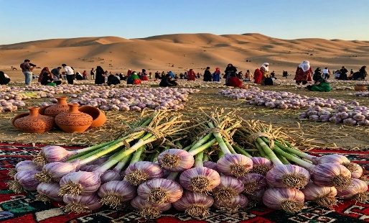
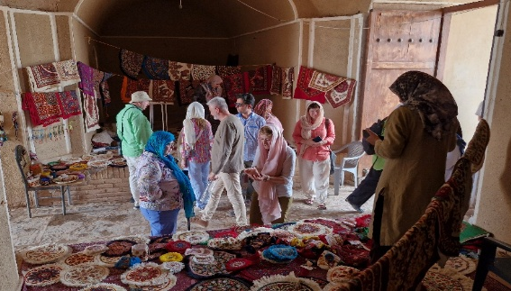
Sohaili Village
Sohaili Village
VIDEO
The garlic festival, astronomical tours, and eco-camps have also contributed to the prosperity of sustainable tourism.On the same day in Mehr 1404, Shafiabad, along with Sohaili and Kandolus, was placed on the list of the world’s best tourism villages. This village proved that even in the harshest climates, with the participation of women and the management of water resources, sustainable tourism can be created

Slide 11
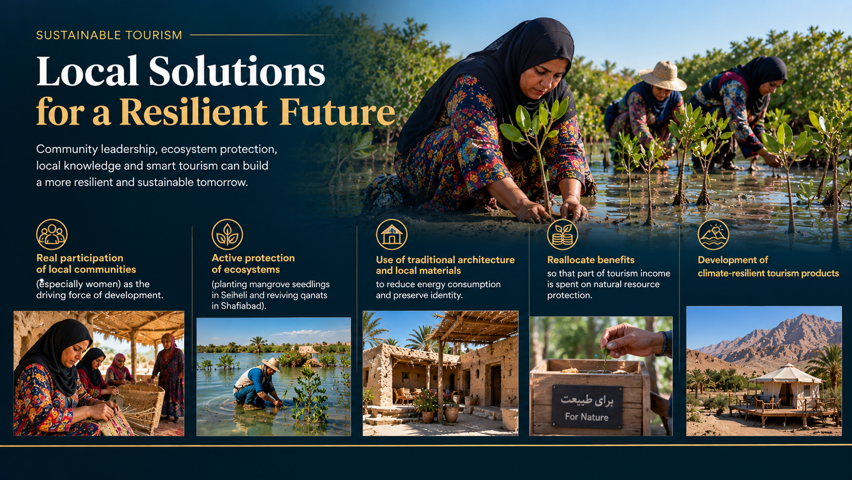
Common Strategies and Lessons Learned for Sustainable Tourism in Iran (English Translation)
Common Strategies and Lessons Learned for Sustainable Tourism in Iran

Slide 12
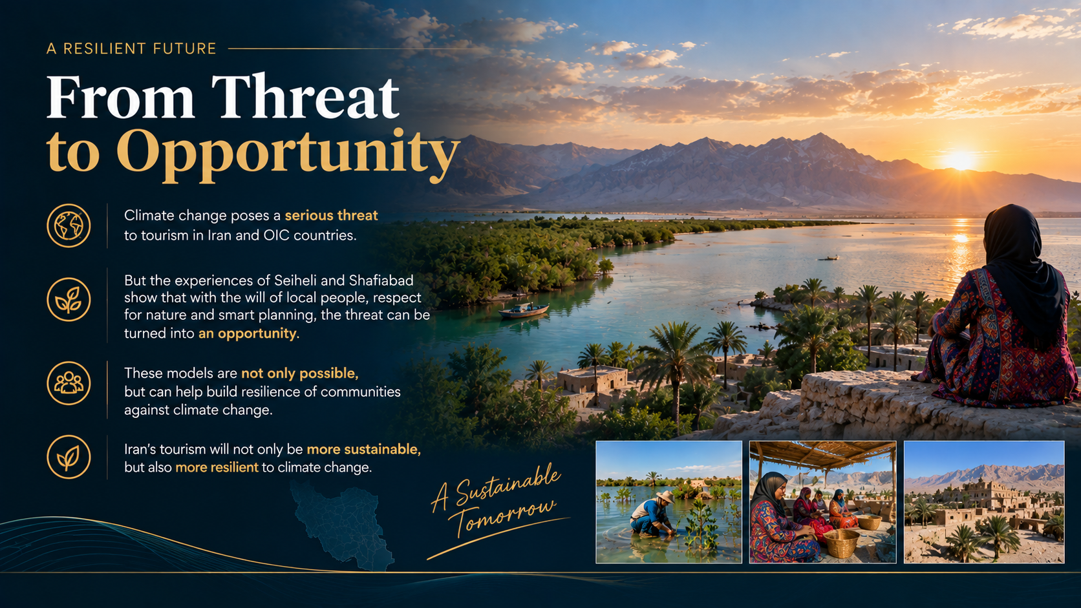
Conclusion

Slide 13
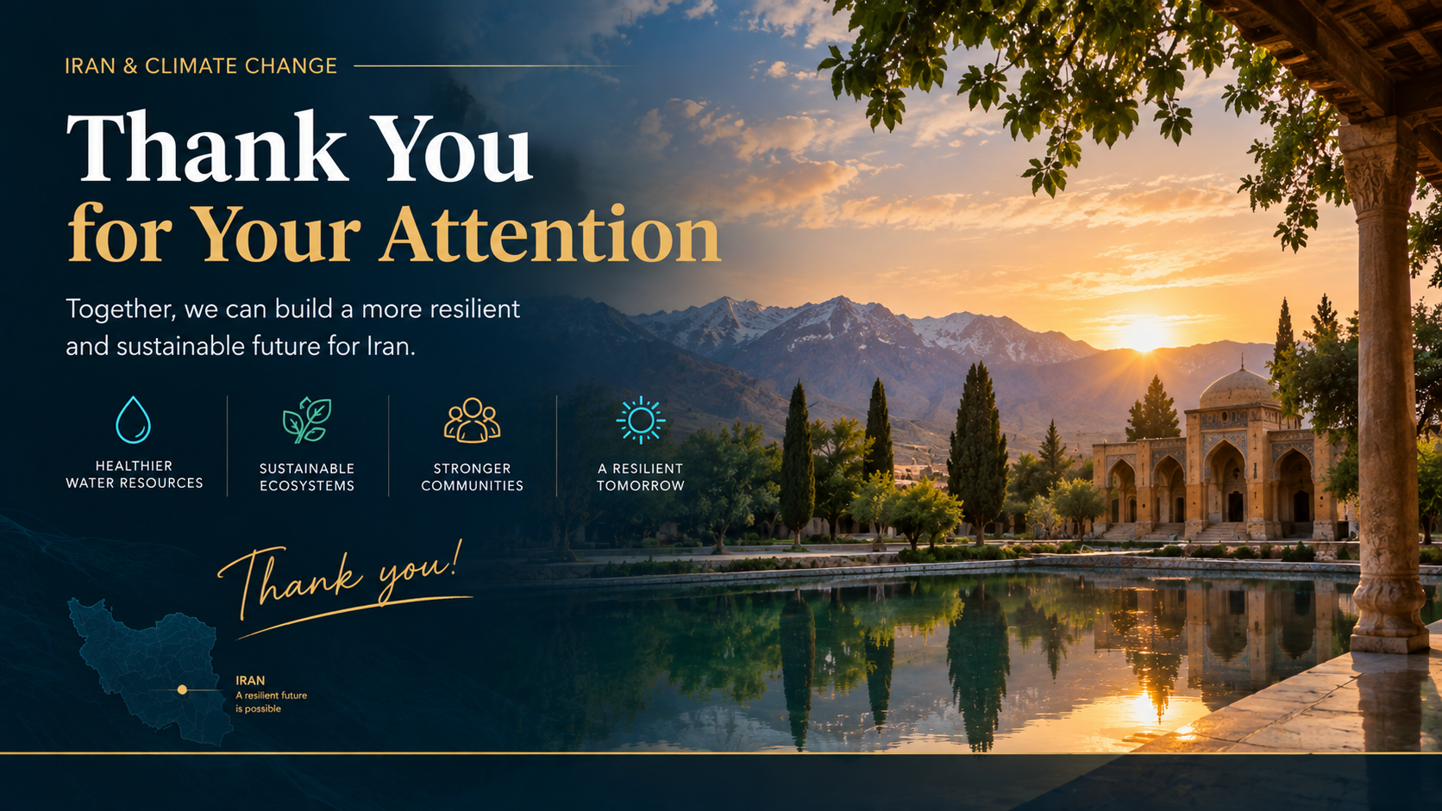
Conclusion
Climate change is a serious threat, but the experiences of Sohaili and Shafiabad prove that with the will of local people, respect for nature, and smart planning, one can become a global model.One beside the sea and mangrove forest, the other in the heart of the Lut Desert; both showed that the future of Iran’s tourism lies in coexistence with the environment and empowerment of local communities.I invite all of you to consider these models in your policies, investments, and personal travels. If every destination can follow part of the path of these two villages, Iran’s tourism will not only become more sustainable, but also more resilient to climate change.

